Slide 1
Smart Power Systems
That Work as Hard as You

Slide 2
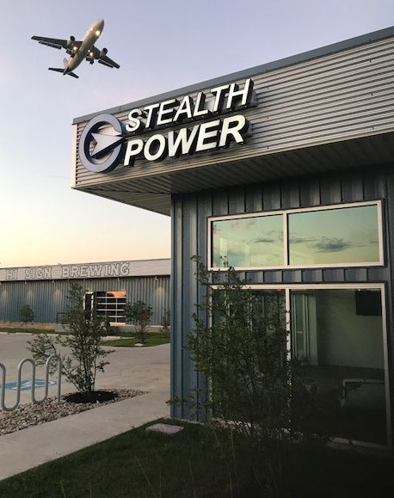
STEALTH POWER is the global leader in mobile power systems with idle reduction capability.
We develop and produce smart, integrated systems for fleets seeking mobile auxiliary power, as well
as for organizations requiring remote hybrid power. Our systems have prevented the release of thousands of tons of toxic emissions and preserved millions of gallons of fuel – as well as millions of dollars –
for our client partners. With manufacturing in the U.S.A., we maintain the highest standard of excellence.
HEADQUARTERS IN AUSTIN, TEXAS

Slide 3
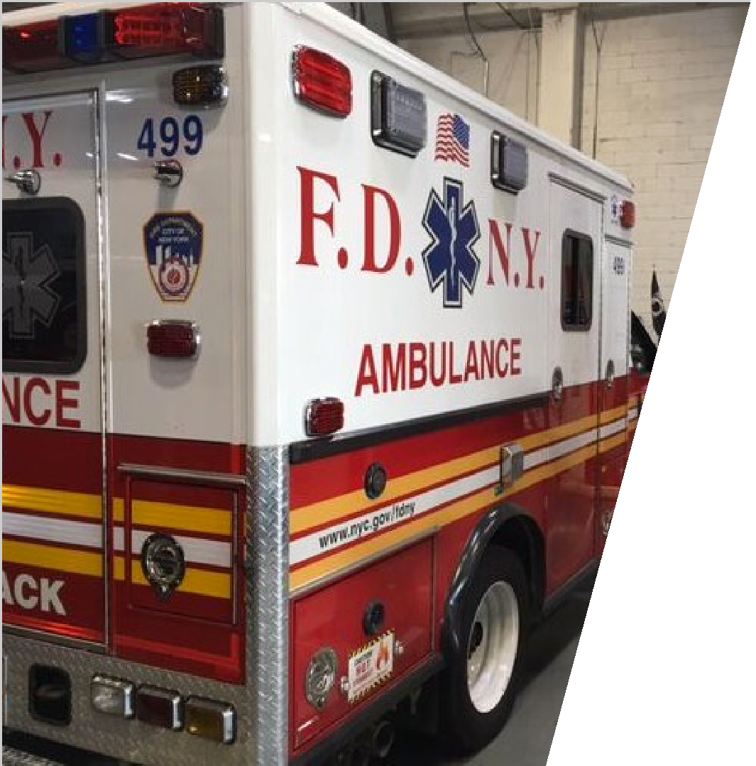
SMART POWER SYSTEMS
04
INTEGRATED SOLUTION
05
INDUSTRY APPLICATIONS
06
POWERFUL SAVINGS
07
EXTENDED OPERATIONS
08
ADVANCED CONTROL
09
PREDICTIVE ANALYTICS
10
CASE STUDIES
11
PRESS COVERAGE
12
LEARN MORE
13

Slide 4




Smart Power
SYSTEMS
MOBILE IDLE REDUCTION
Full mobile power – without engine engagement – for vehicles with demanding electrical needs. Our smart electric-power systems provide energy to operate all onboard equipment while diminishing idling.
REMOTE HYBRID POWER
Our hybrid systems provide safe, scalable power for remote applications, such as oil & gas, mining, irrigation, cell towers, watch towers, operating bases, and electrical grids for remote areas.

Slide 5
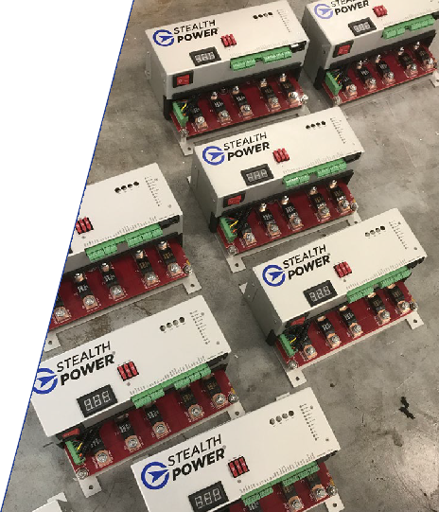
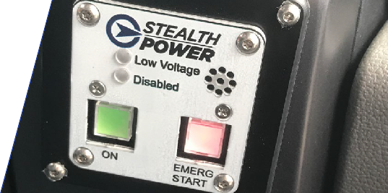
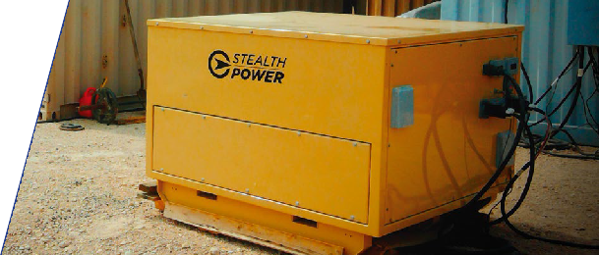
Integrated Solution
MASTER
CONTROL UNIT (MCU)
SMART
We engineer and manufacture integrated software and hardware mobile power systems with idle reduction capability.
POWERFUL
Our systems have been identified as a “take to war” technology by the U.S. Army.
SCALABLE
We can customize and scale our systems based on the mobile power demand of each client.
CONSOLE
CONTROLLER
FLEXIBLE
Our mobile idle reduction system operates with
any make, model, or fuel type of vehicle.
STANDALONE
HYBRID GENERATOR

Slide 6

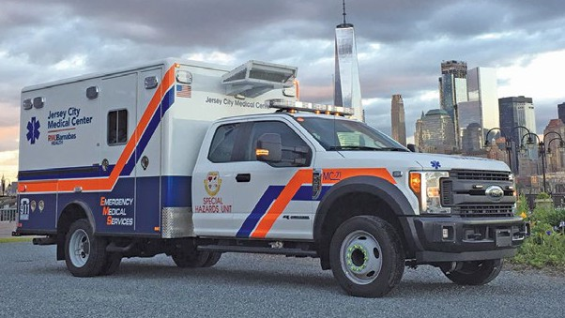
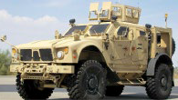
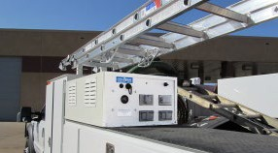
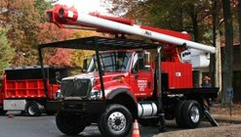
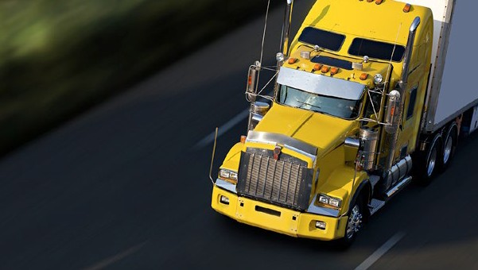
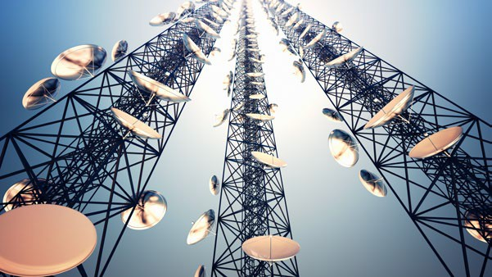

Industry Applications
THE STEALTH POWER SYSTEM FITS ANY VEHICLE, ANY FLEET SIZE. FROM 1KWH TO 60KWH.
Law Enforcement
Ambulance EMS
Military
Service Vehicles
Hydraulic
Long-Haul Trucking
Communications
Oil & Gas

Slide 7

SAVE FUEL
SAVE MAINTENANCE SAVE MONEY
SAVE THE ENVIRONMENT
Powerful Savings

Slide 8
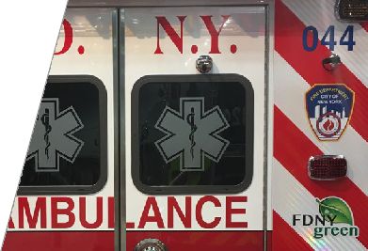

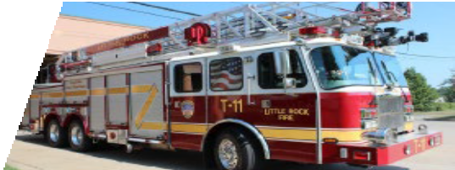
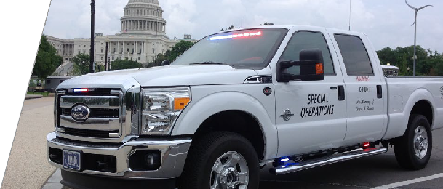
Extended Operations
STEALTH POWER INTELLIGENT ENERGY SYSTEMS (“SPIES”)
stores vehicle produced energy as quickly as possible without overloading the platform‘s existing alternator capacity.
Our smart mobile power systems offer:
Elongated idle- reduction period
Reduced fuel usage and maintenance cost savings
Enhanced “Silent Watch” capability
Emergency vehicle jump start feature

Slide 9
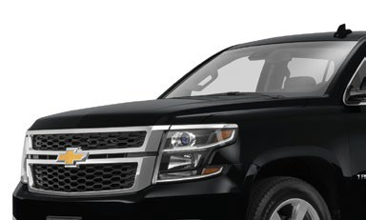

Advanced Control
Our Android/iOS mobile app gives drivers advanced control; allowing them to engage with the system remotely.
SYSTEM TOUCH-START TURN ON OR ADJUST HVAC
CHECK THE STATUS OF THE BATTERY

Slide 10
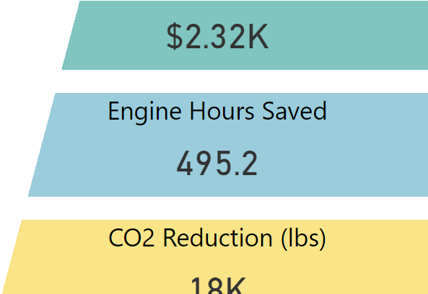




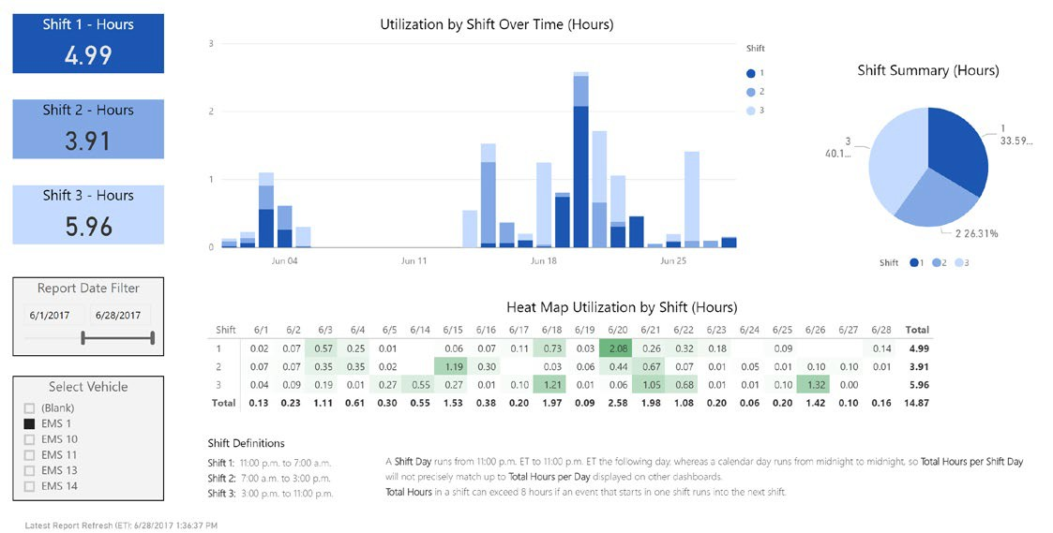
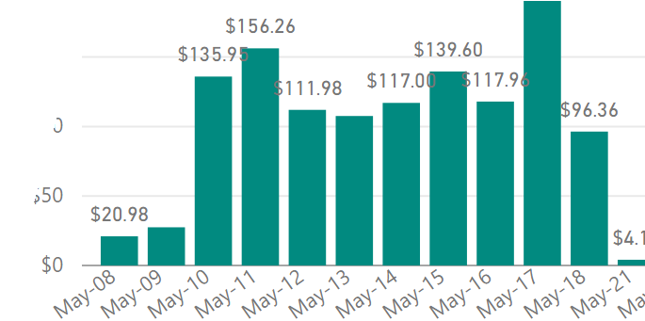
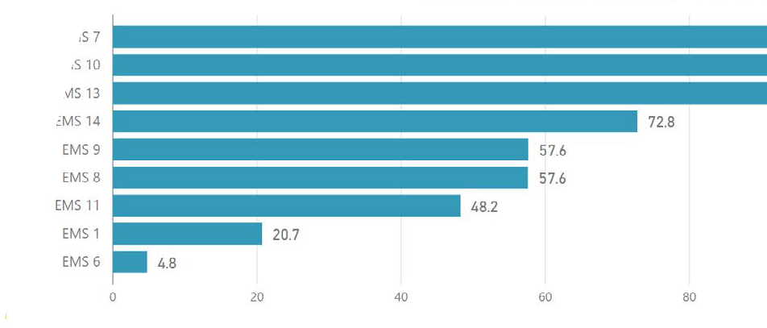
Predictive Analytics
MONTHLY SUMMARIES
Our client dashboard utilizes real-time data to enhance fleet operation and maintenance.
HEAT MAP VIEWS
Anytown USA EMS Fleet – Vehicle Shift Detail
FUEL SAVINGS BY MONTH
10
ENGINE HOURS
BY VEHICLE
SAVINGS

Slide 11
Case Studies

Slide 12








Press Coverage
“FDNY Installs Eco-friendly Mobile Technology to Cut Ambulance Emissions, Conserve Fuel”
“The Surprising Way Emergency Vehicles in Major U.S. Cities Are Going Green”
“New York Fire Department opts for idle-reducing ambulances. System from Stealth Power to cut emissions, fuel use.”
“New York City Ambulances Going Green, Saving Green

Slide 13
Shannon Sentell
Bill Needles
DIRECTOR OF SALES & PUBLIC SAFETY
bneedles@stealthpower.net
(512) 587-7829
CHIEF OPERATING OFFICER
ssentell@stealthpower.net
(512) 306-0088
www.stealthpower.net

