Slide 1
Accessories to Reduce Idling – Plug In Electric Transport Refrigeration Units and Bucket Battery Racks on Trucks
Clean Cities Technologies Conference
November 14, 2017
Allen Dennis
Sr. Program Manager
Electrification Program

Slide 2

Key Aspects of EPRI
Independent
Objective, scientifically based results address reliability, efficiency, affordability, health, safety and the environment
Nonprofit
Chartered to serve the public benefit
Collaborative
Bring together scientists, engineers, academic researchers, industry experts
450+ participants in more than 30 countries
EPRI members generate approximately 90% of the electricity in the United States
International funding of nearly 25% of EPRI’s research, development and demonstrations
Independent
Nonprofit
Collaborative

Slide 3
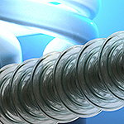
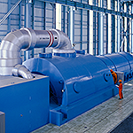


EPRI’s Current Research Areas
Power Delivery and Utilization
Transmission Lines and Substations
Grid Operations and Planning
Distribution
Energy Utilization
Information & Communication Technology
Generation
Advanced Coal Plants, Carbon Capture and Storage
Combustion Turbines
Environmental Controls
Major Component Reliability
Materials and Chemistry
Operations and Maintenance
Power Plant Water Management
Nuclear
Advanced Nuclear Technology
Chemistry, Low-Level Waste, and Radiation Management
Equipment Reliability
Fuel Reliability
Long-Term Operations
Materials Degradation/Aging
Nondestructive Evaluation and Material Characterization
Risk and Safety Management
Used Fuel and High-level Waste Management
Environment and Renewable Energy
Air Quality
Energy and Environmental Analysis
Land and Groundwater
Occupational Health and Safety
Renewable Energy
T&D Environmental Issues
Water and Ecosystems

Slide 4
Electric Transport Refrigeration Units (eTRU)
Notes:
The smart charger features included simulated communication via a mobile app to the EVSE where operate could choose to charge at a favorable “time of day rate” and the fleet operator (or utility in the future) has control to interrupt the charging.
To address one of the economic Barriers of acceptance of the technology for a hybrid work truck application the program provides trucks to participants at the conventional vehicle price. And thus we aim to build customer familiarity with the technology.

Slide 5
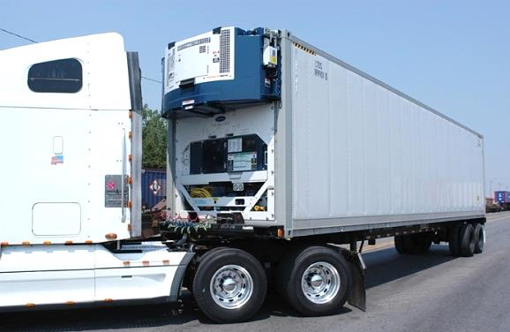
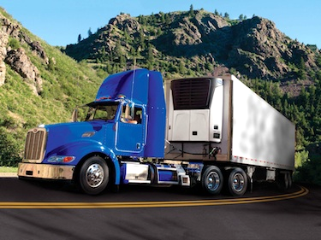
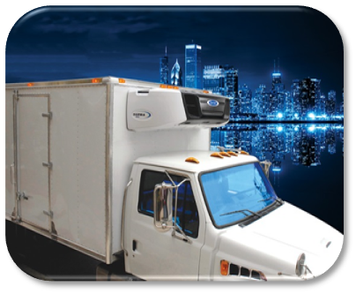
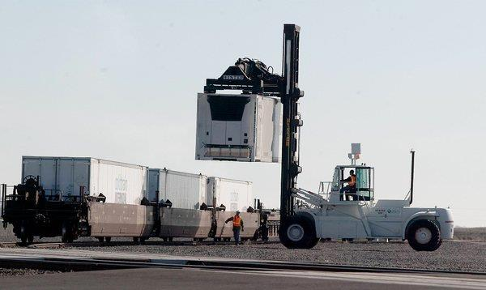
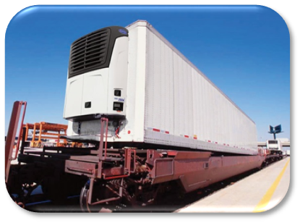
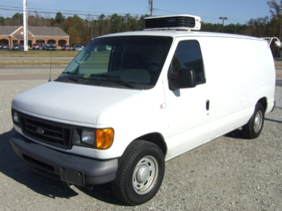
Carrier Transicold Applications
ISO Container
Trailer
Straight Truck
Domestic Container and Intermodal Trailer
Rail
Small Truck or Van
5

Slide 6
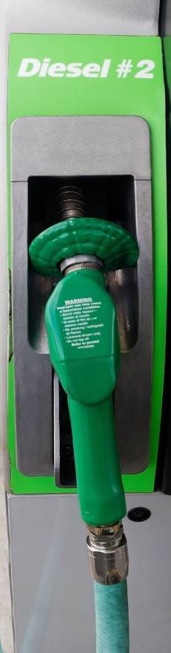

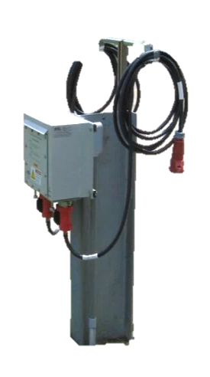
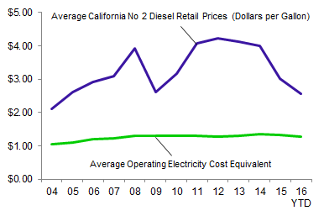
Benefits
Estimated cost/hour at an average operating load
Typical savings: 40-75% per hour
Diesel prices fluctuate
Electricity traditionally stable
$2.10*
$1.15 per hour,
or 55% savings
Diesel Fuel vs. Electricity Historical Price Fluctuations
$0.95**
*Diesel: $2.85 per gallon
**Power: $0.10 per kwh
Source: EIA
6

Slide 7
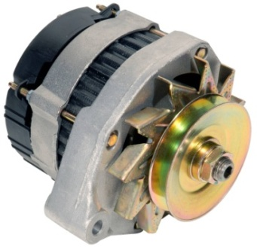
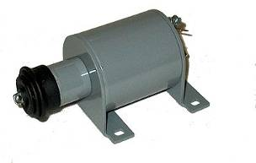
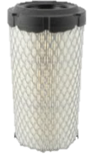


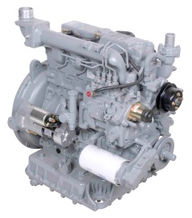
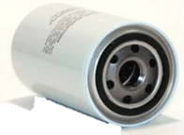
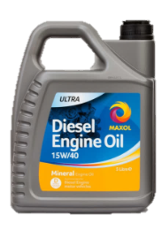
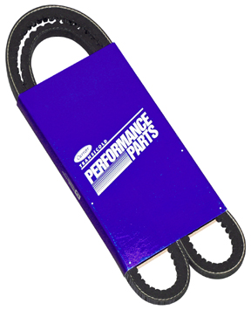
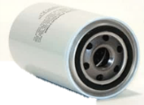
Benefits
Maintenance Savings
Quieter Operation
Lower Emissions
vs.
Most maintenance engine-hour based
Reduces costs ~30% per run hour
5 to 6 dBA quieter
“Significantly or noticeably” quieter
Better sound quality
Zero emissions locally
In general, lower grid emissions than engine
CA power: natural gas
7

Slide 8
Bucket Battery Racks on Trucks
Notes:
The smart charger features included simulated communication via a mobile app to the EVSE where operate could choose to charge at a favorable “time of day rate” and the fleet operator (or utility in the future) has control to interrupt the charging.
To address one of the economic Barriers of acceptance of the technology for a hybrid work truck application the program provides trucks to participants at the conventional vehicle price. And thus we aim to build customer familiarity with the technology.

Slide 9
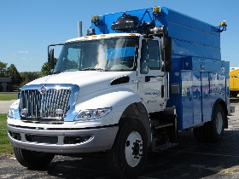
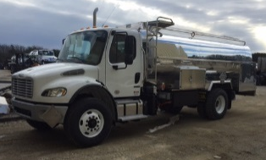
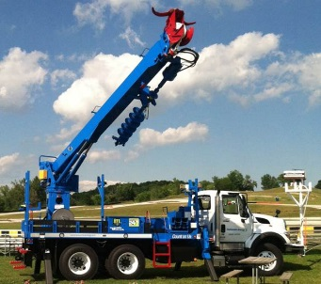
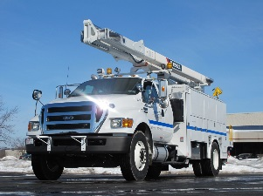
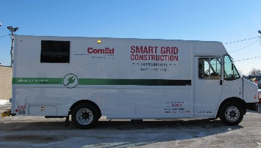
Deployment to the Fleets
Chassis Manufacturers
Freightliner
International
Ford
Kenworth
Final Stage Manufacturers
Altec
DUECO
Terex
Amthor
Vanair
Utilimaster
Notes:
What hybrid benefits did non bucket trucks have? Power assist, Export power, If vehicle hydraulics then power is provided for that system.
3 Tankers at nuclear sites, hybrid used for pumping the fuel and power assist.
Chassis had to be engineered separately, every chassis has a different length, each one needs special modifications.
Final stage manufacturers each configured different trucks.

Slide 10
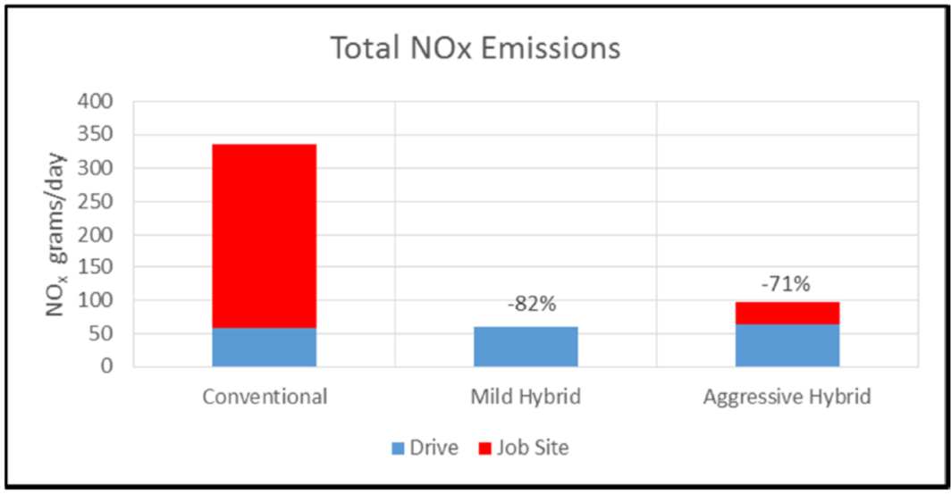
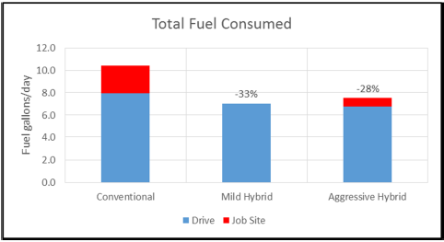
Emissions
During driving conditions NOx results are showing higher for Hybrid vs Conventional
  The amount is dependent on operating conditions
  Hybrid impacts exhaust temperatures, mostly at startup
  SCR systems are more sensitive, potentially due to dosing
Green House Gases are reduced in all cases
For our vocation / applications the driving impact is very small compared to the full work day benefit
  Reduces Green House Gases by up to 50% or greater
  Reduces NOx by up to 80% or greater

Slide 11
Fuel Consumption Comparison
Traction Fuel Consumption
CILCC cycle used
Links to this project results:
https://www.epri.com/#/pages/product/000000003002006566/
https://www.epri.com/#/search/3002009110/
Notes:
Calibration types were placed randomly
Mild – saves battery for job site.
Strong – use power assist as much as possible.
Some customers favored one over the other.

Slide 12


