Slide 1
Autogas Infrastructure Simple, Scalable, and Affordable
Brian Green
Green’s Blue Flame Gas Company

Slide 2
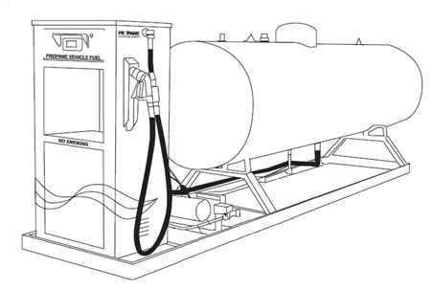
Autogas Infrastructure Components
Dispenser
Tank
Other Requirements:
- Site Preparation
- Power Supply
- Crash Protection
Skid/structure
Plumbing
Pump
Fill Nozzle and Hose

Slide 3
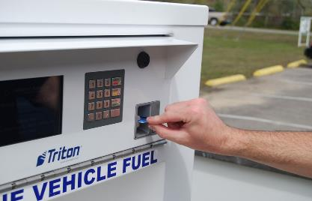
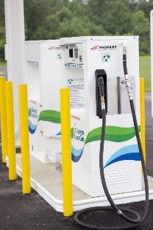
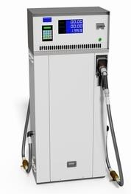
Dispensers and Operation
Simple Access - Push to Start
Card Access
Cellular based communication
Customizable data management
Accommodate multiple fleets at a single location
Single or Dual Hose Set-ups
Installed with hose, nozzle, and, break-away device
Dispensers can be added as your propane fleet grows

Slide 4
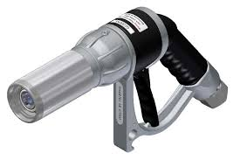
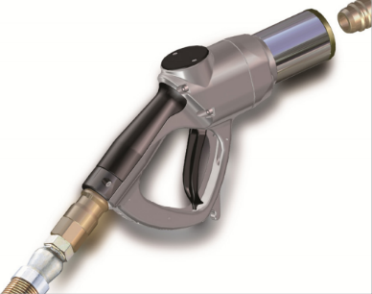
Nozzles
ACME Low Emission
Standard in the propane industry for decades
Connects using ACME Threads
1.9 cc product released
Ultra-Low Emission Quick Connection
Only 0.4 cc product released
Locks when the trigger is pulled
Unlocks automatically then trigger is released
Propane does not flow unless properly connected
Funding is available to switch to Ultra-Low Emission Nozzle
$100 per tank-side connector, $1,000 hose-end

Slide 5
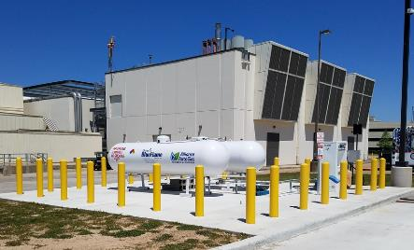
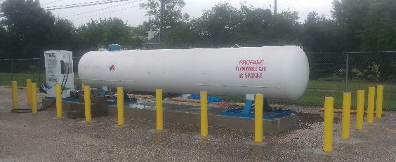
Tank Options – Flexible and Scalable
Horizontal
Preferred option – cost/availability
1,000 gallon/2,000 gallon +
Additional tanks can be added as your propane fleet grows
Tanks are monitored remotely using a cellular device
Sends emails and texts to operations staff when thresholds are met

Slide 6
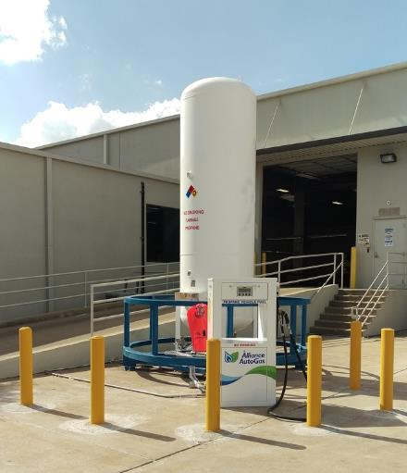
Tank Options – Flexible and Scalable
Vertical
Best option when space is constrained
Cost about 4-5X more than horizontal tanks to purchase and install
Offered in ranges of 660-2000 gallons
X-Base and rails available for retro-fit installations

Slide 7
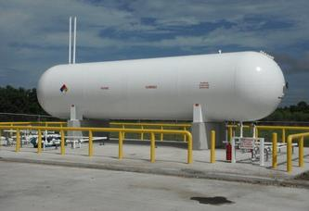
Tank Options – Flexible and Scalable
Large Volume
Long term commitment w/ large fleet (School Districts)
18,000/30,000 gallons
Largest cost to install - Largest cost savings on fuel
Transport Delivery
Redundancy usually built into these installations
Multiple dispensers, dual pumps, etc.
Installation for Clear Creek ISD by Propane Specialty Services

Slide 8
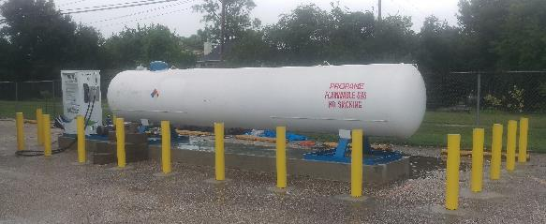
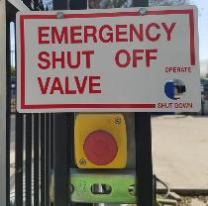
Site Requirements for Autogas Infrastructure
Concrete/Structural
6” concrete pads for most tank installations
Concrete forms for 18,000+ gallon tanks
Electrical
Pump – 240V power supply
Dispenser – 120V power supply
Emergency shut down valve
Crash Protection
Bollards or crash posts and rails per Texas Railroad Commission requirements

Slide 9
Autogas Infrastructure Costs
Purchase tank and dispensing equipment
1000 gallon horizontal tank and dispenser on skid
~$45-60k depending on dispenser and current site
18,000 gallon tank with multiple dispensers and redundant pumps
~$250-300k
Lease tank and dispensing equipment from propane provider
Costs for propane equipment (tanks, pump, dispenser, etc.)
$0
Costs for site preparation, electrical, and crash protection
$5-15k

Slide 10
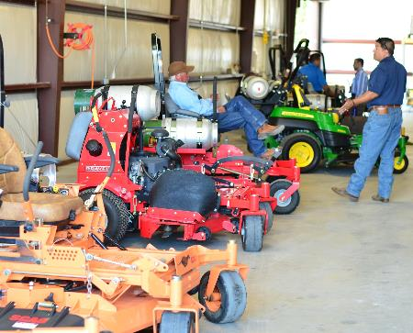
Propane Mowers
Propane is a great fuel for commercial landscaping!
Wide variety of propane conversions and mowers available from OEMs
John Deere, Exmark, Bobcat, Wright, Gravely, Toro…
Refueling Options
Cylinder re-fuel/exchange or dispensing systems
30%+ savings in fuel costs
Bonus: Savings on refueling time
Many landscapers start using propane fleet vehicles also

Slide 11
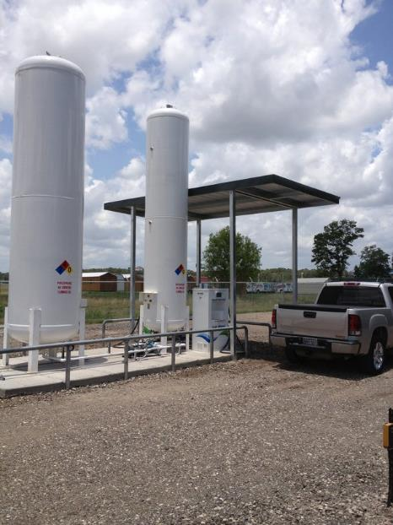
Questions
Brian Green
713-562-8852
brian@greensblueflame.com

