Slide 1
Ready for the EV Revolution?
Dave Aasheim, Sales Director South Central US
November 14, 2017

Slide 2
Top Ten EV/PHEV States
Rank | State | Q2'17
1 | California | 297,859
2 | Washington | 26,136
3 | Florida | 24,345
4 | Texas | 22,208
5 | New York | 20,873
6 | Georgia | 20,618
7 | Michigan | 14,723
8 | Oregon | 14,013
9 | Illinois | 13,551
10 | New Jersey | 12,906
Source: Polk (no GEM NEVs)

Slide 3
Top Metros for EV Adoption
Rank | Metro | Q2‘16 | Q2'17 | Growth
1 | LA | 96,761 | 133,639 | 38%
2 | Bay Area | 82,873 | 112,016 | 35%
3 | NY/NJ/CT | 19,527 | 26,999 | 38%
4 | San Diego | 15,974 | 21,929 | 37%
5 | Seattle | 14,205 | 19,443 | 37%
6 | Atlanta | 20,425 | 18,612 | -9%
7 | Chicago | 8,420 | 11,723 | 39%
8 | DC | 7,818 | 11,444 | 46%
9 | Portland | 7,763 | 11,092 | 43%
10 | Detroit | 7,426 | 11,034 | 49%
11 | Miami | 6,978 | 9,663 | 38%
12 | Phoenix | 6,534 | 9,607 | 47%
13 | Dallas | 6,219 | 8,898 | 43%
14 | Boston | 5,594 | 8,148 | 46%
15 | Denver | 5,129 | 7,733 | 51%
16 | Philadelphia | 5,126 | 7,464 | 46%
17 | Houston | 3,725 | 5,056 | 36%
18 | Austin | 3,294 | 4,741 | 44%
19 | Baltimore | 3,283 | 4,741 | 44%
20 | Honolulu | 3,491 | 4,661 | 34%
Source: Polk (no GEM NEVs)

Slide 4
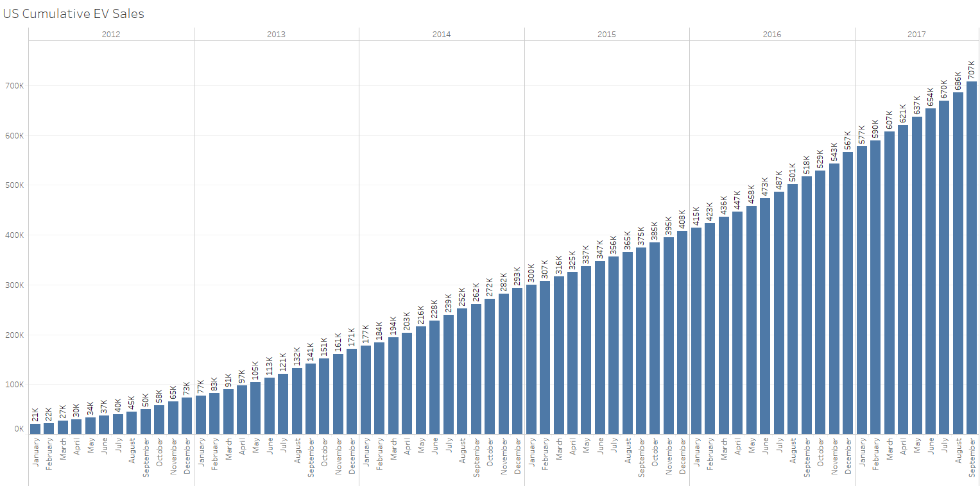
EV Sales Are Growing
707K
600K
500K
400K
300K
200K
100K
Source: Inside EV Sales Scorecard
http://insideevs.com/monthly-plug-in-sales-scorecard/
Over 707,000 cumulative EVs sold through September 2017
Notes:
Electric vehicle sales is expected to grow rapidly over the next ten years so it is a great time to take advantage of the opportunity to show leadership in sustainability by helping propel adoption of this cleaner, more efficient technology.

Slide 5
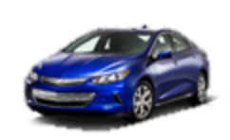
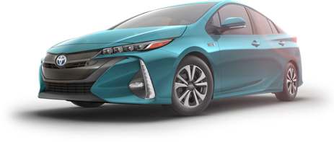
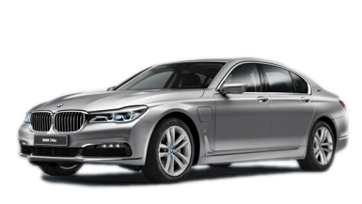
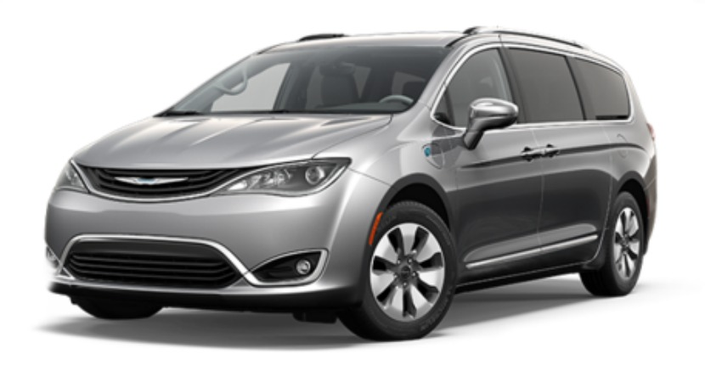
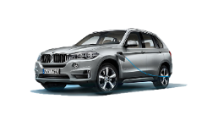
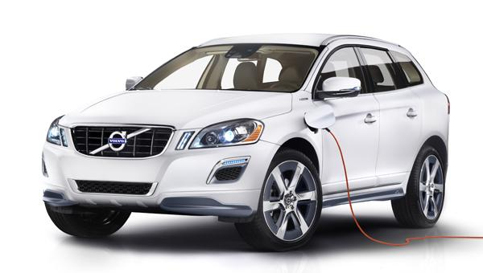
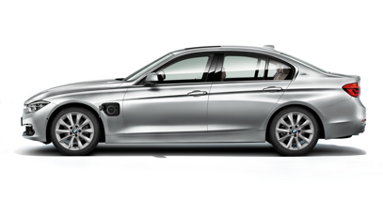
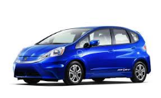
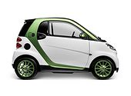
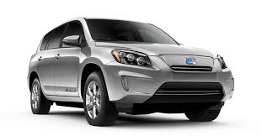
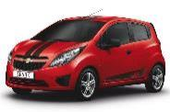
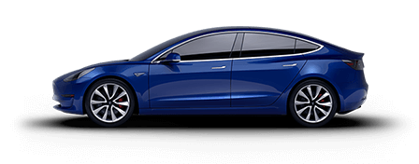
EV Models in USA
Plug-In Hybrid EV
PHEV
Toyota Prius Prime
Chevy Volt
Toyota Prius Plug-in
Cadillac ELR
Mercedez S 550
BMW 740e
Chrysler Pacifica Plug-In
Ford Fusion Energi
BMW X5 xDrive40e
Ford C-Max Energi
Volvo XC90
Plug-In Models
BMW 330e
Hyundai Sonata Plug-In
BMW i8
Porsche Panamera S E
Porsche Cayenne S E
Audi A3 e-tron
Battery EV BEV
34+ currently available
with many more coming in 2018
BEV with DC Fast Charge
Toyota Rav 4 EV
Honda Fit
smart EV
Ford Focus Electric
Fiat 500 E
Chevy Bolt EV
Nissan LEAF
BMW i3
Tesla Model S
Tesla Model X
Mitsubishi i-MiEV
Hyundai Ioniq Electric
VW e-Golf
Chevy Spark
Kia Soul EV
Tesla Model 3
Mercedes B Class

Slide 6
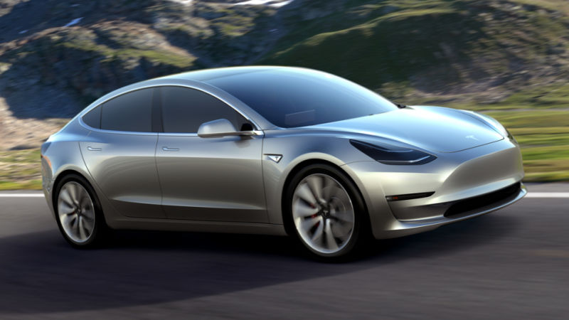
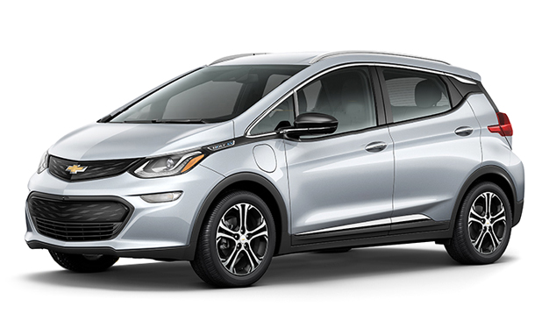

Slide 7
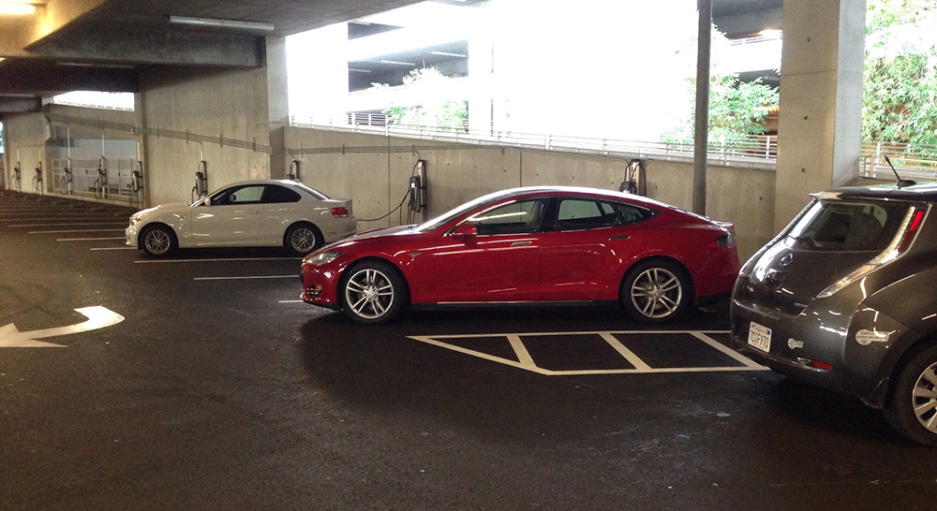
All EVs can use Level 2 EVSE

Slide 8
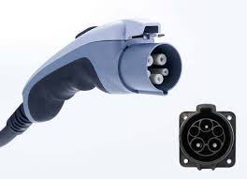
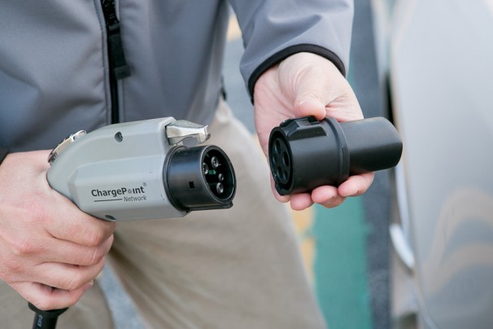
Level 2
J1772 Connector
Tesla Adaptor
Notes:
Three types of DC fast charging exist in the marketplace today. The SAE J1772 combined charging system (CCS), which uses a single port for either AC Level 1 and 2 or DC fast charging was recently introduced. Additionally, Tesla has their own supercharger network, which is based on their own connector and currently only charges their own vehicles.

Slide 9
Drivers Need:
Business Owners Need:
Fast, easy, reliable charging
Convenient locations
Real-time station status and details
A network that knows their car
Tracking of their charging details
Expert assistance on demand
Simple operation, low overhead costs
Customization to meet their requirements
Automatic upgrades
Power management to minimize costs
Support for drivers
Reports that validate ROI

Slide 10
Networked vs. Non-Networked Summary
Capability | Networked Chargers | Non-Networked Chargers
Offer Electricity | ✓ | ✓
Visibility to Drivers (through mobile app, in-dash navigation) | ✓ | ❒
Ability to charge and recover cost (by kWh, hours of usage, time of use, etc.) | ✓ | ❒
Access Control (employees only, public, loyalty rewards) | ✓ | ❒
Remote access and maintenance (check status, availability, etc.) | ✓ | ❒
Analytics (usage, # of unique drivers, charging behavior, utilization, revenue, and costs) | ✓ | ❒
Sustainability reporting (GHG savings, fuel savings) | ✓ | ❒

Slide 11
Charging Station Design and Planning

Slide 12
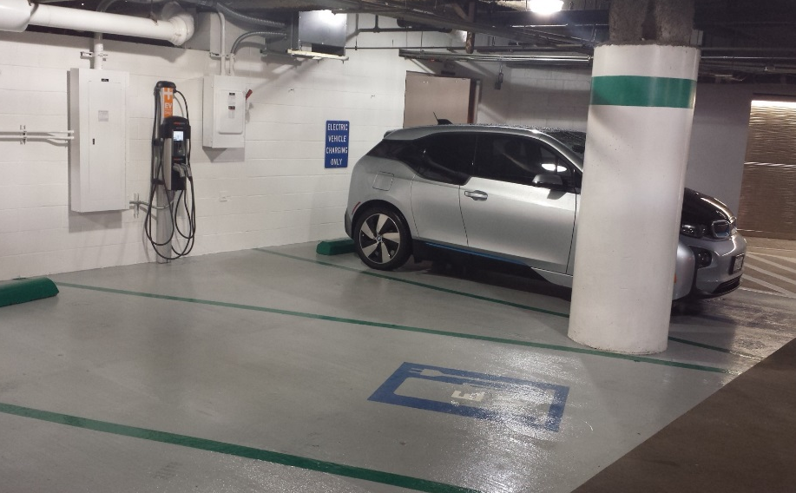
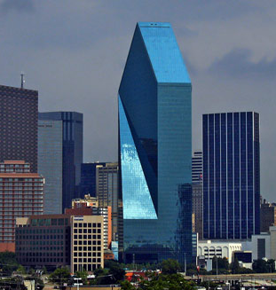
Design and Planning Considerations
Proximity to power source
Proximity to building entrance
Potential trenching
Lighting and security
Pooled water and irrigation
Visibility and signage
Accessibility and ADA

Slide 13
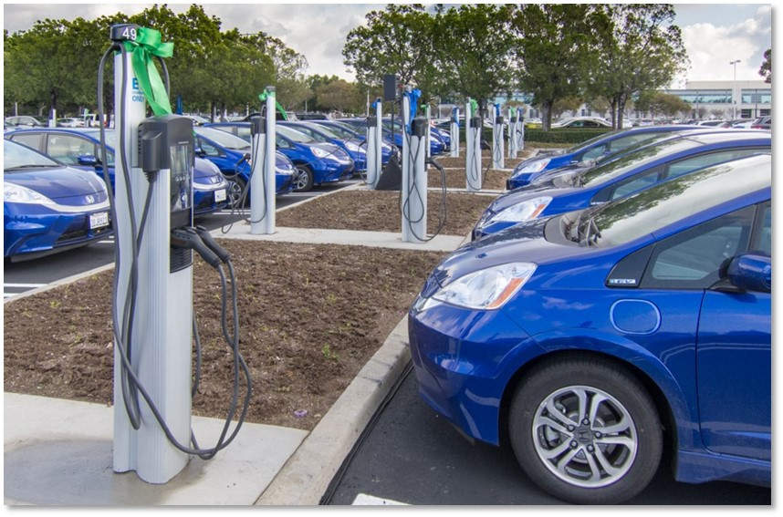
Charging Station Installation

Slide 14
Types of Installation Costs and Cost Drivers
Most Common Installation Costs
Labor
Materials
Electrical service upgrades
Trenching, boring or x-ray
Other Costs
Repaving/repairing parking lots and walkways
Permits
Signage and restriping
For Level 2 commercial EVSE, the installation cost break down is approximately:
Labor: 55-60%
Materials: 30-35%
Permits: 1-5%
Tax: 5%
Notes:
An installation becomes more expensive when:
Trenching or boring a long distance from the electrical panel to the charging location
Upgrading the electrical panel to create dedicated circuits for each EVSE unit
Upgrading the electrical service to provide sufficient electrical capacity to the site

Slide 15
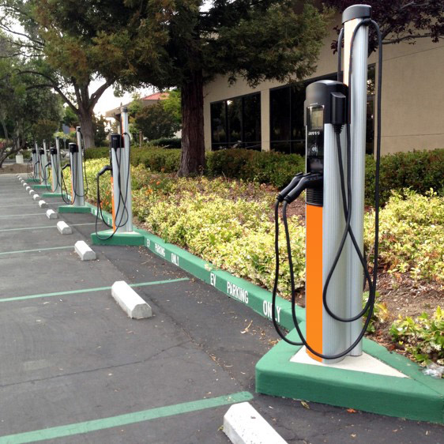
Best Practices for Installation
Locate near power source to reduce installation costs
Plan for dual port stations
Cluster stations
Consider a wall-mount stations
Consider make-ready items for anticipated EV charger needs
Empty conduit sized for the future
Panel capacity
Upgrade electrical service
Trenching and laying the conduit

Slide 16
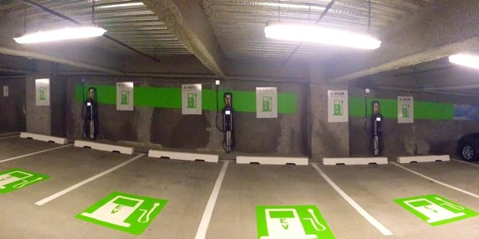
Protection
Install bollards or wheel stops to protect the charging stations from damage by cars.
Bollards should be installed in a way that does not interfere with station and cable operation.
Bollards
Wheel stops

Slide 17
The World’s Largest and Most Open EV Charging Network
42,000+
Largest Community of EV drivers
+ 70% of new EV drivers join every month
+ A driver plugs into our network every 4 seconds
Charging Everywhere
+ 42,000+ charging spots
+ 600+ ports added every month
We’re Established and Growing
+ $165 million in funding
+ Market share leader
+ European Expansion
We Are the Industry Leader According to Time, Bloomberg, CNBC, Navigant Research and many others

Slide 18
42,000+ ChargePoint Stations
Nov= 1,272 kWh Dec= 1,098 kWh Jan= 1,405 kWh

Slide 19
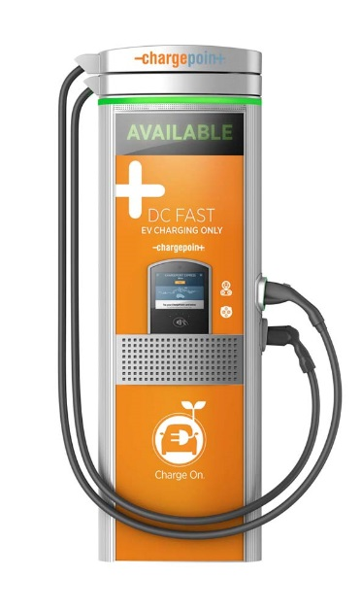
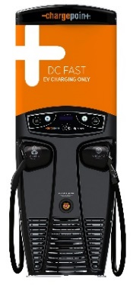
Stations for Every Situation
Single Family
Home
Multi-Family,
Fleet
Commercial/Municipal, Mixed Use
On-Route, Commercial
Home
Level 2
CPF25
Level 2
CT4000
Level 2
CPE100
24kW
CPE200
50kW
CPE250
62.5kW
Express Plus
400kW
Fast DC Chargers
Ultra-fast DC Chargers
Notes:
ChargePoint also has solutions for single-family and multi-family homes.

Slide 20
7,000+ Customers: Some of the World’s Best-Known Brands
Workplace
Retail
Parking
Hospitality
Multi-family
Energy
Fleet
Municipalities
Education
Healthcare

Slide 21
CT4023- Dual Cord Wall Mount
McKinney & Olive- Dallas, TX

Slide 22
CT4021- Dual Cord Bollard Units
Honda North America Employee Parking Lot

Slide 23
CT4023- Dual Cord Wall Mount
Shell Oil- Houston, TX

Slide 24
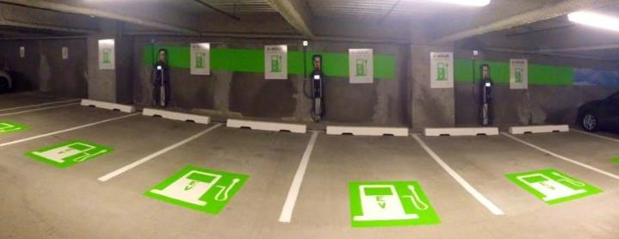
Thank You
For further information on ChargePoint, please contact Dave Aasheim: dave.aasheim@chargepoint.com
(214) 449-7544

