Slide 1

HOUSTON INDEPENDENT SCHOOL DIST.
FLEET OPERATIONS

Slide 2
HOUSTON ISD
BUS FLEET SIZE – Over 1100 Buses in operation running over 14M miles a year servicing 280 schools.
PROPANE BUSES – 161 Buses
WHITE FLEET SIZE – Over 1400 pieces of equipment to include:
Generators, Forklifts, Golf carts, Trucks, PD Etc..
PROPANE WHITE FLEET – 20 Ford Vans

Slide 3
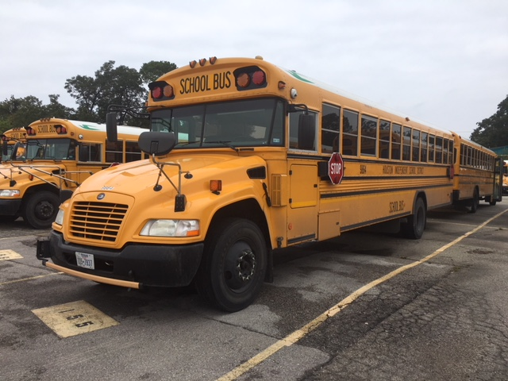
91 PROPANE BLUE BIRD BUSES

Slide 4
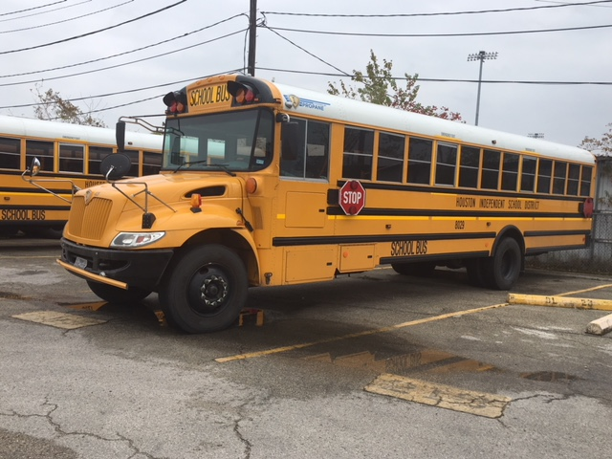
30 PROPANE IC BUSES

Slide 5
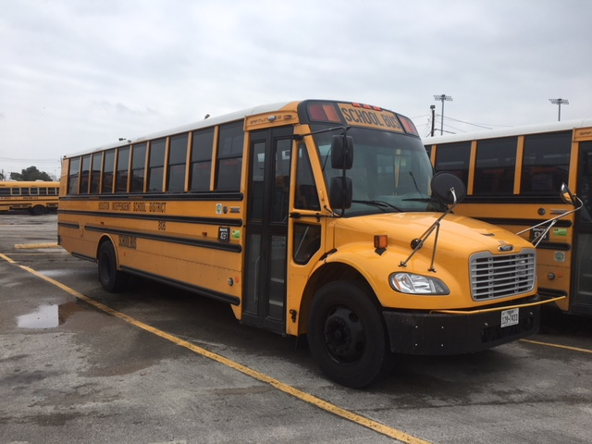
40 PROPANE THOMAS BUS

Slide 6
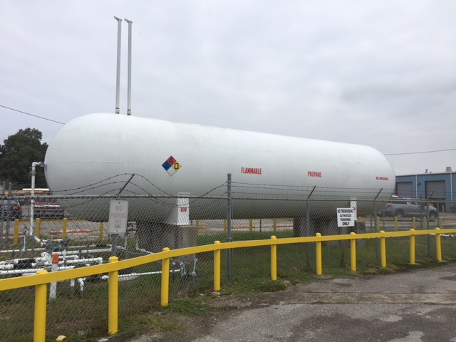
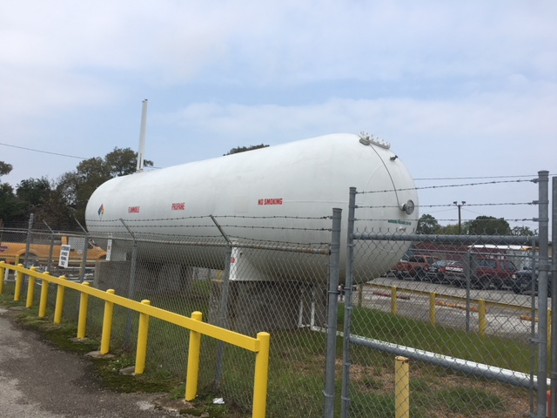
PROPANE INFRASTRUCTURE
Built in 2011 with Grant Funds
18,000 Capacity

Slide 7
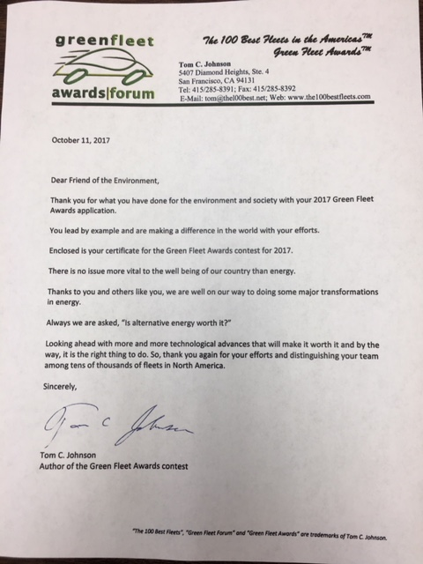

AWARDS
Green Fleet 2017
HISD 2017

Slide 8
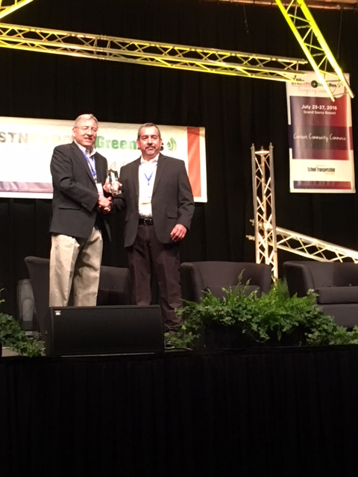
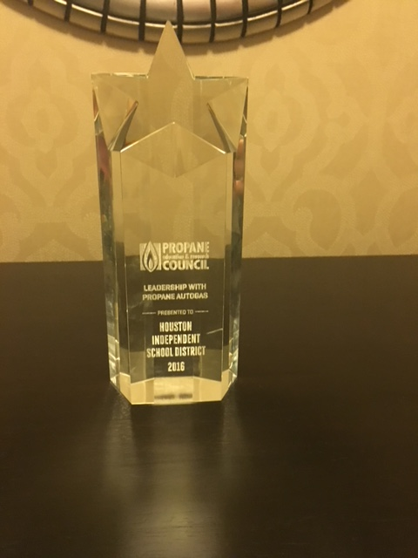
Propane Education & Research Council
Awarded at STN Conference
2016 Award

Slide 9
FUEL COST COMPARISON
2016-2017 FUEL COST COMPARISON
161 Propane buses | 30 IC | 40 Thomas Bus | 91 Blue Bird
Total mileage per year |  |  | 2,184,928.00
Average yearly miles per bus |  |  | 14,469.00
Total Average Propane fuel consumed per year (gallons) |  |  | 624,265.14
Average Propane fuel consumed per bus |  |  | 4134 gal
Average yearly cost of Propane | .85 cents | 3.5 mpg | $530,625.25
Average yearly cost of Diesel | $1.57 | 5 mpg | $686,066.45
Average Propane fuel cost per bus per year |  |  | $3,513.90
Average cost of Diesel usage per bus |  |  | $4,543.26

Slide 10
PREVENTIVE MAINTENANCE & FUEL COST
PREVENTIVE MAINTENANCE & FUEL COST
DIESEL BUS | COST | PROPANE BUS | COST
4 PMI's per year | $453.00 | 4 PMI's per year | $194.00
AVERAGE FUEL COST | $4,543.26 | AVERAGE FUEL COST | $3,513.00
TOTAL COST PER YER | $4,996.26 | TOTAL COST PER YER | $3,707.00
YEARLY SAVINGS PER BUS | $1,259.00
YEARLY SAVINGS PROPANE BUSES | $202,699.00

