Slide 1

Collecting and Using Real World Activity Data
Texas A&M Transportation Institute
Clean Cities Technologies Conference
November 14th, 2017

Slide 2
Outline
About TTI
Collecting Real-World Data
Using Real-World Data
Conclusions

Slide 3

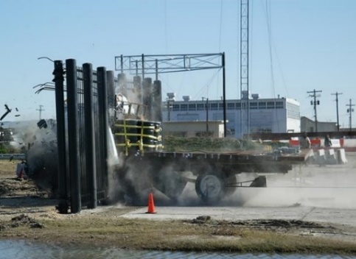
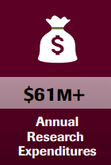

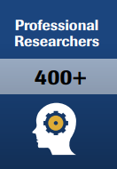



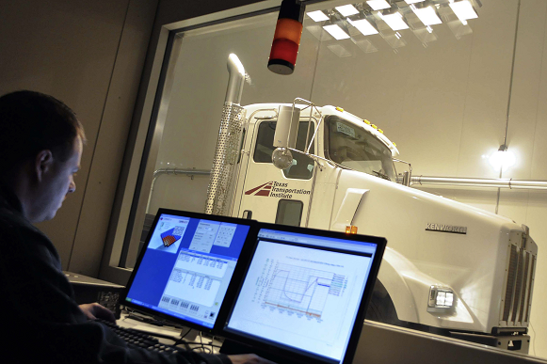
Outline
About TTI
  TTI’s Mission is:
    To solve transportation problems through research
    To transfer technology and knowledge
    To develop diverse human resources to meet the transportation challenges of tomorrow
Research for Wide Range of Private and Public Entities in All Modes

Slide 4

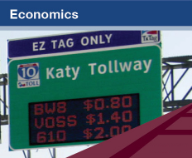





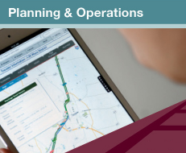




About TTI

Slide 5
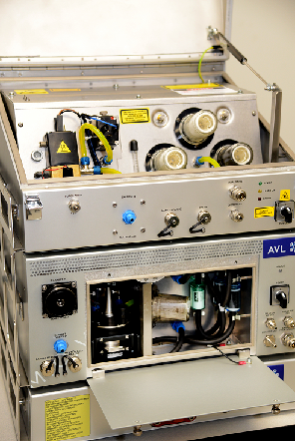
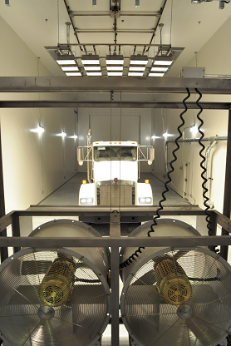

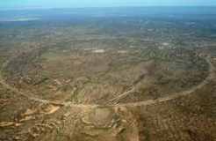
About TTI – Air Quality Group
  The TTI Air Quality Group focuses on transportation related air quality research, including:
    Mobile Source Emissions
    Transportation Sustainability
    Emissions and Fuel Efficiency

Slide 6
About TTI
Collecting Real World Data
  Many different technologies are available today to reduce emissions.
  Effectiveness of technologies depends on many factors, including the activity profile of the vehicles being equipped/replaced.
  New sampling methodologies, measuring equipment, and test procedures and protocols now exist to help better understand what is happening in the real-world.
  These data gathering efforts are also helping to improve the modeling efforts to better estimate to overall impact of different technologies and other emissions reduction programs.

Slide 7
  Collecting Real Word Data - Tools
Detail
Department of Motor Vehicles
Port Gate Data
Fleet Data
Obtain population and temporal allocation
Population Data
Remote Sensing tools: HEAT, Portable tent, mini-PEMS
Random population evaluated for days to months
Obtain emission “snap shots” to identify high emitter population through license plate
Screened Population
Portable Activity Measurements:
Hundreds of vehicles measured over several weeks to months in real world
Obtain activity and temporal allocation
PAMS
Portable Emission Measurements:
10’s of vehicles over one day of real-world operation
Obtain activity, emissions, and temporal allocation
Statistical Power
PEMS

Slide 8
  Real World Tools – Screening Tools
  Screening Tools Take a “Snap Shot” of a vehicle’s emissions.
  Find the high emitting vehicles within a fleet or vocation.
  Screens hundreds of vehicles per day
  No installation on vehicles required, so no removing vehicles from their normal activity.
  Operating conditions of vehicles may vary as they pass through screening, there caution is necessary when comparing vehicles.

Slide 9
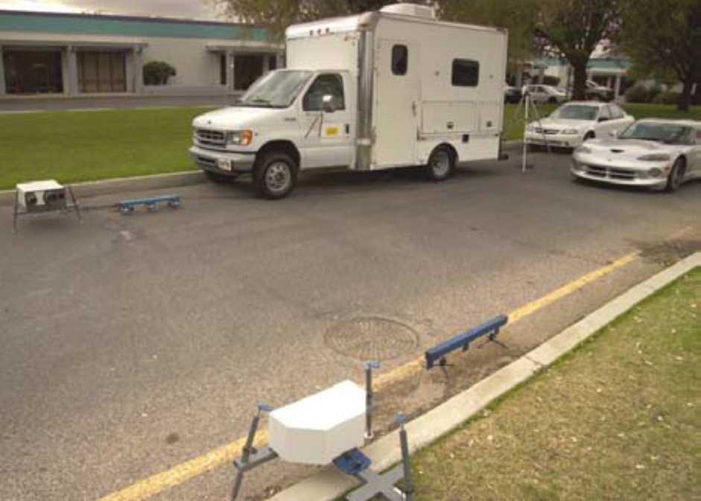
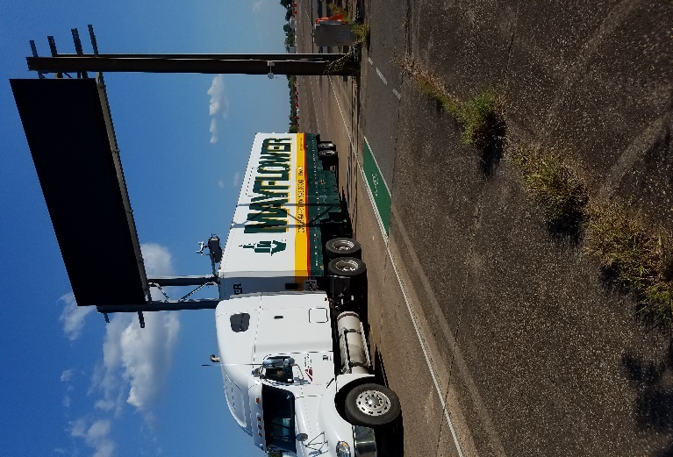
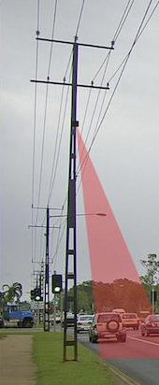
  Real World Tools – Screening Tools
Remote Sensing
HEAT (EDAR)
OHMS (On-road Heavy-duty Measurement System

Slide 10
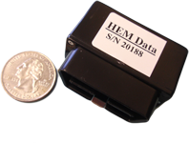
  Real World Tools – PAMS
  Portable Activity Monitoring Systems
  Small data loggers that collect both GPS and on-board vehicle information (OBDII, J1939)
  Works on any compatible vehicle, including light-duty, heavy-duty, and nonroad.
  Improvements continue to be made in size, sensors, and capabilities.
  Cellular capabilities allow for “real-time” analysis of data collected without having to access the vehicle.

Slide 11
  Real World Tools – PEMS
  Portable Emissions Measurement Systems
  Emissions measurement systems that mount on vehicles to measure real-time emissions as vehicles operate under normal conditions.
  Very detailed data on activity and emissions can be collected
  Can measure both gaseous and particulate matter (PM) emissions.
  Combines emissions measurements with vehicle data and GPS.

Slide 12
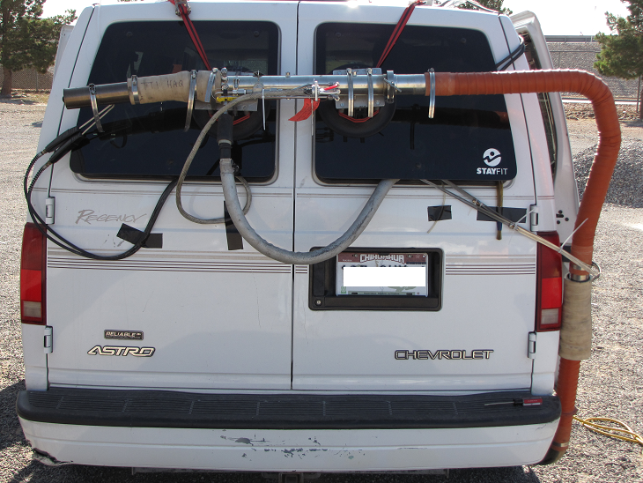
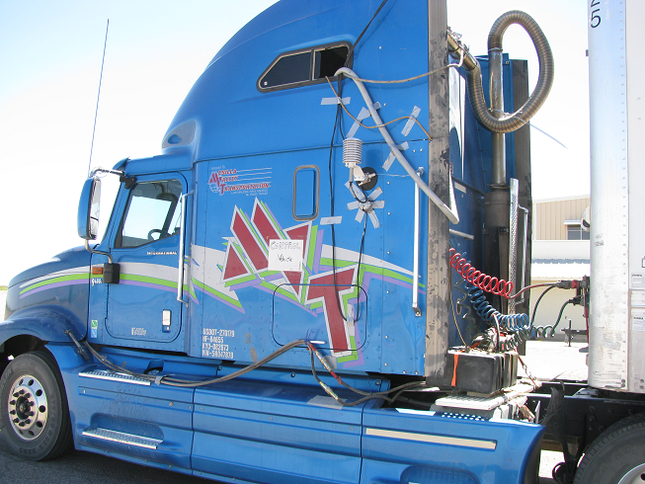
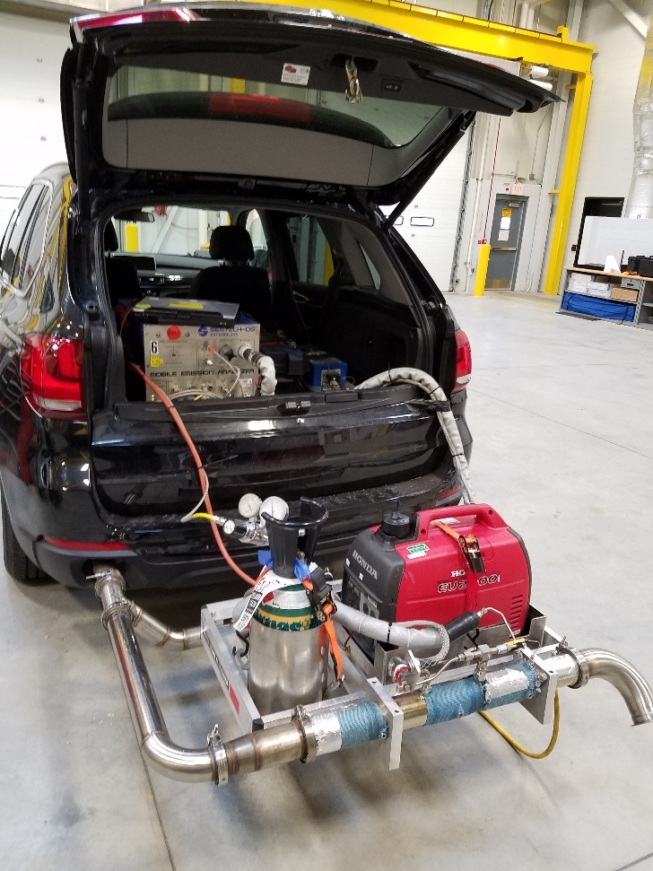
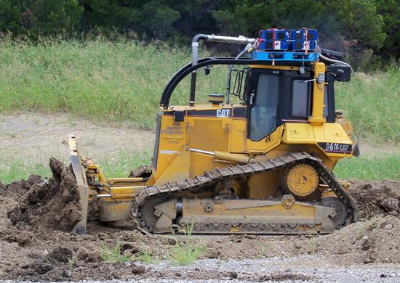
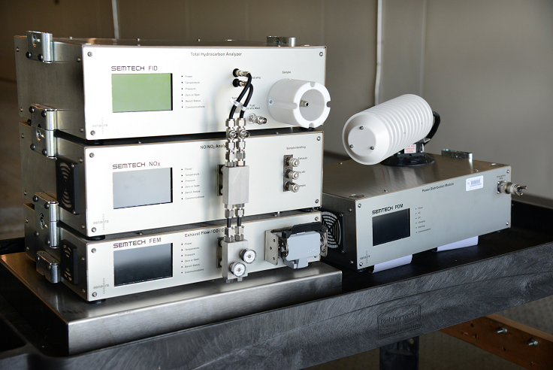
  Real World Tools – PEMS

Slide 13
Real Word Tools - PEMS
Using Real-World Data
Real world data can help:
  Better manage fleets
  Improve emissions models
  Target vehicles/fleets for emissions reduction programs
  Identify gaps in the emissions reduction technologies performance
  Improve planning for future transportation and air quality projects
  Understand fleet activities at certain locations
TTI is working with the U.S. EPA and other partners on several current projects collecting real-world data.

Slide 14
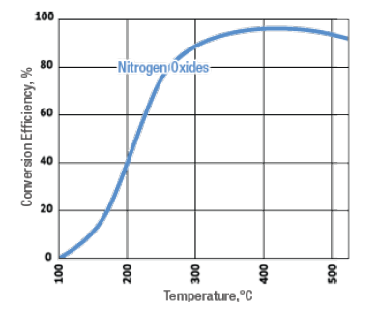
Using Real-World Data – SCR
In order to effectively reduce NOx emissions and SCR needs an exhaust temperature of at least 200 °C.
Heavy duty diesel vehicles are used in many different vocations, each with different driving characteristics.
Monitoring a vehicle’s exhaust temperature during normal operations can determine how effective an SCR would be if installed.

Slide 15
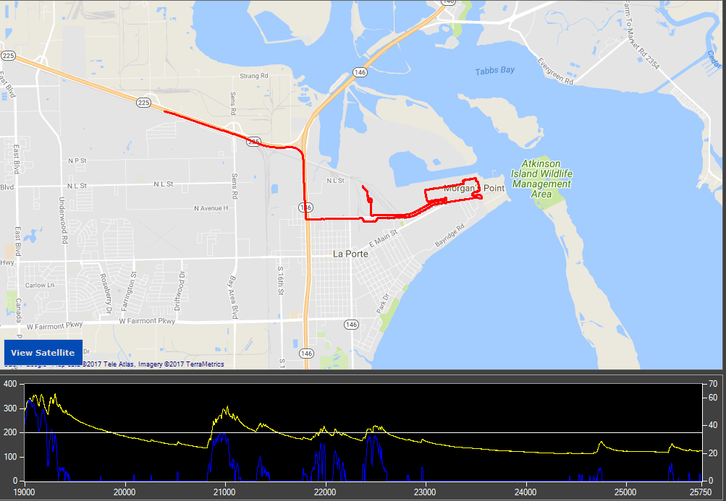
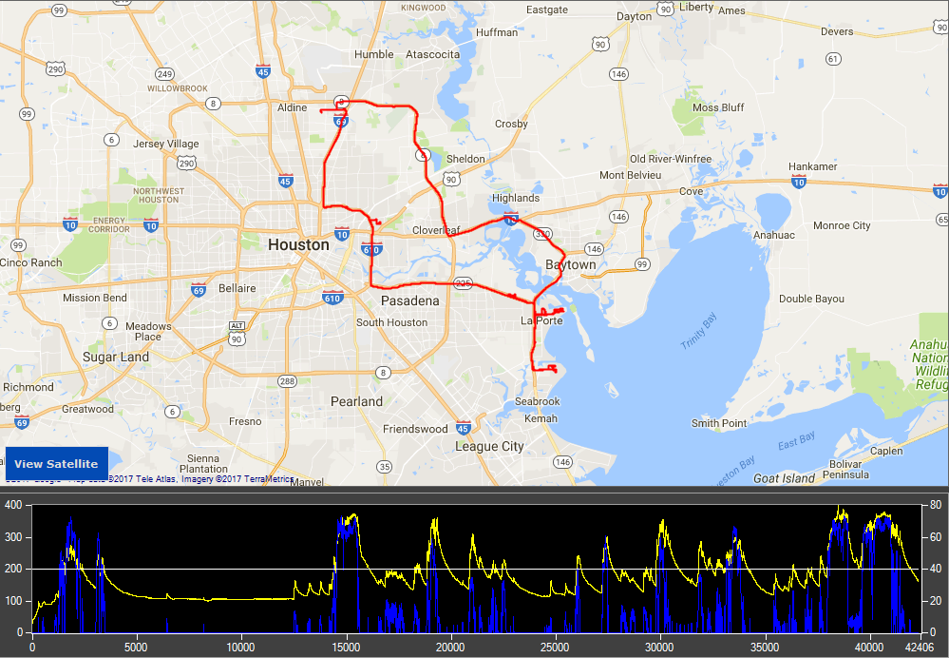
Using Real-World Data – SCR
SCR Effectiveness: Heavy-Duty Truck
Total Trip Time: 1 hour, 18 minutes
Average Speed: 2.5 MPH
Exhaust over 200°C: 17% of trip
SCR Effectiveness: Heavy-Duty Truck
Total Trip Time: 11 hours, 45 minutes
Average Speed: 10.5 MPH
Exhaust over 200°C: 31% of trip
Yellow: Exhaust Temp
Blue: Speed

Slide 16
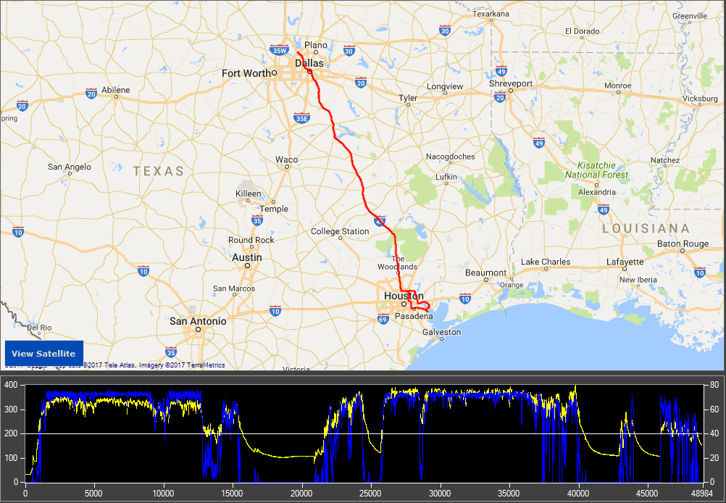
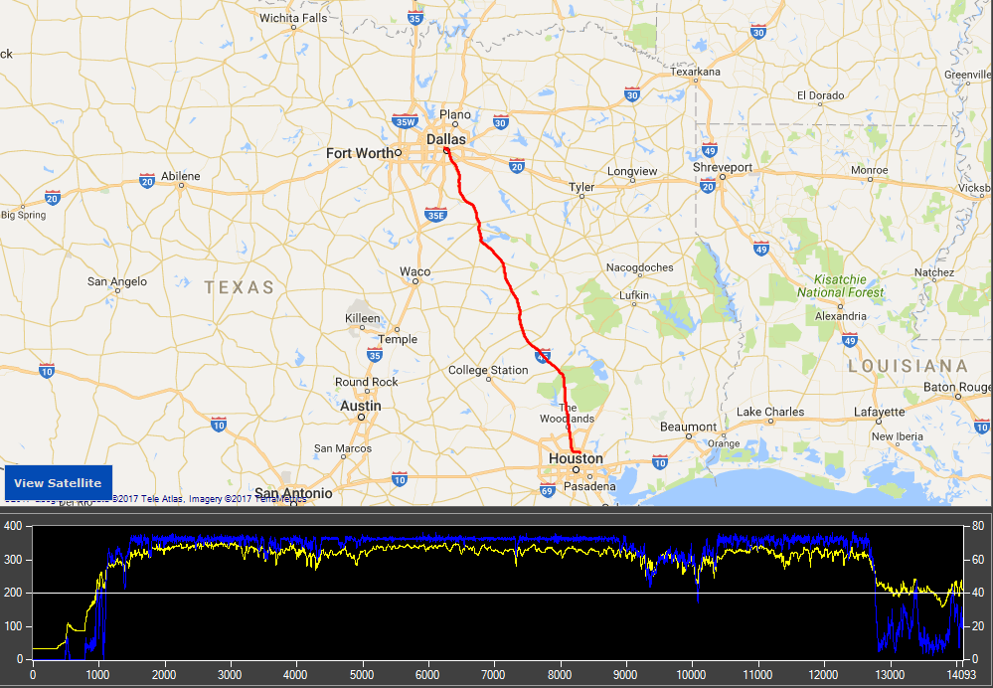
Using Real-World Data – SCR
SCR Effectiveness: Heavy-Duty Truck
Total Trip Time: 3 hours, 45 minutes
Average Speed: 61.6 MPH
Exhaust over 200°C: 90% of trip
SCR Effectiveness: Heavy-Duty Truck
Total Trip Time: 14 hours, 6 minutes
Average Speed: 43.5 MPH
Exhaust over 200°C: 71% of trip
Yellow: Exhaust Temp
Blue: Speed

Slide 17
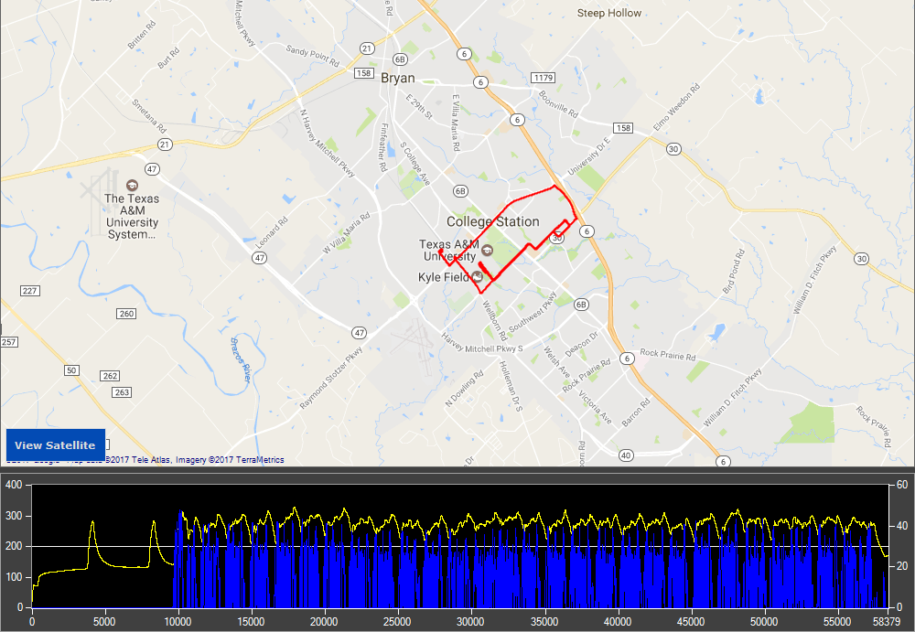
Using Real-World Data – SCR
SCR Effectiveness: Bus
Total Trip Time: 13 Hours, 27 Mins
Average Speed: 12.25 MPH
Exhaust over 200°C: 99%
SCR Effectiveness: Bus
Total Trip Time: 16 Hours, 13 Mins
Average Speed: 10.2 MPH
Exhaust over 200°C: 85%
Yellow: Exhaust Temp
Blue: Speed

Slide 18
Using Real-World Data – SCR
4.8x Higher NOx
4.5x Higher NOx
From Miller et al (2013), Final report to SC-AQMD “In-Use Emissions Testing and Demonstration of Retrofit Technology for Control of On-Road Heavy Duty Engines”, Sep 2013

Slide 19
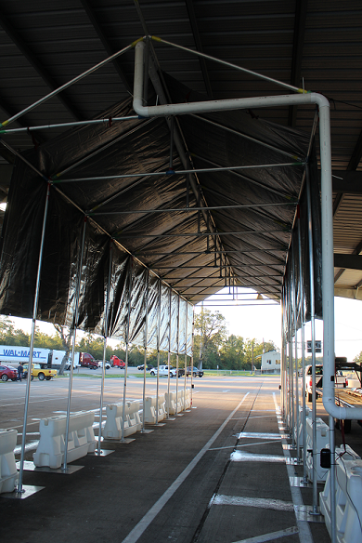
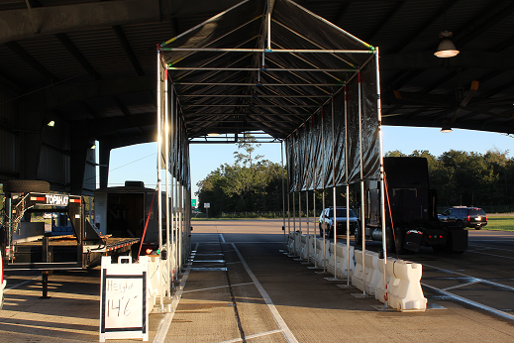
Using Real-World Data – OHMS
OHMS – On-road Heavy-duty Measurement System is screening tool to identify high emitting vehicles.
Screening tool to measure short (5-10 seconds) duration as vehicles pass through system.

Slide 20
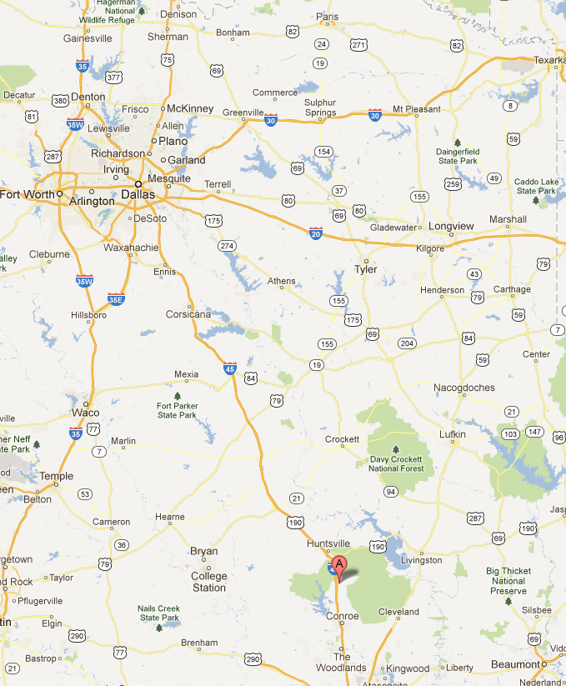
Using Real-World Data – OHMS
New Waverly Weigh Station, on Northbound I-45.
Testing Occurred in June 2012 and again in October 2016.
~1,000 HDDVs went through the OHMS setup over the test period.

Slide 21
Using Real-World Data – OHMS
Model Year Analysis
Average Fleet Age (years) – 2016: 8.9, 2012: 8.3
Average NOx Results (g/kg CO2) – 2016: 10.1, 2012: 18.0

Slide 22
Using Real-World Data – OHMS
Potential NOx Reductions (In DFW Area)
  Classifying HE as any truck higher than the 95th percentile within a MY.
    7.3% of Vehicles accounted for 21% of total NOx emissions.
    Potential reduction of 5.15 tons/day of NOx if HE replaced with “average” vehicle from same MY.
  Classifying HE as any truck higher then the 95th percentile of entire fleet.
    Up to 6.98 tons/day NOx possible depending on how the HE is replaced.
Numbers based on previous report compiled for TCEQ.
  https://www.tceq.texas.gov/assets/public/implementation/air/am/contracts/reports/mob/5820990400FY1111-20110831-tti-tx_hddv_ei.pdf

Slide 23
Using Real-World Data – HGAC
Currently TTI is working with HGAC monitoring Heavy-Duty vehicle activity in the greater Houston area.
Project is looking at different characteristics of the activities, including origins/destinations of the vehicles, idling characteristics, and activities in the Port of Houston.
Project also comparing 1 and 2-minute interval data to 1-second PAMS data.

Slide 24
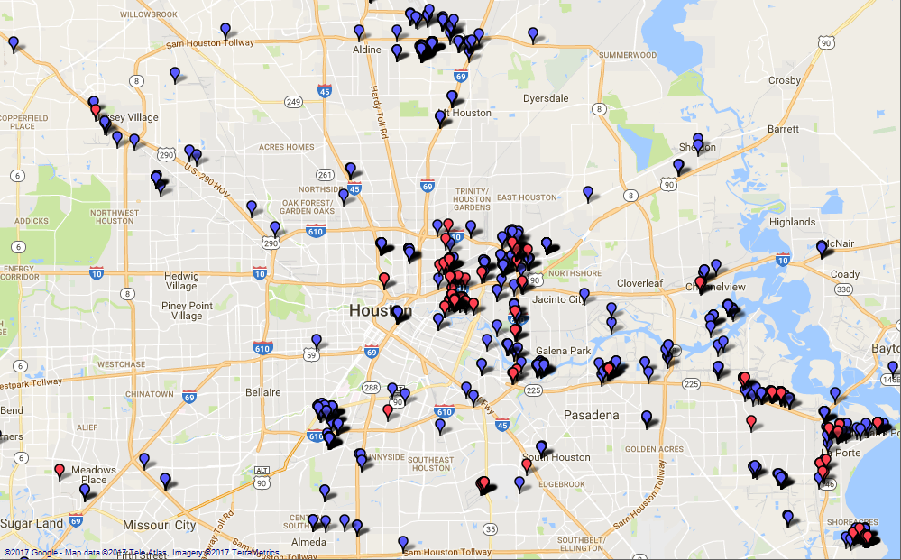
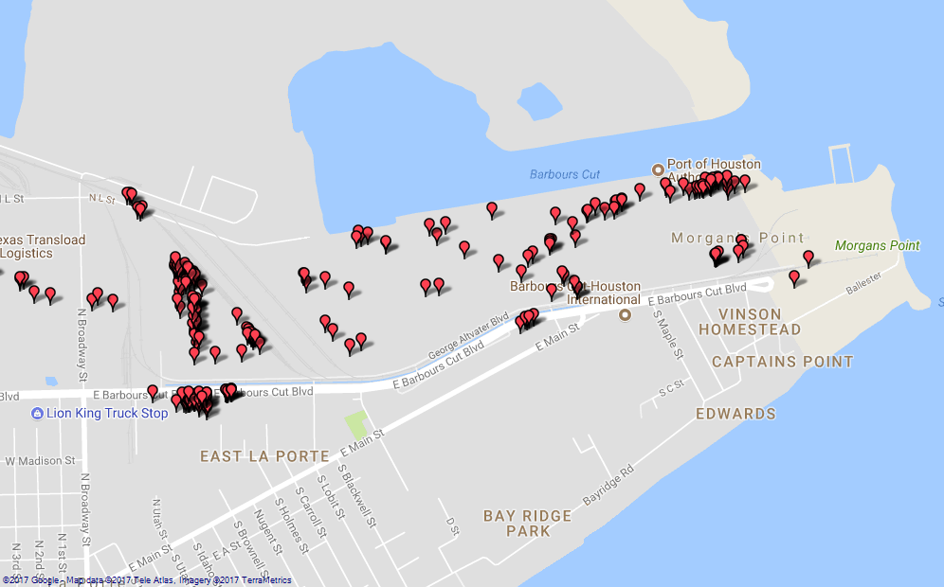
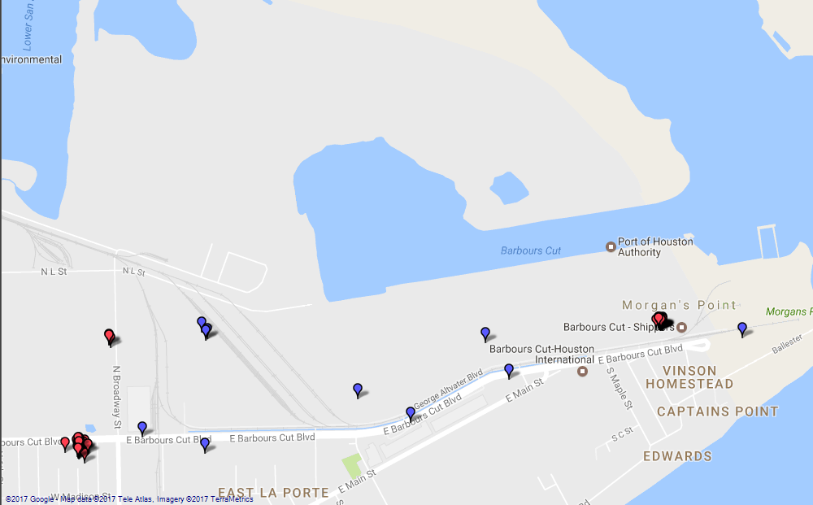
Using Real-World Data – HGAC
Origin and Destinations (O-D)
For this analysis any time a key is turned on (origin) or off (destination)
Barbours Cut Terminal
Idle Events
Barbours Cut Terminal
Origin/Destination

Slide 25
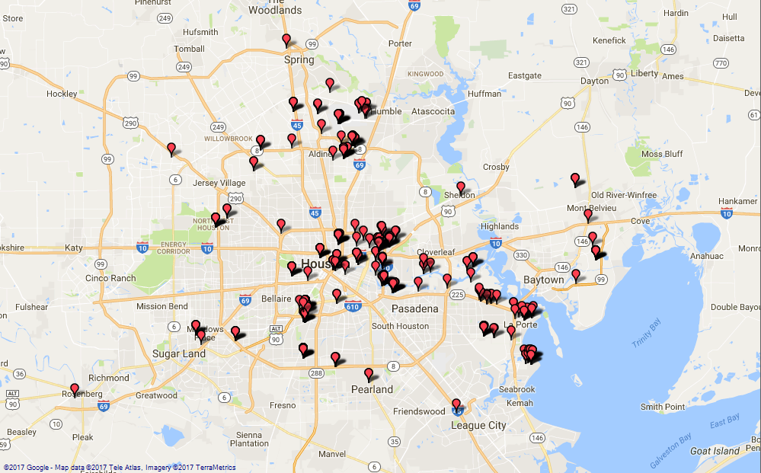
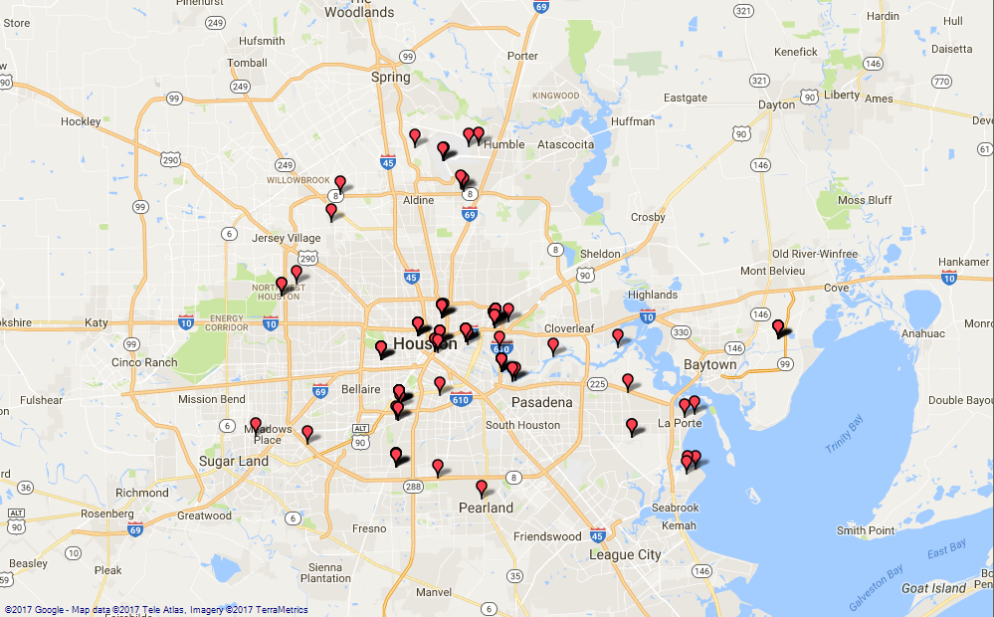
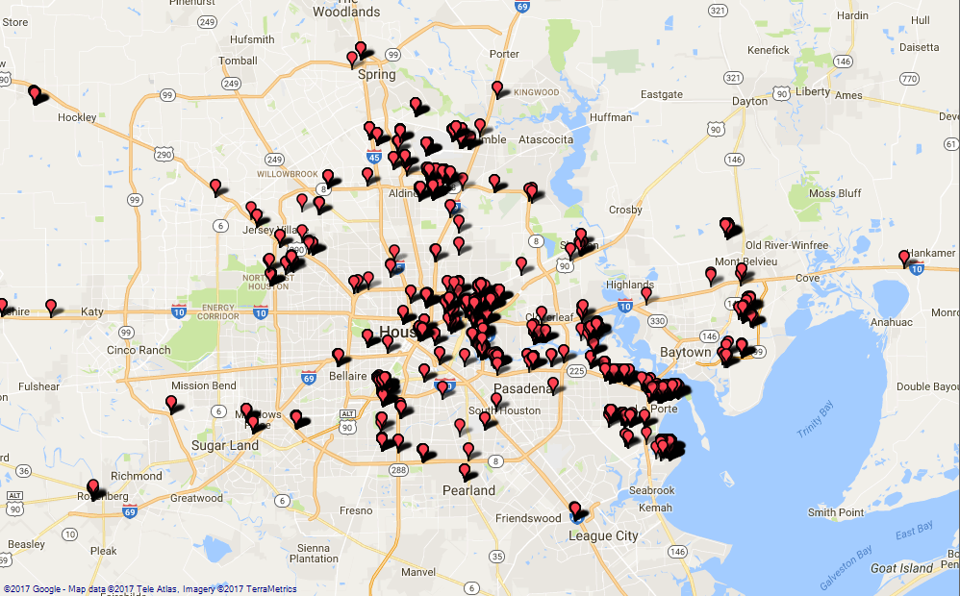
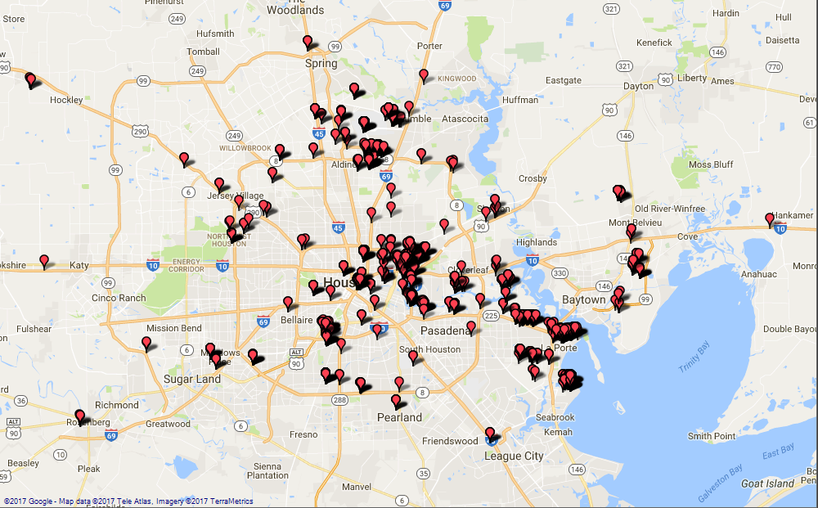
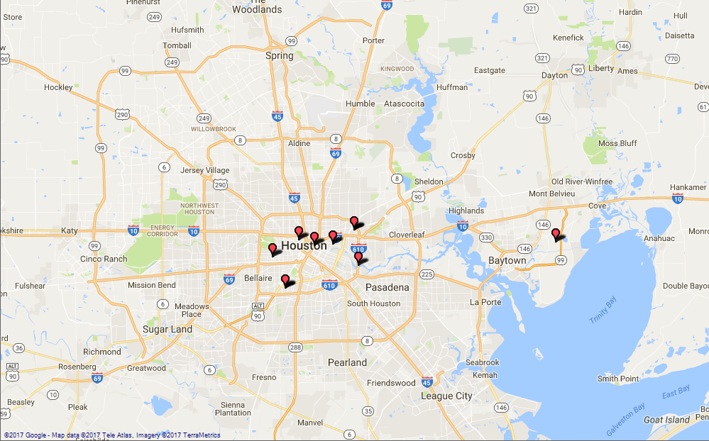
Using Real-World Data – HGAC
Idling
Locations
2+ Hours
1+ Hours
30+ Minutes
10+ Minutes
5+ Minutes

Slide 26
Using Real-World Data – HGAC
Idling Characteristics
Overall Idling
47%
Non-Port Idling
43%
Barbour's Cut
68%
Bayport
71%
Percent of Total Activities
16%
Port Activities
Percent of Idling Activities
24%

Slide 27
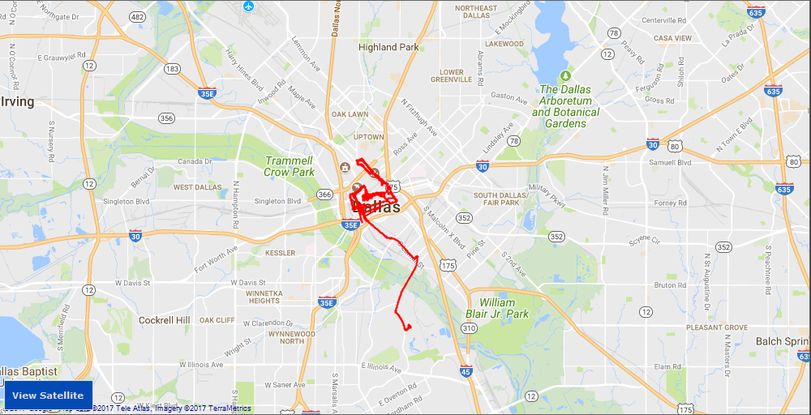
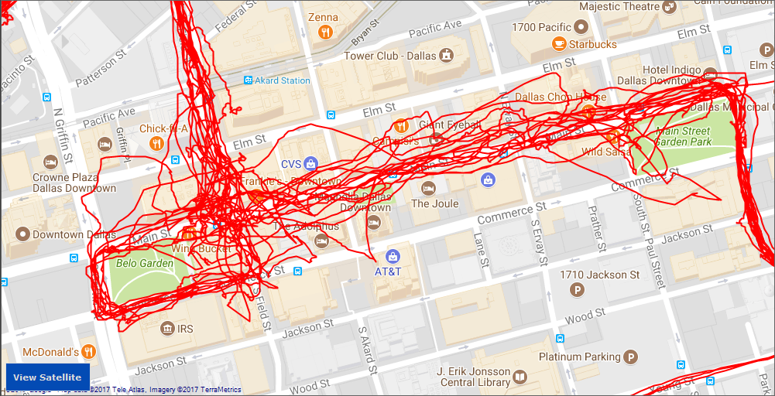
Using Real-World Data – QC
Real-World Data is useful, but careful consideration must be paid to the quality control of the data.
Initial View doesn’t show obvious problems
Closer View shows issues with GPS data

Slide 28
Using Real-World Data – QC
Conclusions
Real-World data is important for better understanding what is happening.
Data must be put through quality control procedures to ensure that erroneous data is not included in analysis.
TTI and others continue to develop tools and methodologies to assist in the collection and analysis of the real-world data.
TTI continues to work with partners and continues to pursue new partnerships to gather data and address new and future research questions.

Slide 29

Conclusions
Questions/Contact
Thank You
Jeremy Johnson
Texas A&M Transportation Institute
J-Johnson@tti.tamu.edu
979-862-7253

