Slide 1
Cummins Westport’s
Next Generation Natural Gas Engines - Move to Zero
November, 2017

Slide 2
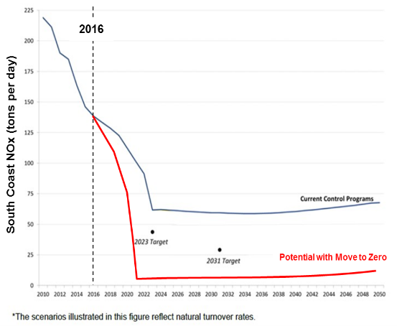
Move to Zero ..remembering why we did this
Air quality goals
Mobile sources key
Not just California
Heavy Duty Vehicles
Move Now with NG !!
Notes:
Bunch of HD vehicles like trucks and buses in the country and always will be… ARB and EPA says these are primary contributor to missing air quality goals (despite good progress)
Since my presentation last year, our technology has moved off the drawing board and into production
Wanted to review a slide from last year on why we began this journey
We found in technology development that we have the ability to help our customers and air quality districts across the country hit Federal Clear Air attainment goals with mature and affordable technology right now.
In 2018, the only CWI engines in production will be compliant to new ODB standards and also have the new ultra-low NOx emission levels
So from 2018 onward, any incremental move to NG will be a move to Zero emissions
We are doing what we can to transform and move the existing NG market and create a value package that has preference against other alternatives
Incremental movement to Zero beyond what we can affect would require incremental industry regulations and incentives… moving from help with development and demonstration to help with implementation and deployment.
In our view, the time for experimenting and testing is over – it’s time to move; time for action
Mobile Sources

Slide 3
2018
Environmental Leadership
Lowest NOx
90% Below EPA Standard
Move
to
Zero
Energy Security
Domestic Fuel
Renewable
RNG = Sub-zero carbon intensity
Economic Advantage
Mature
Affordable,
Ready Now

Slide 4
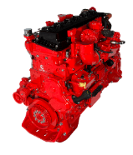
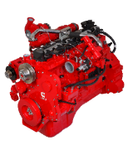
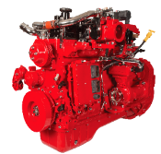

Introducing CWI 2018 North American Products
New Product Names
EPA/ARB Ultra Low emissions certification
Lowest Emission MR and HD engines in North America
On-Board Diagnostics (OBD) applied for optimal emissions system performance

Slide 5
2018 Changes
Emission Certification | EPA/CARB Near Zero (NZ) 0.02 g NOx | EPA/CARB Near Zero (NZ) 0.02 g NOx | EPA/CARB Optional Low NOx 0.1 g NOx
NOx Reduction to 2017 EPA | 90% | 90% | 50%
OBD | YES | YES | YES
CCV | YES | YES | YES
TWC | Same size as ‘17 ISL G NZ One piece design Mid bed O2/Temp Sensor OEM Harness | Increase in size (TBA) One piece design Mid bed O2/Temp Sensor OEM Harness | Same size as ‘17 ISB6.7 G One piece design Mid bed O2/Temp Sensor OEM Harness
Product Changes | Steel Pistons New Liners Improved Ring Pack New Valve Seat Material New Oil Cooler Improved Piston Cooling Additional crankcase pressure sensor New CM2380 ECM 500 kbaud datalink New wiring harness New Ignition Control Module | New fuel system improves performance and reduces parts content On-engine electric CCV filter with 2 CCP sensors CM2380 ECM 500 kbaud datalink New wiring harness New 2380 ICM | Additional crankcase pressure sensor New CM2380 ECM 500 kbaud datalink New wiring harness New Ignition Control Module

Slide 6
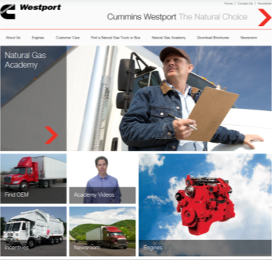
Move to Zero - check out our website for more
Product details
Instructional videos and engine walk arounds
Tips on operating a NG fleet
Fuel quality calculator
NG Playbook
GHG calculator
www.cumminswestport.com
Notes:
Thanks everyone for your time and attention today
Hope you enjoy the rest of this session and lunch as well as the rest of the Expo

