Slide 1
TECHNOLOGY AND TRANSPORTATION: How GPS Assists in Operational Efficiencies
Kyle Kristynik
President, Jetco Delivery
November 14, 2017
Houston, Texas

Slide 2
GPS: The Benefits
Allows us to:
Proof of wait-time/detention charges.
Know how fast a truck is traveling and how much idle time, thus helping the conservation of fuel

Slide 3
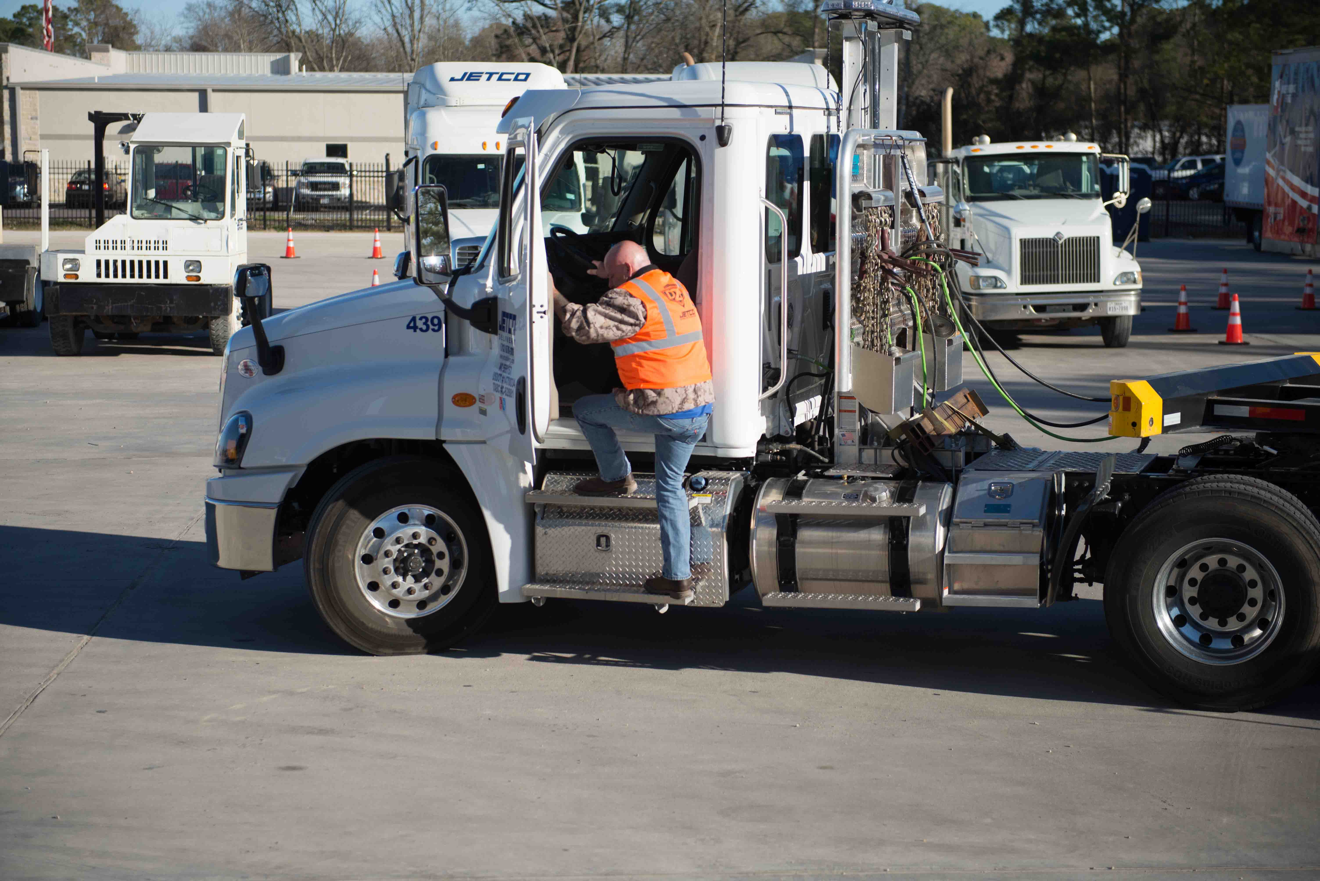
GPS: The Benefits
Allows us to:
Know if truck is functioning properly based on ECM data
Promote the safety of our drivers and the public

Slide 4
GPS: The Benefits
Allows us to:
Create and maintain fuel efficient routes
Collect statistical data of engine running hours rather than mileage on the engine

Slide 5
THANK YOU!
Kyle Kristynik
President, Jetco Delivery
713.676.1111
kkristynik@jetcodelivery.com
jetcodelivery.com

