Slide 1
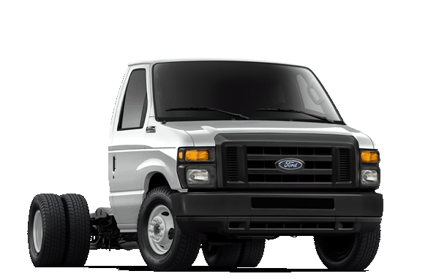
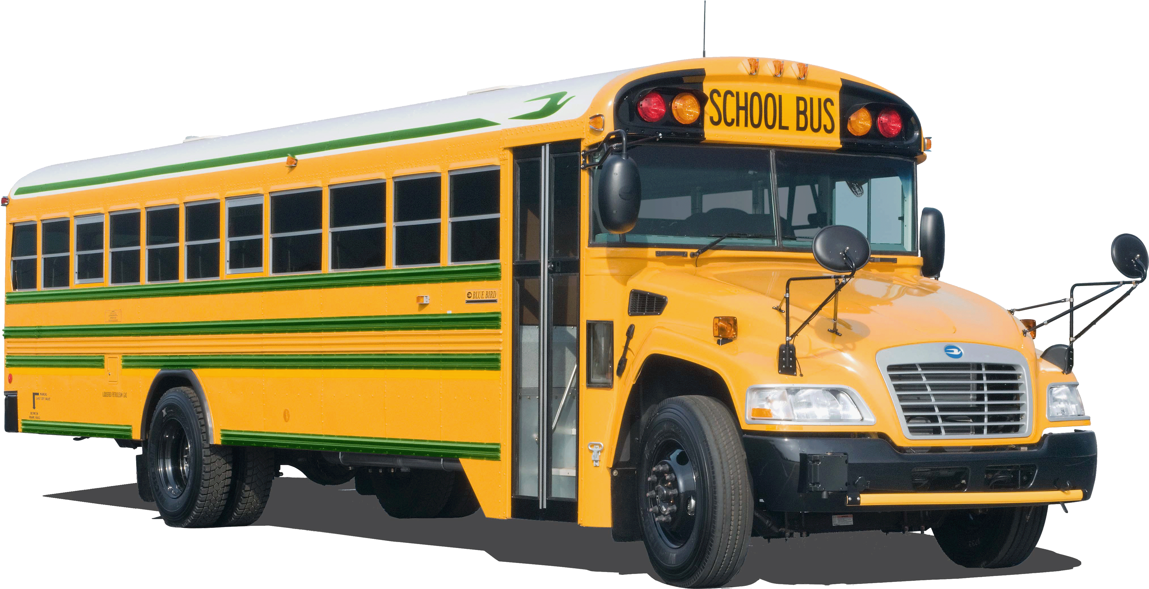
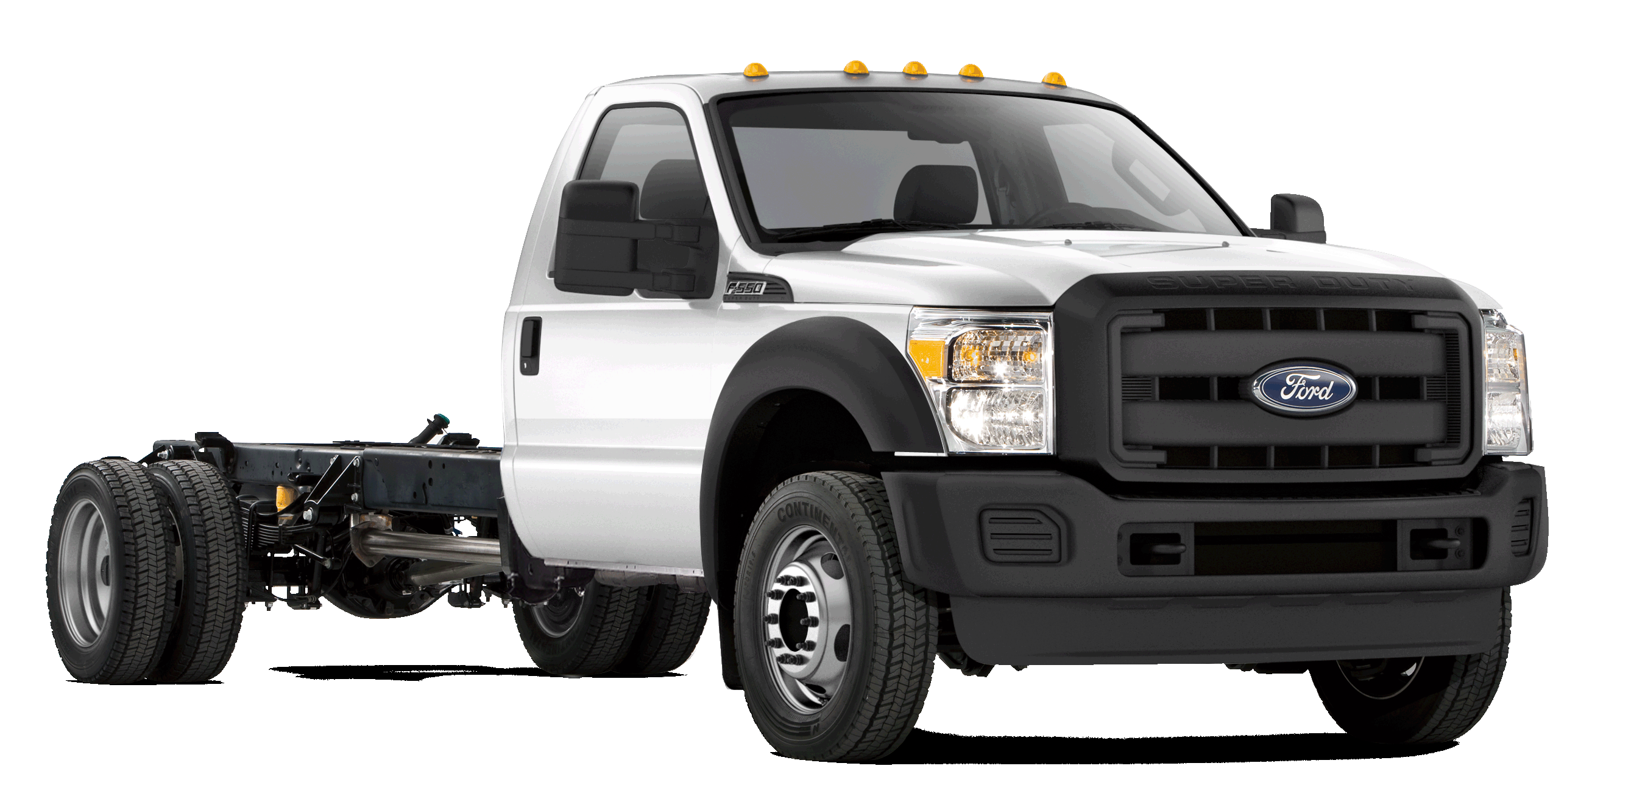
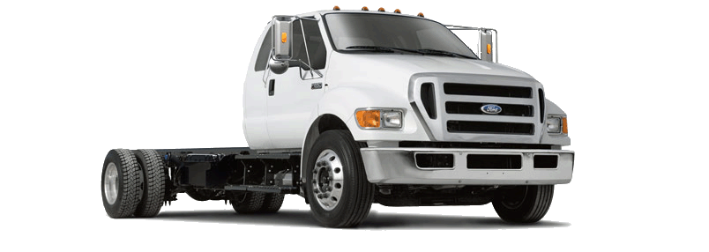
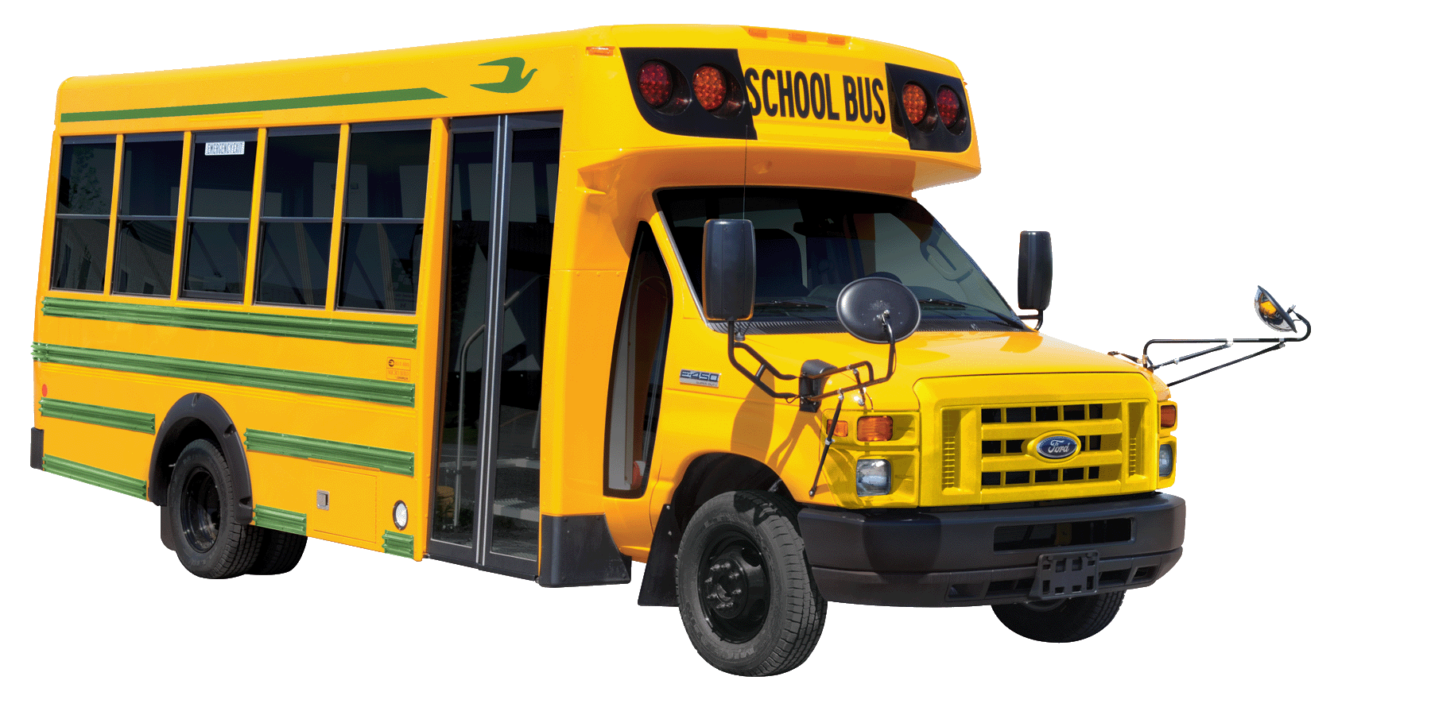
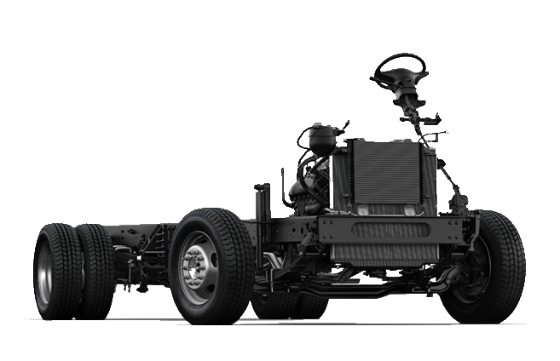
Near-Zero Emission
Propane Autogas Engines

Slide 2
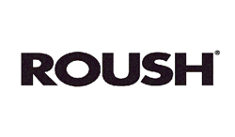

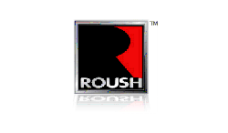

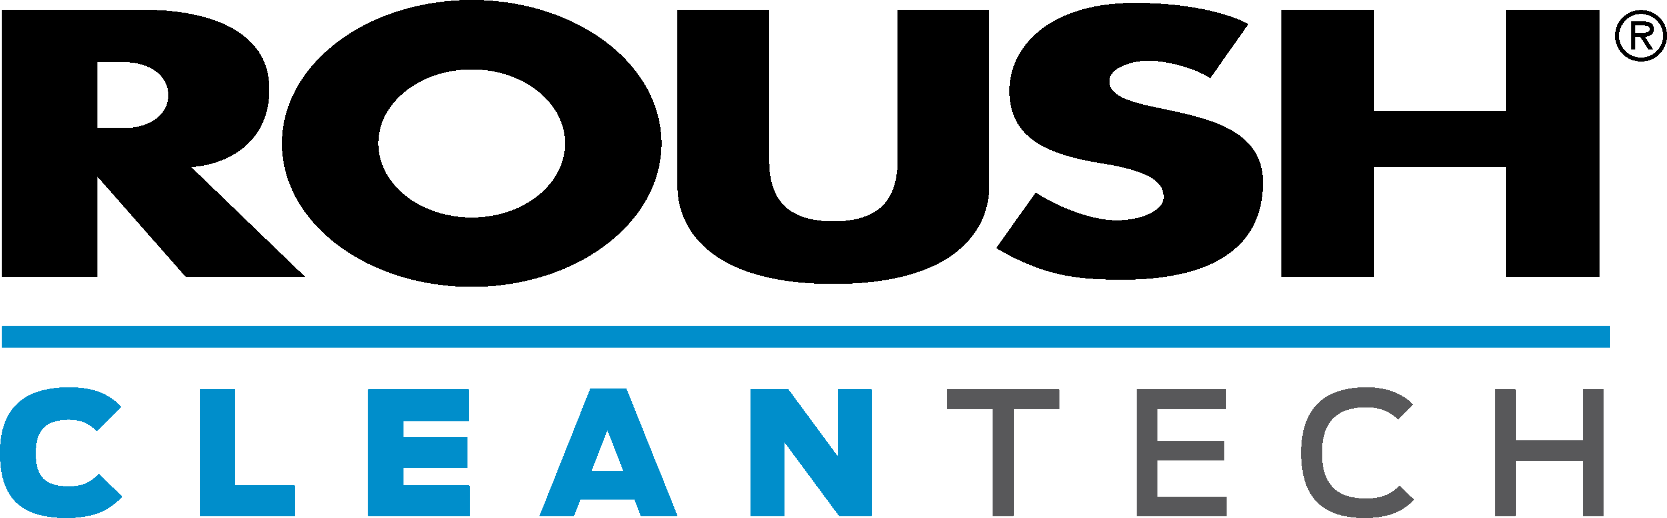
Enterprise Brand Portfolio
ROUSH Industries
OEM manufacturing, engineering, prototyping and design
Roush Fenway Racing
NASCAR racing team(s)
ROUSH Performance
Industry leading high performance vehicles
ROUSH CleanTech
Propane autogas powered commercial vehicles.

Slide 3
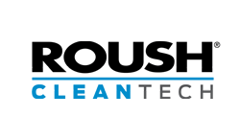
ROUSH CleanTech
  Founded in 2010.
  Dedicated to developing quality alternative fuel solutions.
  Propane autogas focus.
  EPA and CARB certification.
  Platform customization to suit customer needs.
  Reduces operating costs, carbon footprint.
  OEM support through Ford and BPN dealers.
  Creating opportunities for partner companies.
  Using American fuel and American technology.

Slide 4
Units in Operation

Slide 5

Our Scorecard
ACCUMULATED OVER
OVER
OVER
17,500
430
720
VEHICLES ON THE ROAD
MILLION MILES
SCHOOL DISTRICTS

Slide 6
Why The Hockey Stick?
Reliable Technology & Robust Service Program
Strong OEM Partners/Ford & Blue Bird
1,000 Customers & 400 Million Miles of Data
Low Cost Infrastructure
Plentiful Fuel
Emerging Low NOx Certifications
Easy to Scale

Slide 7
Propane Autogas Product Lineup
Medium duty Ford trucks, chassis cabs, cutaways, and stripped chassis; and Blue Bird Type A and C school bus.
Factory Ford warranty maintained.
No loss of HP / torque / towing capacity.
Serviceable with existing diagnostic equipment.
EPA & CARB Certified.
Ford F-53 / F-59
Ford E-450
Ford F-450/550
Ford F-650/750
Blue Bird Vision
Micro Bird G5

Slide 8
Ultra Low
NOX EMISSIONS

Slide 9
Drive for Reduced NOx
ARB is encouraging all Manufacturers of Record (MORs) to overachieve on the NOx standard to support smog reduction.
ARB has issued alternative standards at 0.1, 0.05 and 0.02g/bhp-hr for NOx.
The recent VW settlement also includes funding that supports NOx reductions across all 50 states that off sets the increase in NOx caused by their diesel emissions.

Slide 10
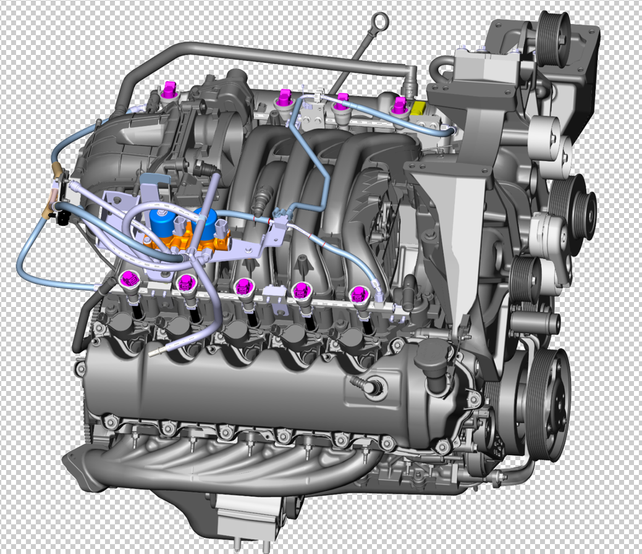
Production Powertrain
Achievement of Ultra Low NOx starts with a high quality production engine
At ROUSH CleanTech, we start with:
Ford 6.8L V10 3V Spark Ignition
Used by Ford in all HD Vehicle applications
  F 450/550 Chassis Cab
  F 650/750 Chassis Cab
  F 53/59 Stripped Chassis
320 HP/460 Lbs. Ft
Close to 2 Million in operation
Started production in 1997
For gasoline, meets or exceeds all emissions standards presently through 2017.

Slide 11
RCT Status of Low NOx
June 7th 2017 ROUSH CleanTech announces achievement of very low NOx with the 6.8L V10 Engine.
For the 2017 MY RCT LPG Blue Bird Buses and applicable Ford Truck upfits are now certified to 0.05 g/bhp-hr NOx.
This is achieved with no extra hardware or increased variable cost.
CO CO2 NOx NMHC
Full Useful Life STD 14.4 627 0.05 0.140
Actual Cert Level 2.7 614 0.03 0.04
The low NOx levels were achieved through careful, significant calibration changes and a CSSR (cold start spark retard) approach.

Slide 12
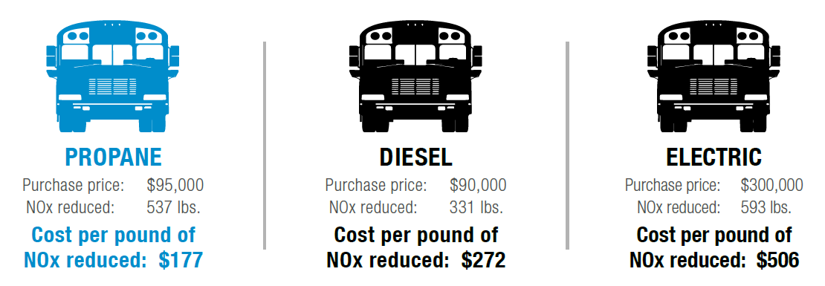
Cost Effectiveness

Slide 13
Student transportation

Slide 14
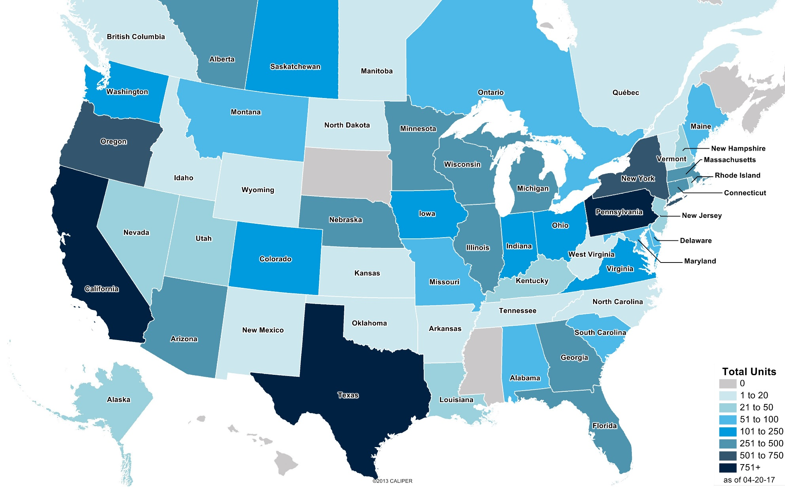
Propane School Bus Deployments

Slide 15
A Growing Trend
OVER
OVER
10,000
720
SCHOOL BUSES
SCHOOL DISTRICTS

Slide 16
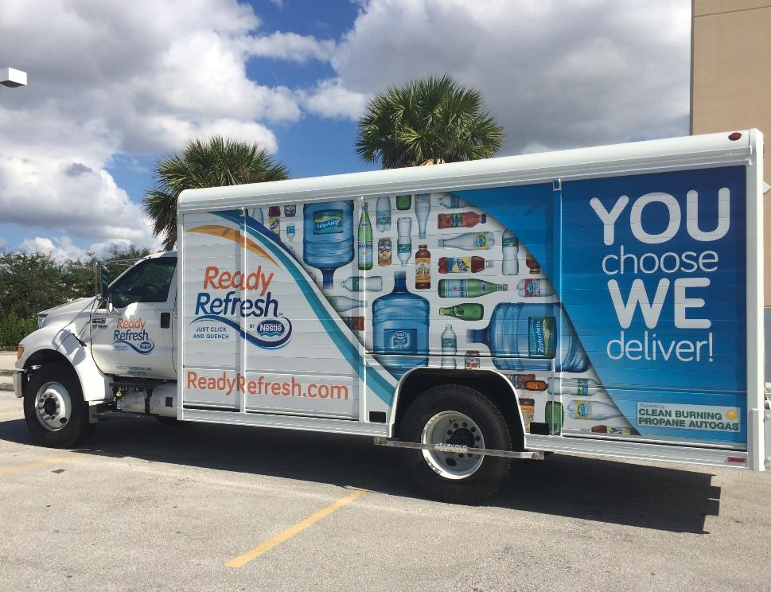
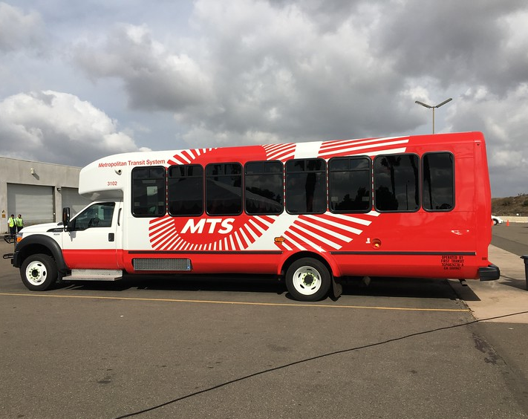
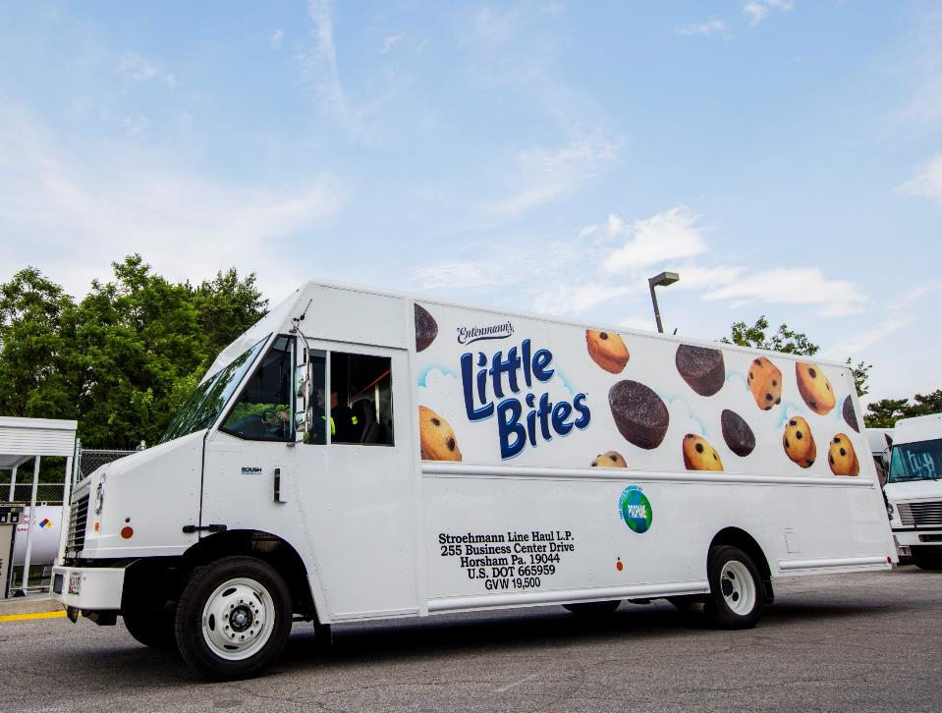
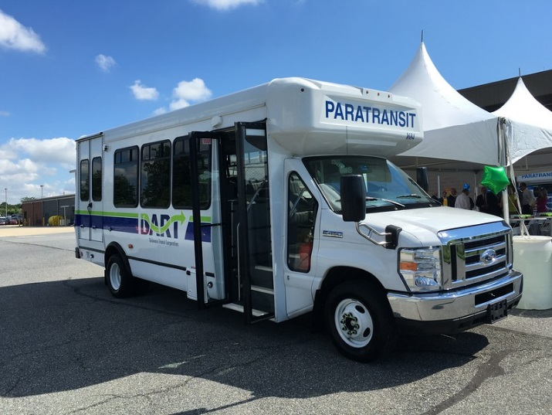
Other Markets..
Food & Beverage
Para Transit

Slide 17
Thank you
800.59.ROUSH
ROUSHcleantech.com
Joe Rudolph
Director, Business Development
317.407.8696
joe.rudolph@roush.com

