Slide 1
Clean Vehicles Program

Slide 2
Clean Vehicles and Drayage Truck Programs
Heavy-Duty Diesel Truck Replacements
School Bus Replacements
Alternative Fuel Refueling Stations
Non-Road Engine Replacements(limited basis)
Low Interest Truck Loan

Slide 3
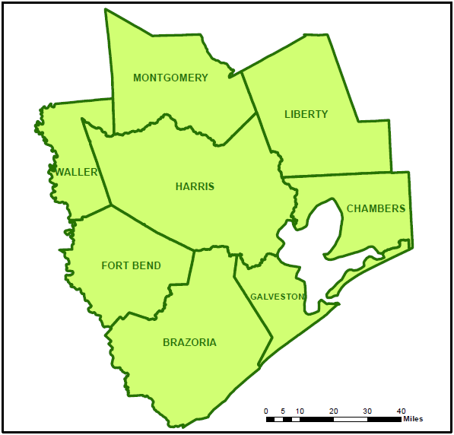
8 County Non-Attainment Region

Slide 4
Available Funding

Slide 5
Any Questions?
Contact: Robert Veazie
Manager
832-681-2578
CleanVehicles@h-gac.com

