Slide 1
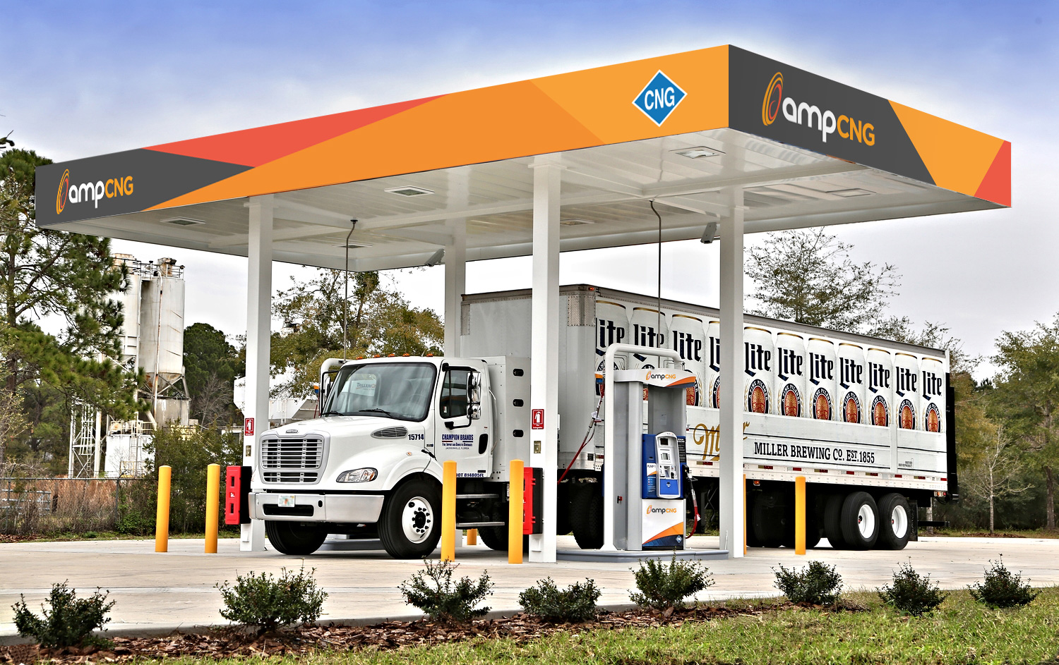
wered by
CNG and RNG Transportation Fuel Opportunities - - November 2017

Slide 2
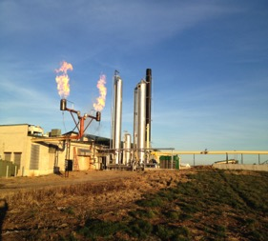
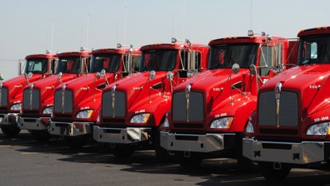
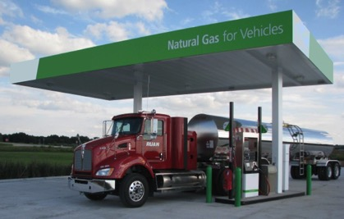
Where we Started
Running 20,000+ miles a day on CNG delivering milk through the Midwest
Built two CNG fueling stations for trucks—fueling
200K+ DGE’s a month
On-farm anaerobic digester provides 1.5M DGE of gas a year to station.
Fleet of 42 long-range CNG trucks—one of the largest CNG fleets in the US
Project can source gas from local utility when renewable is not available.
First agriculture-based CNG projects to be registered with the US EPA’s Renewable Fuel Standard.

Slide 3
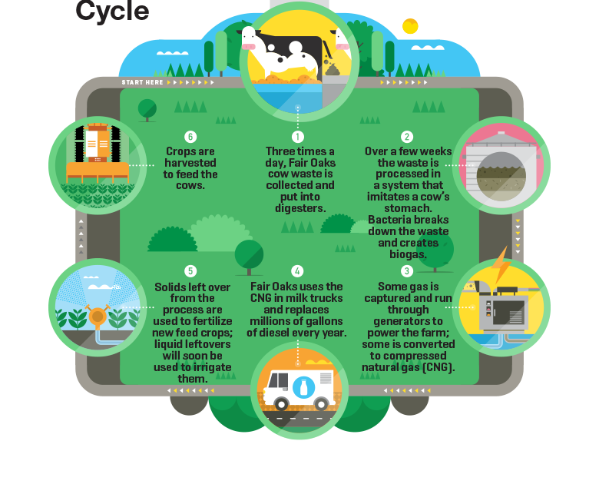
Renewable Dairy Fuels
ampCNG’s project at Fair Oaks Farm is in partnership with one of the largest dairy farms nationwide. We transform manure from 15,000 cows into 1.5 million DGEs of bio-CNG per year.
Source: Fortune Magazine February 1, 2016

Slide 4
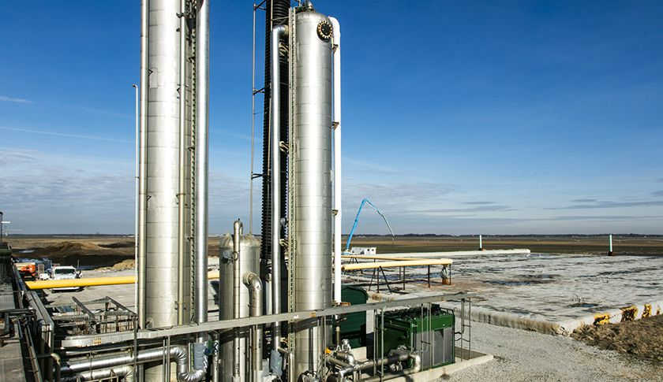
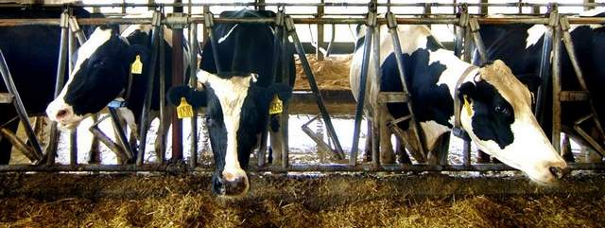
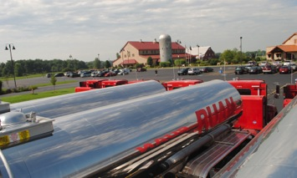
Why CNG?
CNG is much cleaner than burning diesel. Improves
CO2 20-25%
NOx 35-90%
particulate-matter 67-94%
ampCNG Renewable Natural Gas (RNG) provides over 100% lower GHG emissions vs diesel
With Cummins Near Zero engine and RNG, NOx emissions are comparable to Electric Vehicles
Whether CNG or RNG, this is an American Fuel that is inexpensive and stable in price long-term

Slide 5
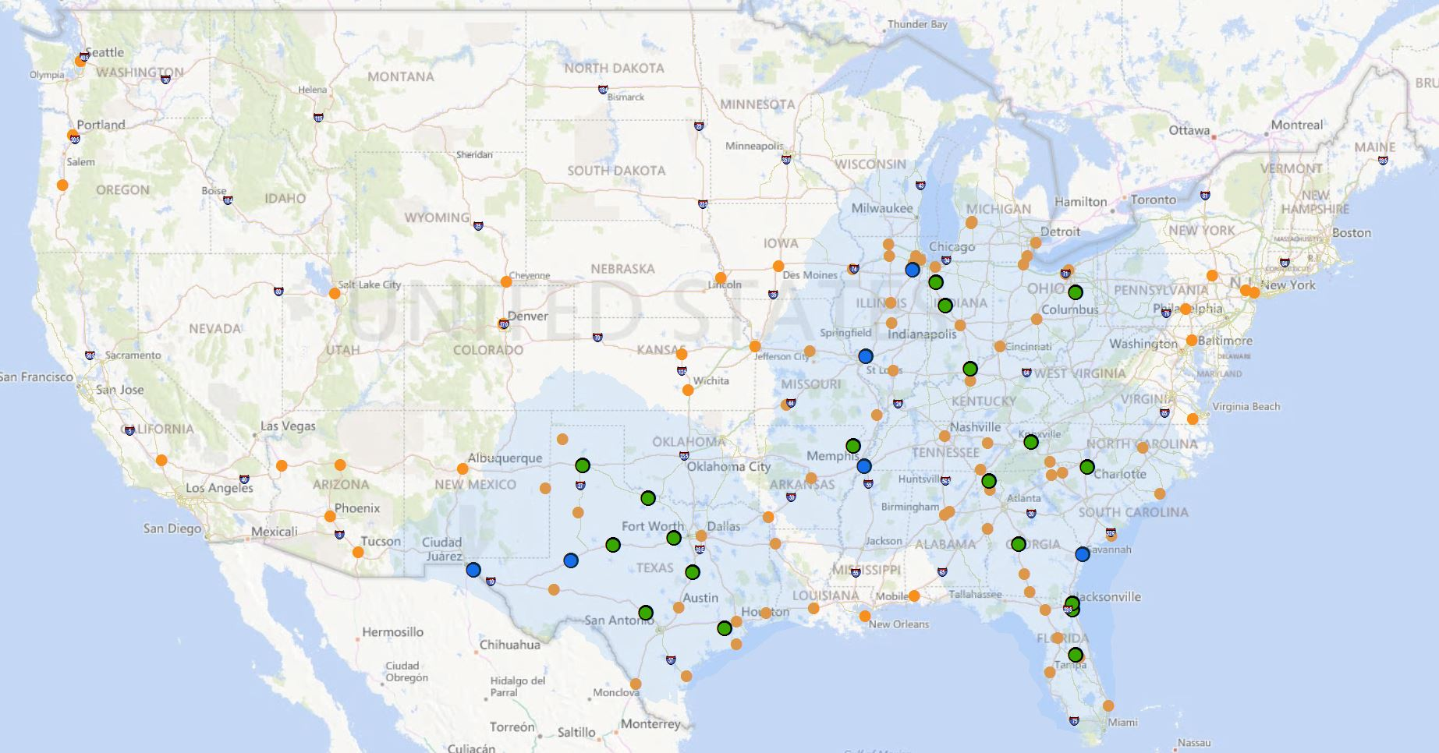
Our Network
ampCNG is building a national network of Heavy Duty public access, ultra fast-fill CNG fueling stations to fuel the future of trucking in the US.
Station Status
Open (19)
In Development (6)
Future Station

Slide 6
Evaluating Fuel Sustainability
Carbon Intensity Score for Green House Gases
Cost Effective NO_{X} Reductions
Available, Proven Technologies

Slide 7
Heavy-Duty trucks a key area of focus given relative contribution to emissions
Transportation sector a leading source of GHG emissions
While HD trucks total <1% of vehicles on the road…
… they are responsible for ~23% of GHG emissions
Residential
Motorcycles
Commercial
Trucks
4%
Other
2%
Ships
Commercial
Rail
Aircraft
Agriculture
Automobiles
21%
Industry
Medium & Heavy-Duty Trucks
27%
Transportation
Pickups, Vans, SUVs & Public-sector Trucks
Light-Duty Vehicles
29%
Electricity
2015 GHG Emissions by Sector
2015 Count of Vehicles by Type
2015 Emissions by Vehicle Type
Source: EPA (https://www.epa.gov/greenvehicles/fast-facts-transportation-greenhouse-gas-emissions); FHWA

Slide 8
Carbon Intensity Score
Measures greenhouse gas (GHG) emissions
Takes into account the entire well-to-wheels GHG emissions impact of a fuel pathway
Measured in grams of CO2 equivalent per megajoule of energy consumed
Based on Department of Energy’s Argonne National Lab studies and methodology
Discrete Components of Crude to ULSD Pathway
Carbon Intensity
(gCO2e/MJ)
CRUDE RECOVERY
12.71
CRUDE TRANSPORTATION
AND STORAGE
CRUDE REFINING TO ULSD
14.90
ULSD TRANSPORTATION
AND STORAGE
0.35
TAILPIPE EMISSIONS
70.48
98.44
Source: Department of Energy Argonne National Lab, California Environmental Protection Agency Air Resources Board (ARB),
ampCNG analysis
Notes:
For Carbon Intensity breakout. See Table A-1 (page 8):
https://www.arb.ca.gov/fuels/lcfs/121514ulsd.pdf
NOTE: Took the difference between 2011 Diesel CI score (102.82) and 2017 Diesel Baseline CI (98.44) from the Tailpipe Emissions Carbon Intensity, so that the Diesel numbers for slide 3, 4 amd 7 matched.

Slide 9
A Bad Current State: Diesel
CI Score: 98
Source: Department of Energy Argonne National Lab, California ARB

Slide 10
Good: Renewable Electric
CI Score: 0
Source: Department of Energy Argonne National Lab, California ARB

Slide 11
Great: Renewable Natural Gas
CI Score: -255
Source: Department of Energy Argonne National Lab, California ARB

Slide 12
Impact of GHG Reduction
180 MT GHG emissions per year
0 MT GHG emission per year
-512 MT GHG emissions per year
RNG
0 cars
26 cars
154 cars
Source: California ARB, United States Environmental Protection Agency (EPA), ampCNG analysis

Slide 13
Carbon Intensity Scores
Source: Department of Energy Argonne National Lab, California ARB

Slide 14
NO_{X} Emissions Are Dangerous
NO_{X} is a primary cause of smog, responsible for its ugly brown color
Heavy-duty diesel trucks cause 26% of NO_{X} emission nationwide
NO_{X} emissions react in the atmosphere to form ground-level ozone
Ground-level ozone impacts lung function leading to chronic obstruction pulmonary disease (COPD), exacerbation of asthma and premature death
Harris County ground-level ozone levels are above the National Air Ambient Quality Standard
“Haze” on Houston skyline is ground-level ozone
Source: EPA
Notes:
Sources:
Causal link asthma and NO2:
https://www.federalregister.gov/documents/2017/07/26/2017-15591/review-of-the-primary-national-ambient-air-quality-standards-for-oxides-of-nitrogen
Nonattainment Counties
https://www3.epa.gov/airquality/greenbook/ancl.html
Chicago image from:
https://cleancities.energy.gov/files/u/news_events/document/document_url/294/AFLEET_2017_Update_and_NOx_Emissions_Webinar-posting.pdf
Ground-level ozone health risks:
http://www.nejm.org/doi/full/10.1056/NEJMoa0803894

Slide 15
Cost Effective NO_{X} Reductions
 | Units | CNG/RNG | EV
Cost of Class-8 Truck | $ | 175,000 | 350,000
NOx Reduction | g/mile | 6.62 | 6.80
Cost of NOx Reduction | $/MT | 6,939 | 28,265
*As compared to baseline diesel truck cost of $120,000
Note: Prices are for new tractor trucks, assumes lifetime truck mileage of 1.2 million miles (100k miles per year over 12 year useful life), trucks are displacing emissions of a 2007-09 Engine Model Year diesel Heavy Duty over 33,000 lbs GVWR tractor truck
Source: ampCNG estimates for refuse truck prices, California EPA ARB

Slide 16
Available Proven Technologies
EV Class 8 Trucks will not be available for 3-5 years?
CNG/RNG Class 8 Trucks available today
One year delay with new clean diesel = 10 years of CNG/RNG NOX emissions
One year delay with 2007-2009 diesel = 39 years of CNG/RNG NOX emissions
Source: California ARB

Slide 17
Contact information
Steve Josephs, P.E.
Co-founder, Vice President of Engineering
SJosephs@ampCNG.com
(630) 235-9841

