Slide 1
UPS’s Path to Reduced Emissions
April 19, 2017
Robert Filosa West Region Automotive

Slide 5
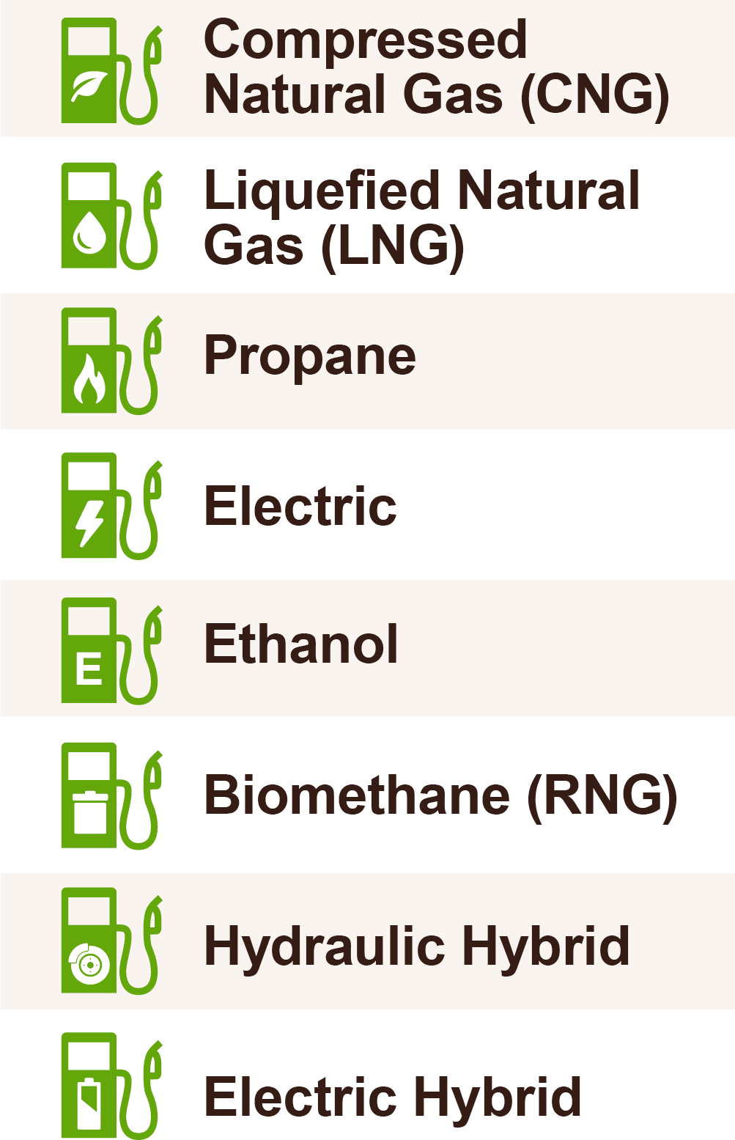
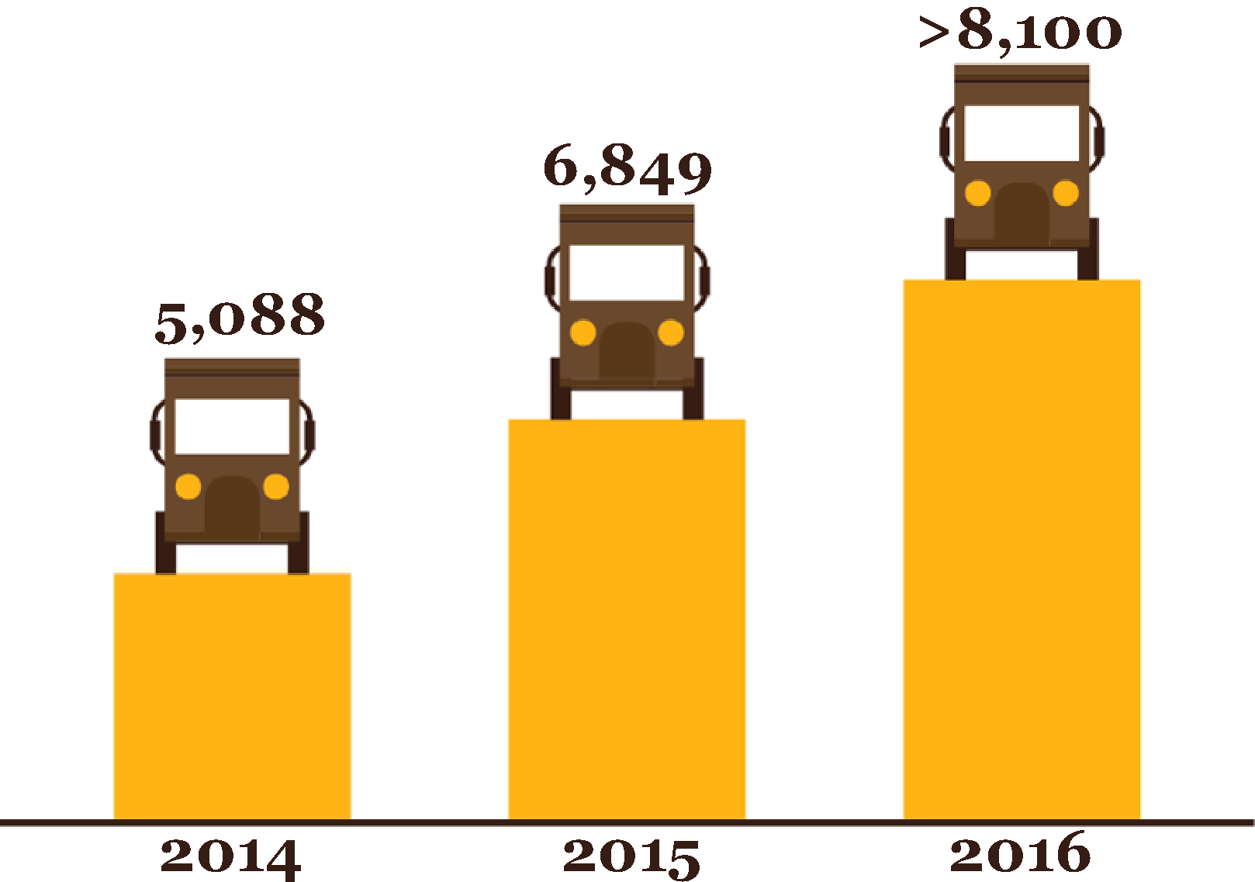
Alternative Fuel and Advanced Technology Fleet Continues to Grow
Today we have 8,594 units

Slide 7
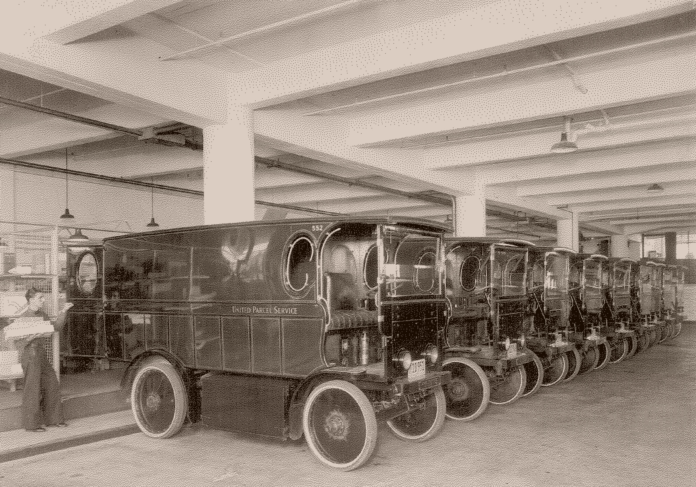
UPS Fleet of Plug-in Electric Package Cars
New York City, 1930’s

Slide 8
Global Alternative Fuel & Advanced Technology Vehicles
Total Vehicles (U.S. & International): 8,116
Fuel Type | U.S. |  |  |  | International
Hybrid Electric | 454 Package Cars |  |  |  | 10 Package Cars
Electric | 122 Package Cars |  |  |  | 135 Package Cars | 14 Electric Bikes
Propane | 1,172 Package Cars |  | 4 Shifters |  | 1,116 Package Cars | 14 Shifters
Biomethane |  |  |  |  | 19 Tractors
Composite Body Diesel | 398 Package Cars
Compressed Natural Gas | 1,790 Package Cars | 76 Shifters |  | 1,208 Tractors | 76 Package Cars
Liquid Natural Gas | 1,355 Tractors
Ethanol |  |  |  |  | 62 Package Cars
Hydraulic Hybrid | 91 Package Cars

Slide 9
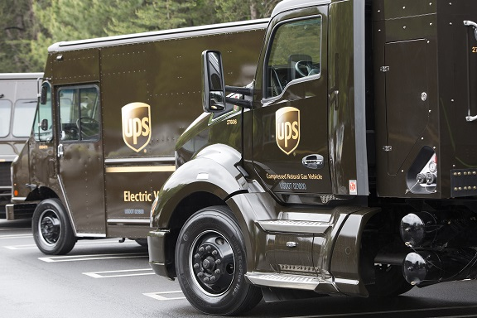
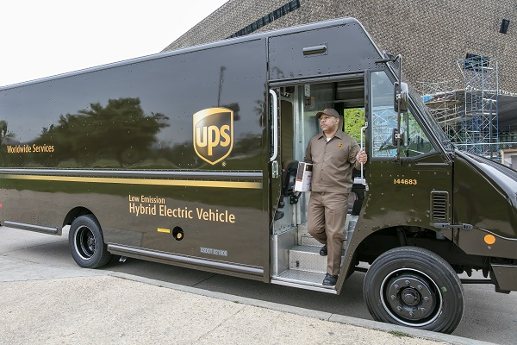
United States Alternative Fuel & Advanced Technology Vehicles
United States Total: 6,670
Fuel Type | Vehicle Specification
Electric Vehicles: 122 | P70E – 40 Package Cars P100E – 81 Package Cars P120E – 1 Package Car
Propane Vehicles: 1,176 | P63P – 149 Package Cars P80P –731 Package Cars P100P – 292 Package Cars HSP – 4 Shifters
Composite Body Diesel Vehicles: 398 | P63D – 398 Package Cars
Compressed Natural Gas (CNG) Vehicles: 3,074 | P70C – 149 Package Cars P80C – 305 Package Cars P100C – 1,335 Package Cars P120C – 1 Package Car | HSC/HSCV – 76 Shifters HTCT – 828 Tractors HTCTX – 380
Hybrid Electric Vehicles (HEV): 454 | P70H – 25 Package Cars P100H – 348 Package Cars PG10E – 81 Package Cars
Hydraulic Hybrid Vehicles (HHV): 91 | P10HH – 91 Package Cars
Liquid Natural Gas (LNG): 1,355 | HTLG – 687 Tractors HTLGT – 668 Tandem Tractors

Slide 10
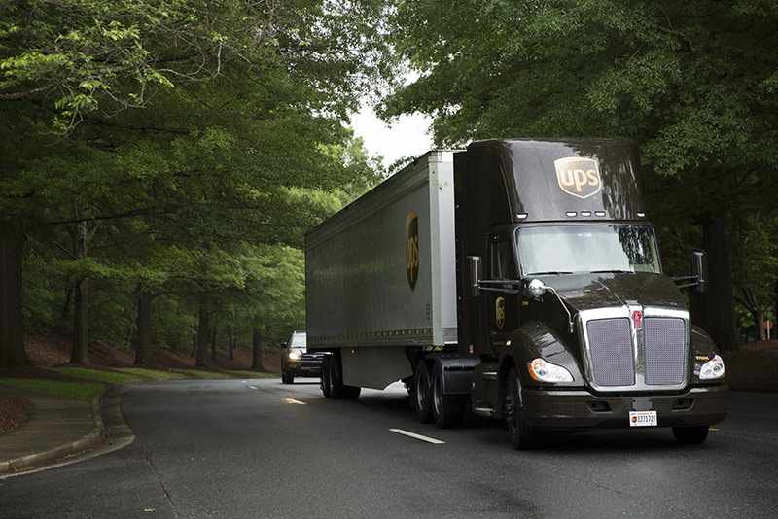
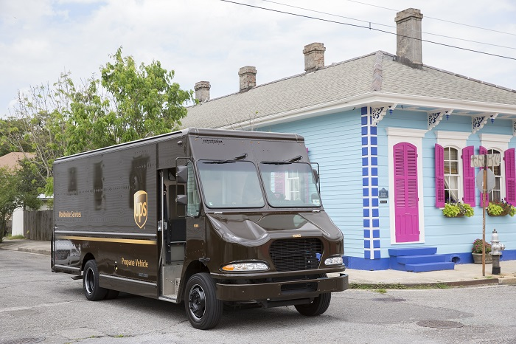
International Alternative Fuel & Advanced Technology Vehicles
International Total: 1,446
Region | Vehicle Specification
Europe: 235 | CNG – 66 Package Cars Biomethane – 19 Tractors Hybrid Electric – 3 Package Cars Electric – 134 Package Cars / 13 Electric Bikes
Asia Pacific: 14 | CNG – 10 Package Cars Hybrid Electric – 3 Package Cars Electric – 1 Electric Bike
Canada: 1,098 | Propane – 1,084 Package Cars / 14 Shifters
Latin America: 99 Vehicles | Ethanol – 62 Package Cars Propane – 32 Package Cars Electric – 1 Package Car Hybrid Electric – 4 Package Cars

Slide 11
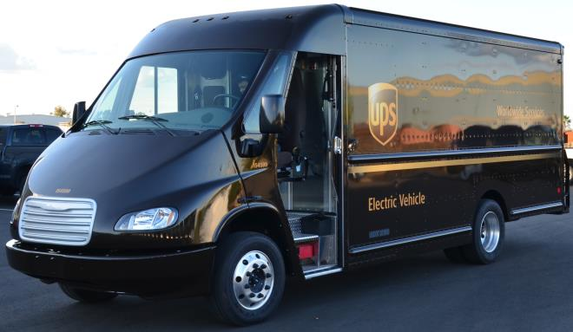
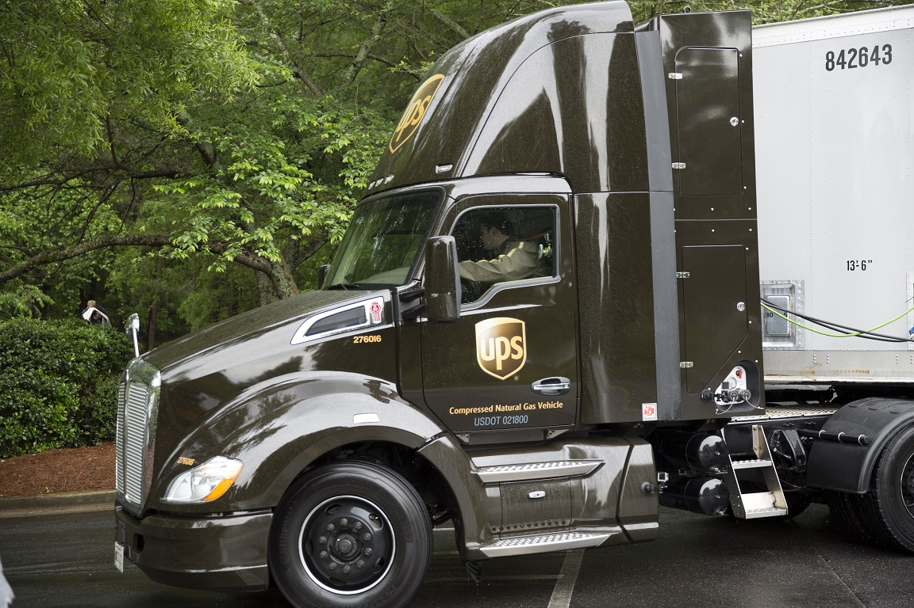
Global Alternative Fuel & Advanced Technology Vehicles
Total Vehicles (U.S. & international)
Region | Vehicle Specification
United States Fleet: 6,670 (7.1% of U.S. Small Package Fleet) | Compressed Natural Gas Vehicles – 3,074 Liquid Natural Gas Vehicles – 1,355 Hybrid Electric Vehicles – 454 Electric Vehicles – 122 Hydraulic Hybrid Vehicles – 91 Propane Vehicles – 1,176 Composite Body Diesel – 398
International Small Package Fleet: 1,446 (9.3% of International Small Package Fleet) | Propane Vehicles – 1,130 Compressed Natural Gas Vehicles – 76 Electric Vehicles – 135 E-Bikes – 14 Ethanol Vehicles – 62 Biomethane Vehicles – 19 Hybrid Electric Vehicles – 10

