Slide 1
Make a Bold Impact on Air Quality Today
Clear the Air – Transportation in the Port Region Summit
March 2, 2017

Slide 2
About NGVAmerica
NGVAmerica is a national organization dedicated to the development of a growing, profitable, and sustainable market for using more natural gas in transportation.
NGVAmerica represents 200+ companies, LDCs, fleets, OEMS, environmental and government organizations.

Slide 3
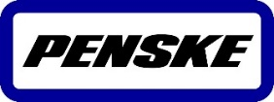
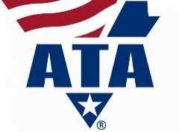
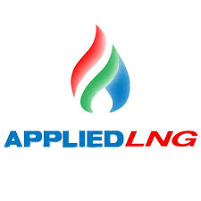
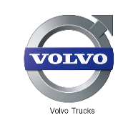
NGVAmerica Members

Slide 4
Federal Policy – Level Playing Field for NGVs
5-year extension of the fuel & infrastructure credits
Remove $30,000 cap on infrastructure credit
Adjust the 12% FET for HD natural gas trucks
Seek $15m for U.S. DOE NGV R&D in FY 2017
Seek $50m for deployment grants for Clean Cities
Equalize tax treatment of LNG used in marine/inland waterways
2,000 lb. Weight Exemption for NGVs
Phase II MD & HD Truck Standards

Slide 5
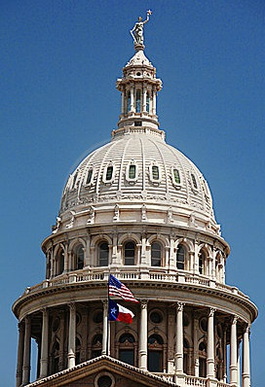
State policy putting more NGVs on the road...
What are states doing to do promote NGVs?
Vehicle purchase grants or tax incentives
Fuel station grants or tax incentives
Sales & use tax exemptions
Motor fuel tax preferential or equal treatment
HOV lane access
Method of sale GGE/DGE
Weight exemption/FAST Act implementation
Market participant

Slide 6
The Problem
Urban Emissions & Public Health

Slide 7
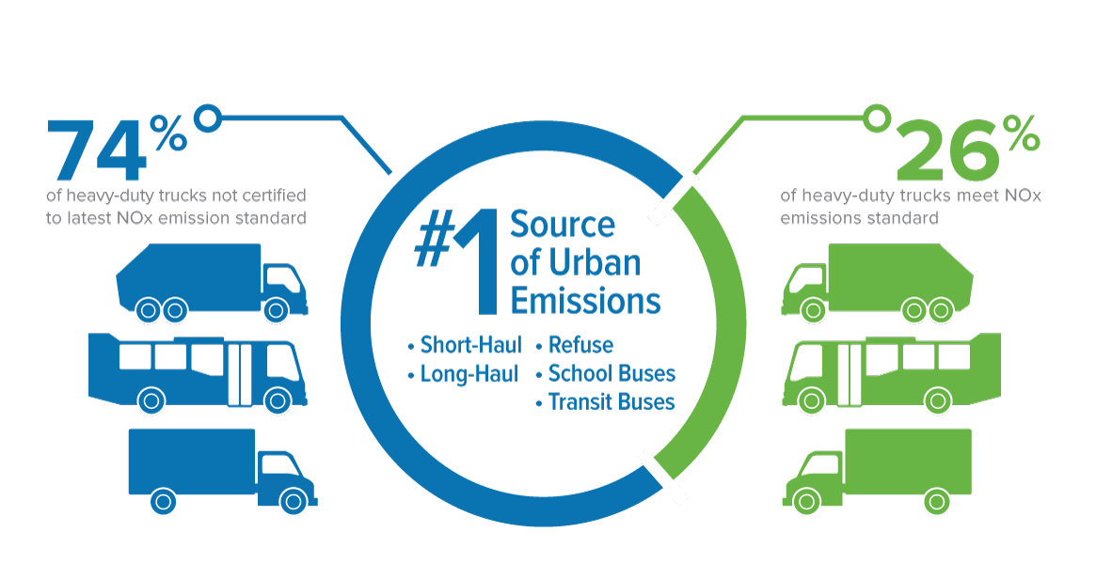
Urban Emissions: Leading Sources
Source: DTF Analysis on HIS Vehicles in Operation Data, December 2015
Notes:
Medium- and heavy-duty engines are the #1 source of toxic air contaminants and ozone-forming emissions of nitrogen oxides (NOx) in almost every single U.S. metropolitan region
3 out of 4 commercial vehicles on the road today do not meet the EPA’s current NOx emissions standards (0.2g NOx/bhp-hr)

Slide 8
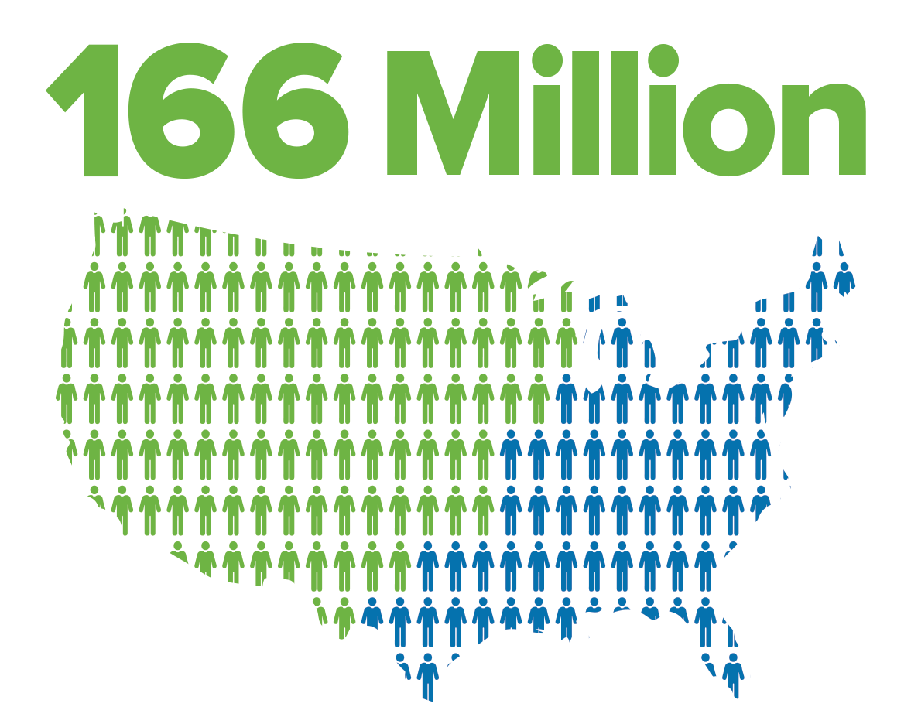
Urban Emissions: Public Health Impacts
Breathing in particle pollution increases the risk of:
Asthma
Lung Cancer
Heart Disease
Premature Death
≈ 50%
of Americans live in areas with air that is unhealthy to breathe
Source: American Lung Association's "State of the Air 2016"

Slide 9
The Solution
Natural Gas Vehicles: Sustainable, Responsible, Available

Slide 10
Advantages of Natural Gas as a Transportation Fuel
Abundant Domestic Availability, Widespread Distribution Infrastructure, Low Cost and Price Stability

Slide 11
North America has an abundant domestic supply of conventional natural gas
Source: U.S. Energy Information Administration, January 2017

Slide 12
North America has abundant sources of renewable natural gas that can be harnessed
Source: Coalition for Renewable Natural Gas, 2017

Slide 13
Source: Coalition for Renewable Natural Gas, 2017
Renewable natural gas production is steadily increasing to meet growing demand throughout the U.S.

Slide 14
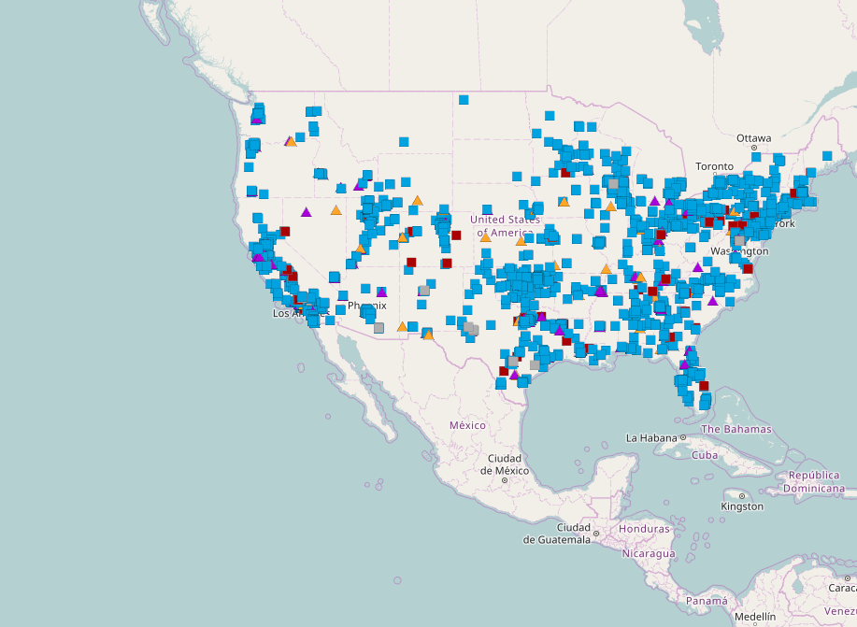
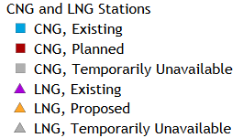
Natural gas fuel station infrastructure is continually expanding
≈2,000 Natural Gas Stations
More than doubled past 5 years
10-12+ new stations per month
Source: NGVAmerica, January 2017

Slide 15
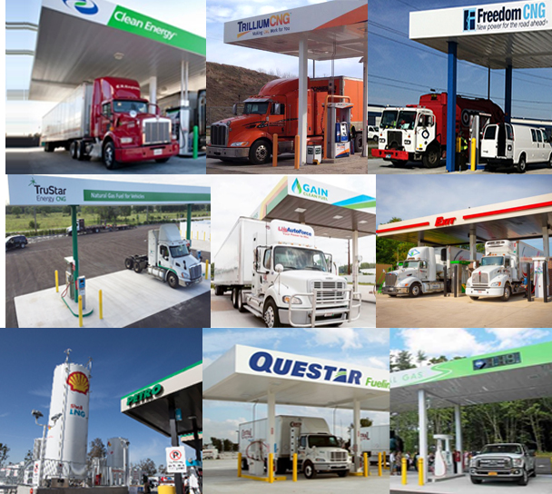
Diverse network of natural gas station developers
Natural gas retail fuel sellers
LDCs
C-Stores
Truck Stops
Grocery/Warehouse stores
Leasing companies
Gas exploration & production
Midstream pipeline

Slide 16
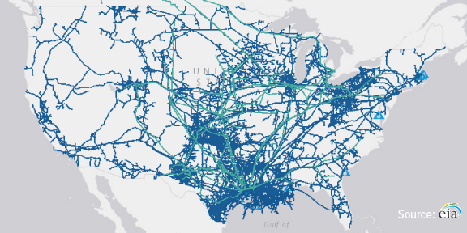
The U.S. natural gas pipeline system is well poised to support a national network of CNG and LNG fueling stations
2.5+ million miles of U.S. pipeline infrastructure

Slide 17
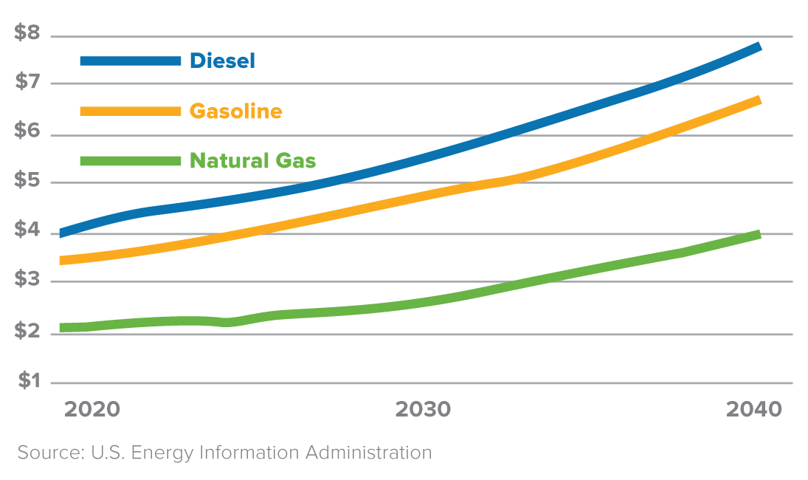
Projected Fuel-Price Differential (prices per $DGE)
Natural Gas Provides Long-Term Fuel Cost Savings
Natural Gas vs. Oil:
3:1 price advantage over oil on a Btu basis
Pump prices $0.75 to $1 lower than diesel

Slide 18
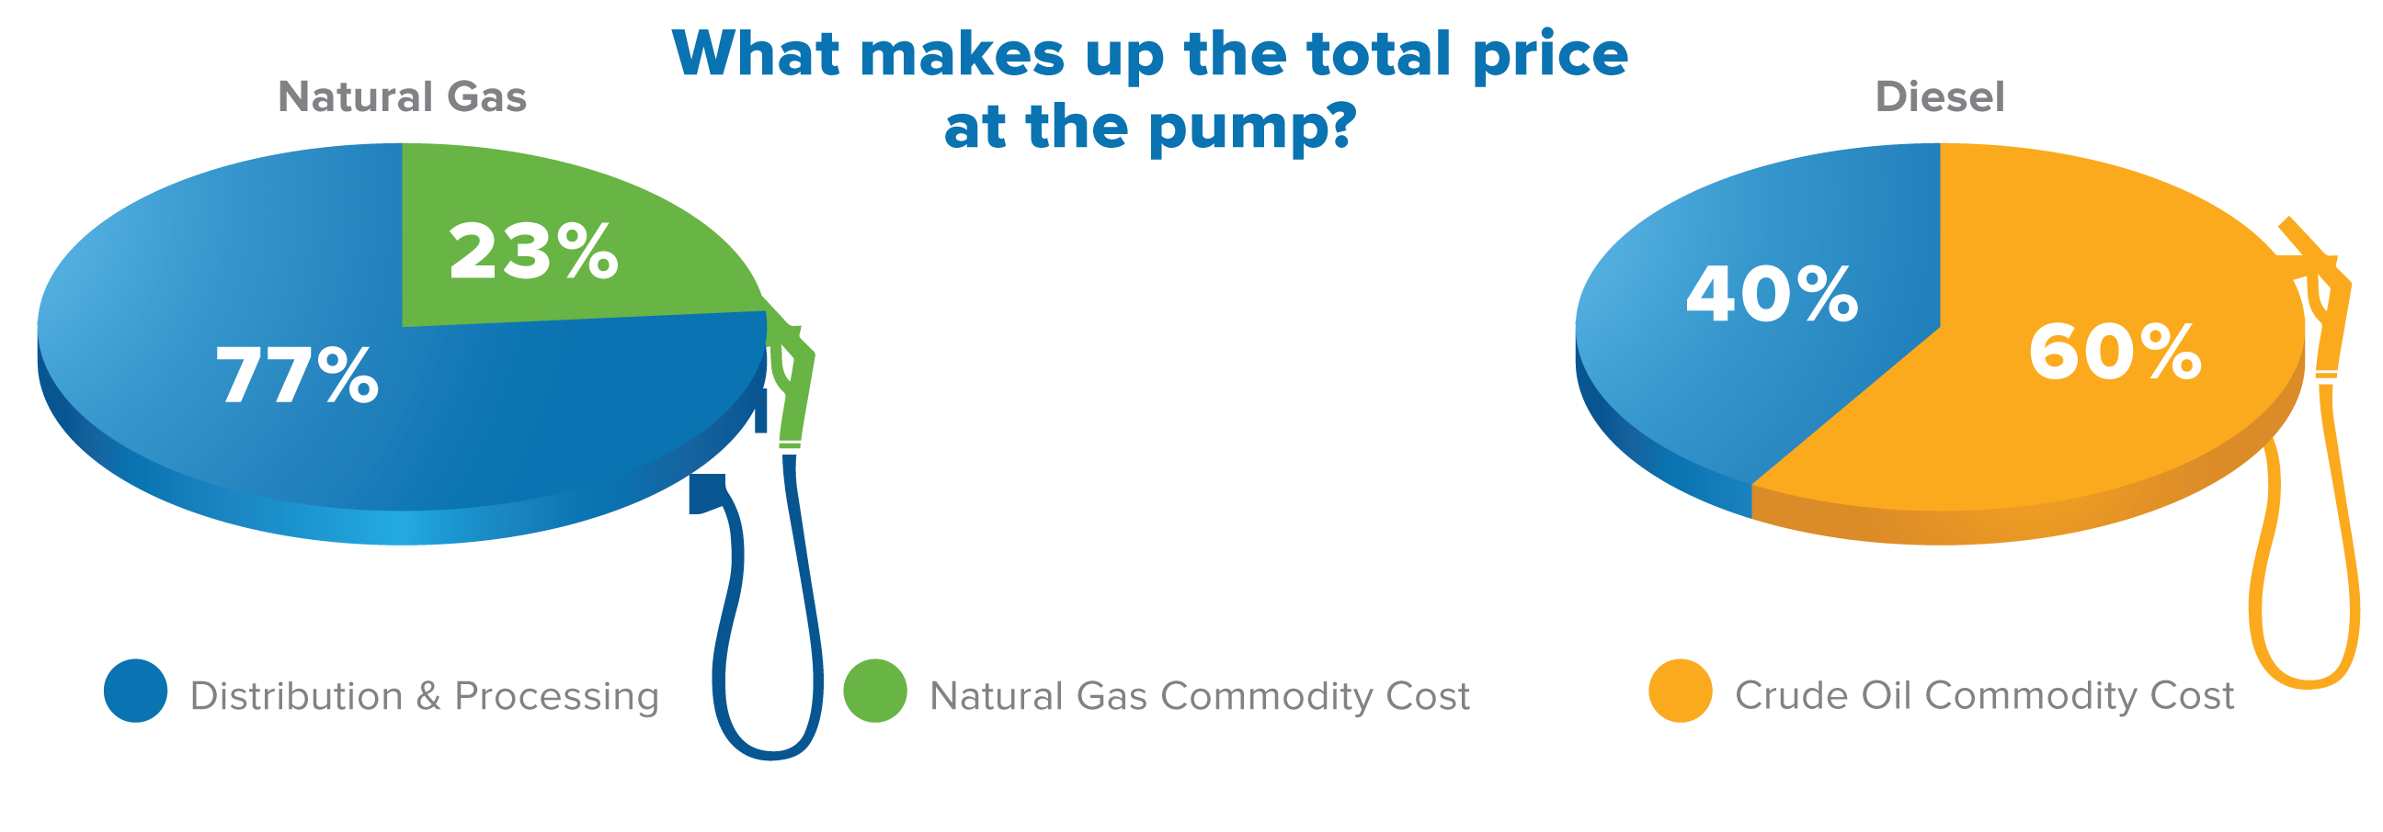
Natural Gas Provides Fuel Price Stability
Natural Gas:
Decades of affordable domestic reserves
Natural gas sourced from North America
Commodity cost makes up 23% of sales price
Diesel:
History of volatile price swings
Crude oil sourced fuel from high-conflict regions
Commodity cost makes up 60% of sales price

Slide 19
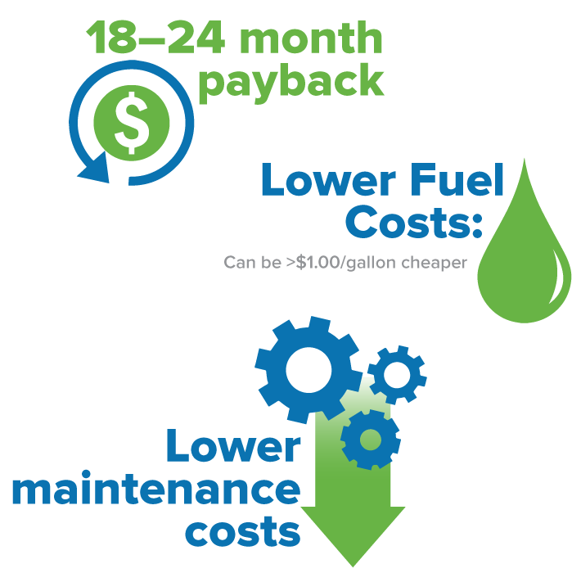
Depending on range and application, fleets can realize a pay back in as little as 18–24 months due to:
Lower fuel costs
Lower maintenance costs

Slide 20
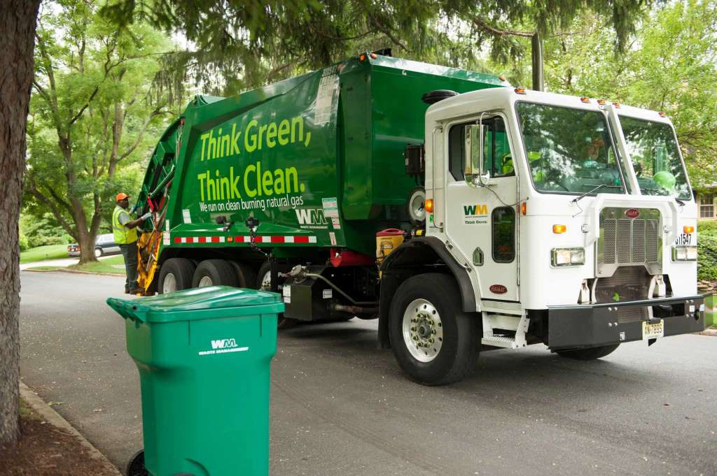
Natural gas vehicles significantly reduce noise pollution in the local community.

Slide 21
The Solution
Natural Gas Vehicles: Sustainable, Responsible, Available

Slide 22
Sustainable
NGVs Offer Unmatched Emission Reduction Benefits

Slide 23
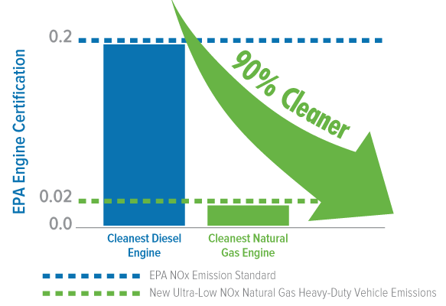
The cleanest heavy-duty truck engine in the world is powered by natural gas
- Certified in 2015 by the U.S. Environmental Protection Agency and California Air Resources Board
The Cummins Westport Ultra-Low NOx engine is certified to a 0.02 g/bhp-hr standard, which is:
90% cleaner than the EPA’s current NOx standard
90% cleaner than the latest available diesel engine
Notes:
Trucks with this engine have a similar emissions profile to that of a heavy-duty battery electric truck plugged into the California electrical grid.

Slide 24
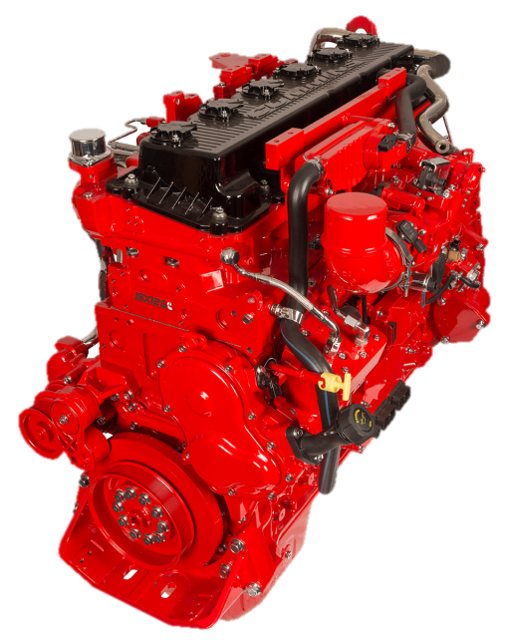
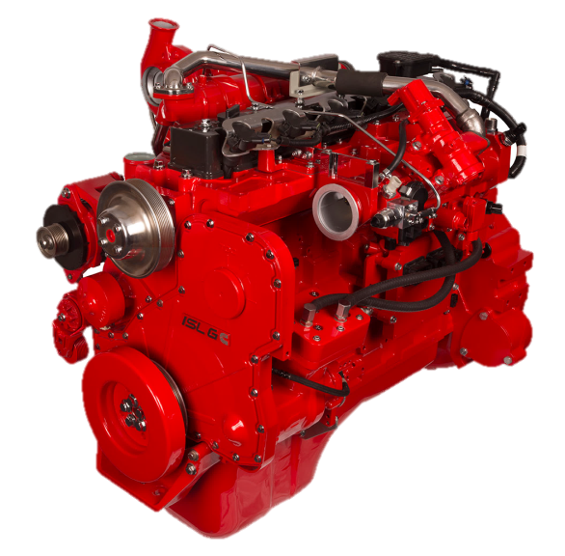
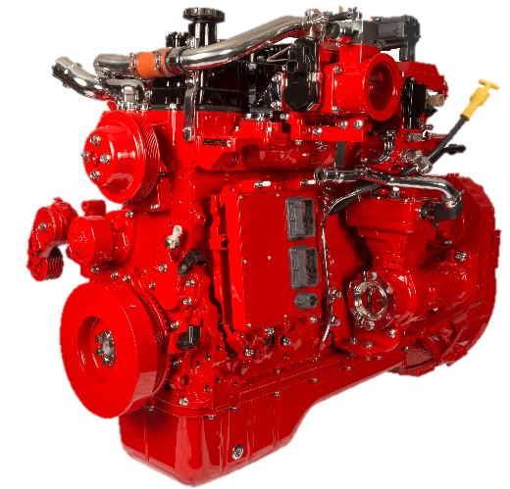
Cummins Westport Optional Near Zero Product Line
ISB6.7 G
6.7L
Spark Ignited, SEGR, TWC
Peak Rating: 260 hp
660 lb-ft torque
33,000 lb. GVW
School bus/Shuttle bus/Sweeper/Yard spotter
0.1 g/bhp NOx Available Now
ISL G
8.9L
Spark Ignited, SEGR, TWC
Peak Rating: 320 hp
1000 lb-ft torque
66,000 lb. GVW
Refuse/Transit/Regional P&D Truck/Mixers
NZ Available Now
ISX12 G
11.9L
Spark Ignited, SEGR, TWC
Peak Rating: 400 hp
1450 lb-ft torque
80,000 lb. GVW
Regional Haul Truck/Tractor/Refuse
NZ Available Q1 2018

Slide 25
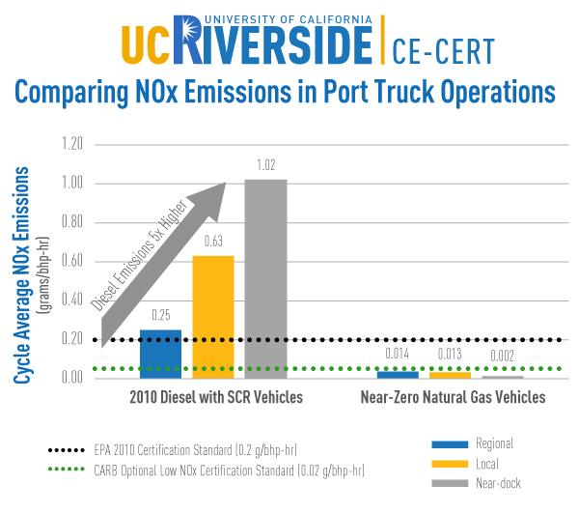
In-use testing results of heavy-duty trucks in port applications found:
» Natural gas vehicles emitted lower NOx:
The ISL G natural gas engine emitted lower NOx emissions than its EPA certification standard. Emissions decreased as the duty cycles decreased (i.e., slower speeds, idling, stop-and-go traffic).
» Diesel vehicles emit up to 5x more NOx:
2010 diesel engines with SCR emitted up to 5 times more NOx emissions than its EPA certification standard. Emissions increased as the duty cycles decreased.
Notes:
The data has been pulled from UCR CE-CERT test results of the Cummins Westport ISL G near-zero natural gas engine and 2010 diesel engines with selective catalytic reduction (SCR) emission control systems.) While port applications are illustrated in the figure above, UCR CE-CERT also tested refuse and transit applications and found that they provided similar comparative results. These duty cycles represent a significant majority of heavy-duty vehicle trips in the South Coast Air Basin and in other urbanized areas.

Slide 26
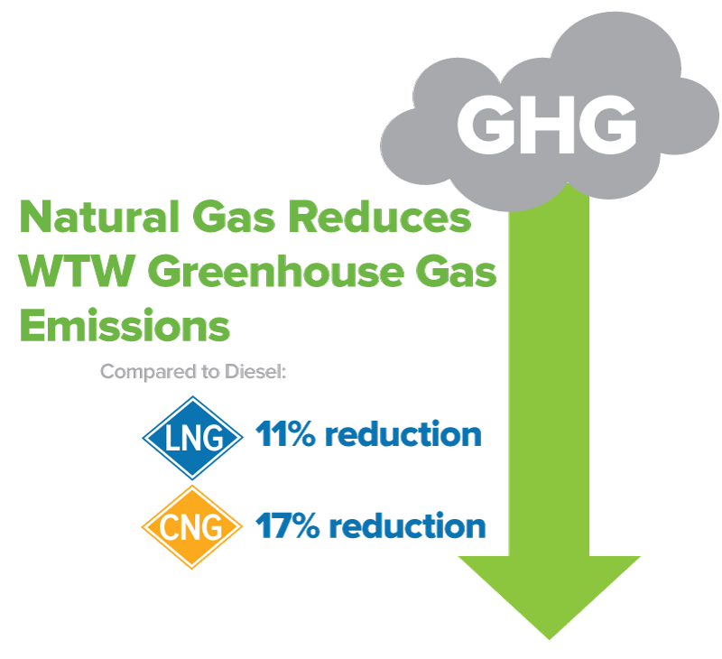
Fueling with natural gas reduces CO₂ and greenhouse gas emissions
Source: NGVAmerica Emissions Whitepaper based on CARB LCFS
*Numbers compared to diesel emissions (well-to-wheel)

Slide 27
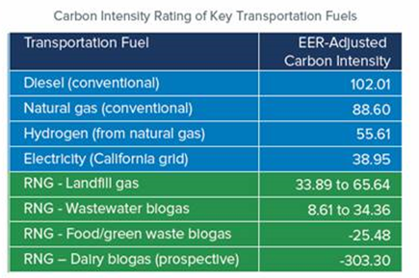
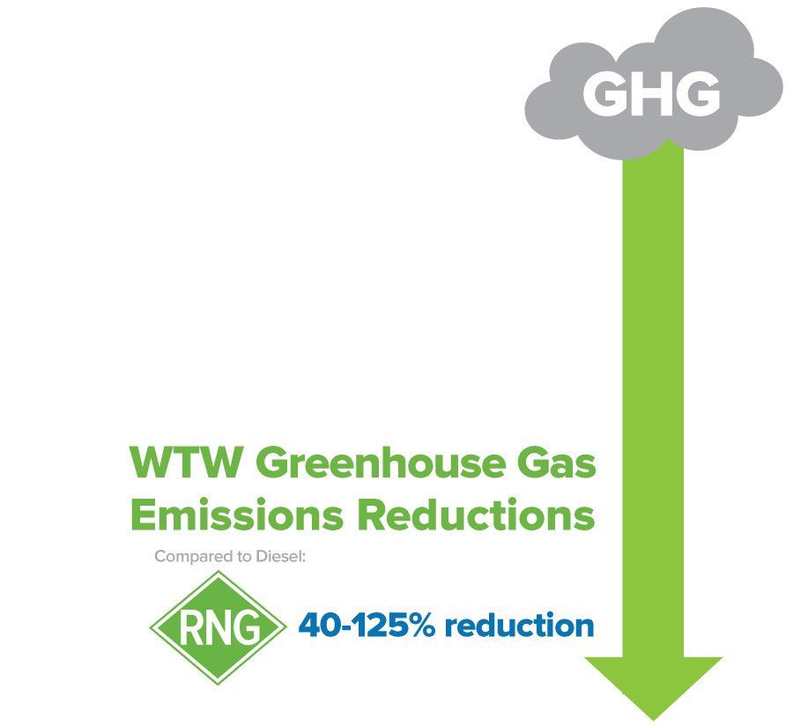
Renewable natural gas (RNG) provides even greater CO₂ and greenhouse gas emission reductions
Source: www.arb.ca.gov/fuels/lcfs/fuelpathways/pathwaytable.htm, CARB, February 2017. Adjusted for heavy-duty truck applications.

Slide 28
What does this really mean?
NGVs + RNG offer the cleanest commercially available path to reduce heavy-duty vehicle emissions
(for likely a decade or more).

Slide 29
Available
NGVs are Road-Tested & Commercially Available

Slide 30
HD Vocational OEMs Autocar Truck Capacity Crane Carrier Elgin Johnston Kalmar Mack McNeilus Peterbilt Power Solutions Int’l Schwarze Tymco HD OEMs Cummins Westport Freightliner Kenworth Mack Peterbilt Volvo | HD Bus OEMs Blue Bird Bus DesignLine El Dorado Gillig New Flyer New Flyer/NABI Bus NOVA Bus Motor Coach Industries Thomas Built Bus HD Retrofit/ Repowers American Power Group Clean Air Power Diesel 2 Gas Fyda Energy Solutions NGV Motori Omnitek Engineering | MD Retrofits AGA Systems Altech-Eco Crazy Diamond Performance Greenkraft Landi Renzo USA/Baytech M-Tech Solutions Nat-G NGV Motori USA PowerFuel Conversions Roush CleanTech STAG Westport Fuel Systems Zavoli Fuel Systems Agility Fuel Solutions Momentum Fuel Technologies Mainstay
Available from OEMs with established sales and service networks

Slide 31
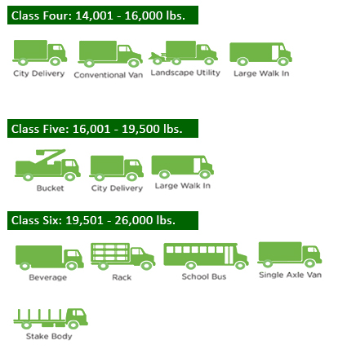
Class 4-6 Vehicles and NGV Availability

Slide 32
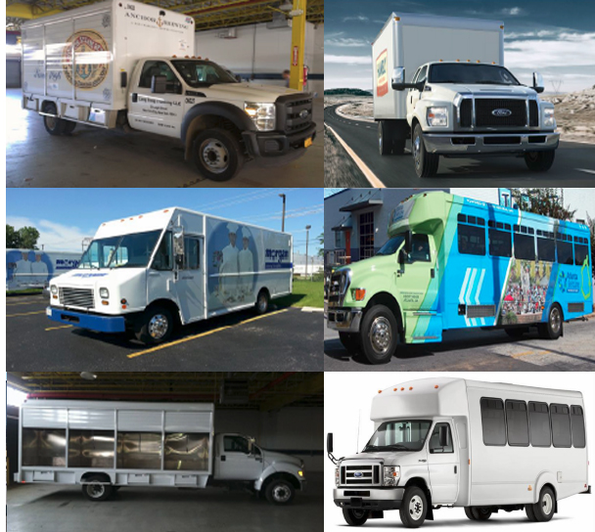
Class 4-6 Vehicles and NGV Availability

Slide 33
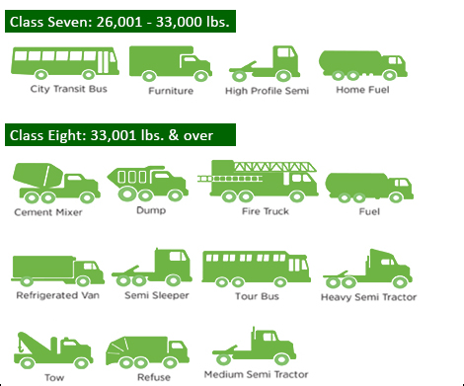
Class 7-8 Vehicles and NGV Availability

Slide 34
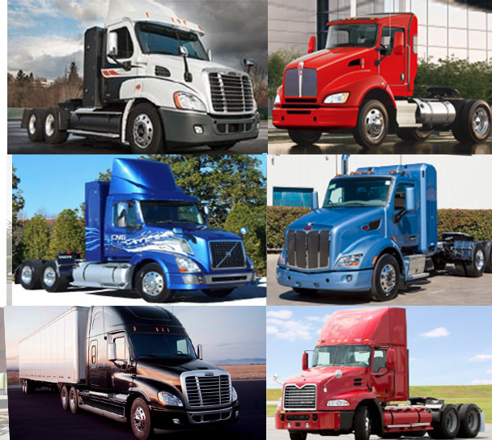
Class 7-8 Vehicles and NGV Availability

Slide 35
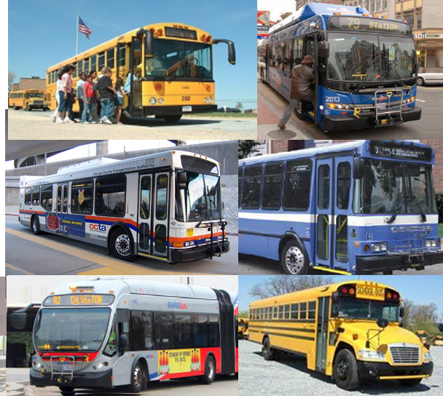
School/Transit Bus and NGV Availability

Slide 36
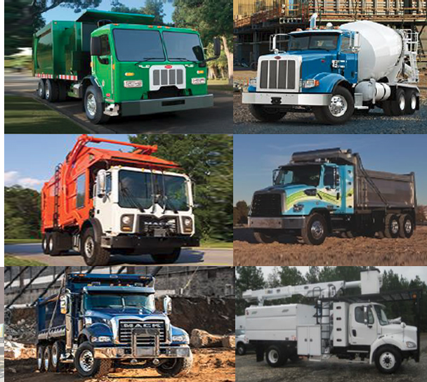
Refuse Vehicles and NGV Availability

Slide 37
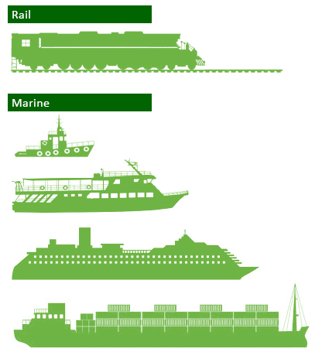
Non-Road, High Horsepower Applications

Slide 38
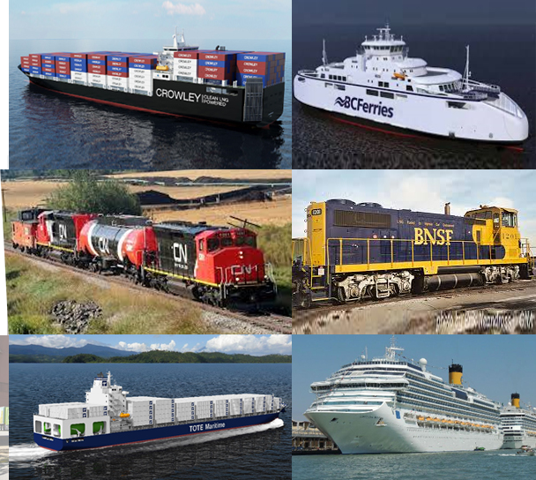
Non-Road, High Horsepower Applications

Slide 39
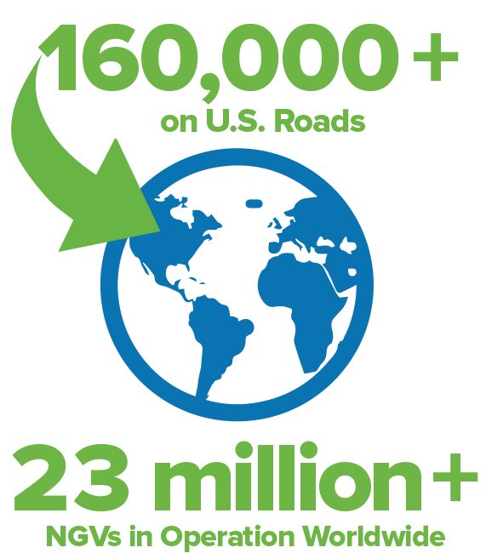
NGVs are road-tested, proven technologies that are operating worldwide
Data Source: NGVGlobal, December 2016
Notes:
http://www.iangv.org/current-ngv-stats/

Slide 40
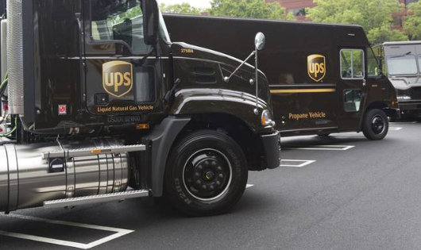
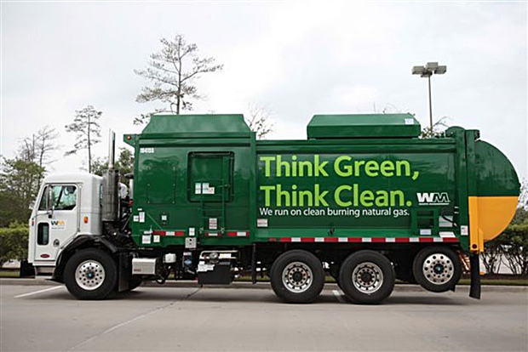
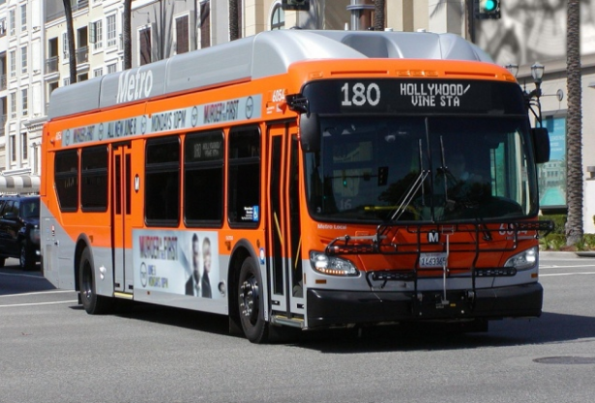
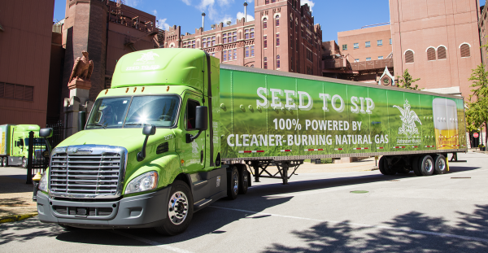
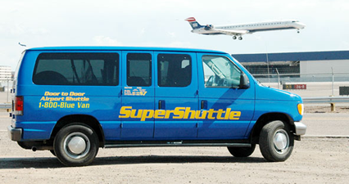
Several high-profile fleet operators use NGVs in daily operations
Notes:
UPS: http://arnoldpublicaffairs.com/wp-content/uploads/2011/09/ups-natural-gas.jpg
Frito-Lay: http://cdn.potatopro.com/cdn/farfuture/WAG3fHhqqgOLXr4uyLMQp5QSGim3XFo8nucpzydYuAA/mtime:1470934151/sites/default/files/field/image/frito-lay-cng-trucks-809.jpg
WM: http://www.cartalk.com/sites/default/files/blogs/jim-motavalli/images/natural%20gas%20garbage%20truck.jpg
AT&T: http://www.worktruckonline.com/fc_images/articles/28-attmainbg.jpg
AB: http://www.joc.com/sites/default/files/resize/u48612/Anheuser-Busch%20truck-600x371.png
LA Metro: http://ngtnews.com/wp-content/uploads/2016/11/hollywood-bus.png

Slide 41
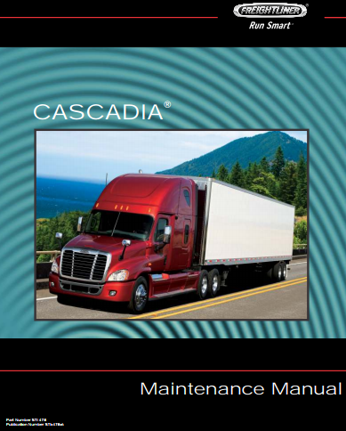
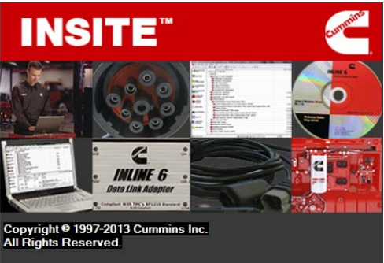
NGV Service & Maintenance Improvements
Continued maintenance free after-treatment
No DEF + simple 3-way catalyst
Service location growth
Over 170 NGV capable service stations throughout U.S.
Service tools now more user friendly
Online service tools diagnose NGV component and system issues
NGV systems being installed in a mass production manner
Increased system reliability and quality
Components and systems now included in OEM manuals
No longer a supplement
Service parts available from vehicle manufacturers
No longer a need to go to multiple locations to service truck
Fuel system inspection & maintenance facility requirements being streamlined
Industry stakeholders working on improvements

Slide 42
Opportunity
Volkswagen Environmental Mitigation Trust Funding

Slide 43
$2.9 Billion Volkswagen Environmental Mitigation Trust
Funding must be used to:
Address excess nitrogen oxide (NOx) emissions through vehicle purchases/ repowers
Benefit residents in areas with greatest need (e.g., near urban/industrial areas)
Replace polluting diesel equipment with cleaner, new or repowered vehicles, including:
Local freight trucks
Transit buses
School buses
Shuttle buses
Refuse trucks
Notes:
Add Additional Slide:
- Social justice aspect (areas with the greatest need)

Slide 44
Funds for Each State ($2,925,000,000)
Initial Subaccounts | Combined Totals
Alaska | $8,125,000.00
Hawaii | $8,125,000.00
North Dakota | $8,125,000.00
Puerto Rico | $8,125,000.00
South Dakota | $8,125,000.00
Wyoming | $8,125,000.00
District of Columbia | $8,125,000.00
Delaware | $9,676,682.97
Mississippi | $9,874,413.91
West Virginia | $12,131,842.13
Nebraska | $12,248,347.48
Montana | $12,602,424.88
Rhode Island | $14,368,857.94
Arkansas | $14,647,709.09
Kansa | $15,662,238.80
Idaho | $17,349,037.39
New Mexico | $17,982,660.90
Vermont | $18,692,130.18
Louisiana | $19,848,805.30
Initial Subaccounts | Combined Totals
Kentucky | $20,378,649.58
Oklahoma | $20,922,485.12
Iowa | $21,201,737.70
Maine | $21,053,064.48
South Carolina | $33,895,491.39
Nevada | $24,874,024.48
Alabama | $25,480,967.86
New Hampshire | $30,914,841.09
Utah | $35,177,506.14
Indiana | $40,935,880.59
Missouri | $41,152,051.74
Tennessee | $45,759,914.40
Minnesota | $47,001,661.43
Connecticut | $55,721,169.94
Arizona | $56,660,078.00
Georgia | $63,624,725.56
Michigan | $64,807,014.63
Colorado | $68,739,918.33
Initial Subaccounts | Combined Totals
Wisconsin | $67,077,457.70
New Jersey | $72,215,085.39
Oregon | $72,967,518.46
Massachusetts | $75,064,424.40
Maryland | $75,714,238.01
Ohio | $75,302,522.67
North Carolina | $92,045,658.00
Virginia | $93,633,980.48
Illinois | $108,679,676.98
Washington | $112,745,650.15
Pennsylvania | $118,569,539.52
New York | $127,701,806.94
Florida | $166,278,744.54
Texas | $209,319,163.57
California | $422,636,320.14
Tribal acct | $54,447,921.22
Tribal Admin Cost | $1,088,958.42
Trust Admin Cost | $29,250,000.00

Slide 45
Responsible
NGVs Maximize the Impact of Available Funding
Notes:
Natural gas delivers greater numbers of:
Total vehicles
NOx emission reductions

Slide 46
Short/Regional Haul Truck Comparison – 100% Funding Scenario
Data Source: NOx emissions are based on low-NOx natural gas engines. EV emissions are the same as natural gas emissions based on the inclusion of power plant emissions, EPA MOVES emission factors for 2017 diesel vehicle, and EPA MOVES for 2007 replacement diesel vehicles. Useful life, cost and mileage vary by applications. Additional details available from NGVA upon request.
Dollar-for-Dollar, NGVs Deliver the Largest & Most Cost-Effective NOx Emissions Reductions
Notes:
Allowable Funding Levels – States may choose to use lesser amounts, incremental cost, eliminate or minimize some categories or other variations in funding
Funding for vehicles owned by governmental entities is authorized at up to 100% of the cost of a new replacement vehicle or repower regardless of technology type
For non-governmental entities the funding is generally up to 25% of the cost of a new replacement vehicle or up to 40% of the cost of repowering the vehicle with a new alternative fuel or diesel engine
Drayage vehicles up to 50% of the cost of a new replacement vehicle or up to 40% for repower
Repowering or replacing a vehicle with electric vehicle technology is funded at up to 75% of the cost in the case of non-governmental entities

Slide 47
Refuse Comparison – 100% Funding Scenario
Data Source: NOx emissions are based on low-NOx natural gas engines. EV emissions are the same as natural gas emissions based on the inclusion of power plant emissions, EPA MOVES emission factors for 2017 diesel vehicle, and EPA MOVES for 2007 replacement diesel vehicles. Useful life, cost and mileage vary by applications. Additional details available from NGVA upon request.
Dollar-for-Dollar, NGVs Deliver the Largest & Most Cost-Effective NOx Emissions Reductions
Notes:
Allowable Funding Levels – States may choose to use lesser amounts, incremental cost, eliminate or minimize some categories or other variations in funding
Funding for vehicles owned by governmental entities is authorized at up to 100% of the cost of a new replacement vehicle or repower regardless of technology type
For non-governmental entities the funding is generally up to 25% of the cost of a new replacement vehicle or up to 40% of the cost of repowering the vehicle with a new alternative fuel or diesel engine
Drayage vehicles up to 50% of the cost of a new replacement vehicle or up to 40% for repower
Repowering or replacing a vehicle with electric vehicle technology is funded at up to 75% of the cost in the case of non-governmental entities

Slide 48
School Bus Comparison – 100% Funding Scenario
Data Source: NOx emissions are based on low-NOx natural gas engines. EV emissions are the same as natural gas emissions based on the inclusion of power plant emissions, EPA MOVES emission factors for 2017 diesel vehicle, and EPA MOVES for 2007 replacement diesel vehicles. Useful life, cost and mileage vary by applications. Additional details available from NGVA upon request.
Dollar-for-Dollar, NGVs Deliver the Largest & Most Cost-Effective NOx Emissions Reductions
Notes:
Allowable Funding Levels – States may choose to use lesser amounts, incremental cost, eliminate or minimize some categories or other variations in funding
Funding for vehicles owned by governmental entities is authorized at up to 100% of the cost of a new replacement vehicle or repower regardless of technology type
For non-governmental entities the funding is generally up to 25% of the cost of a new replacement vehicle or up to 40% of the cost of repowering the vehicle with a new alternative fuel or diesel engine
Drayage vehicles up to 50% of the cost of a new replacement vehicle or up to 40% for repower
Repowering or replacing a vehicle with electric vehicle technology is funded at up to 75% of the cost in the case of non-governmental entities

Slide 49
Transit Comparison – 100% Funding Scenario
Data Source: NOx emissions are based on low-NOx natural gas engines. EV emissions are the same as natural gas emissions based on the inclusion of power plant emissions, EPA MOVES emission factors for 2017 diesel vehicle, and EPA MOVES for 2007 replacement diesel vehicles. Useful life, cost and mileage vary by applications. Additional details available from NGVA upon request.
Dollar-for-Dollar, NGVs Deliver the Largest & Most Cost-Effective NOx Emissions Reductions
Notes:
Allowable Funding Levels – States may choose to use lesser amounts, incremental cost, eliminate or minimize some categories or other variations in funding
Funding for vehicles owned by governmental entities is authorized at up to 100% of the cost of a new replacement vehicle or repower regardless of technology type
For non-governmental entities the funding is generally up to 25% of the cost of a new replacement vehicle or up to 40% of the cost of repowering the vehicle with a new alternative fuel or diesel engine
Drayage vehicles up to 50% of the cost of a new replacement vehicle or up to 40% for repower
Repowering or replacing a vehicle with electric vehicle technology is funded at up to 75% of the cost in the case of non-governmental entities

Slide 50
Conclusion: NGVs are the Best Value for State VW Funds

Slide 51
Matthew Godlewski
President, NGVAmerica
mgodlewski@ngvamerica.org
To learn more, visit: www.ngvamerica.org

