Slide 1
Clean Cities Annual Report

Slide 2
Background
Annual survey of public and private stakeholders from of nearly 100 Clean Cities coalitions
Report submitted annually includes major activities and accomplishments for the previous calendar year
Summarizes the use of and the impacts of alternative fuel use in our region
Provides planning data for the Coalition and H-GAC

Slide 3
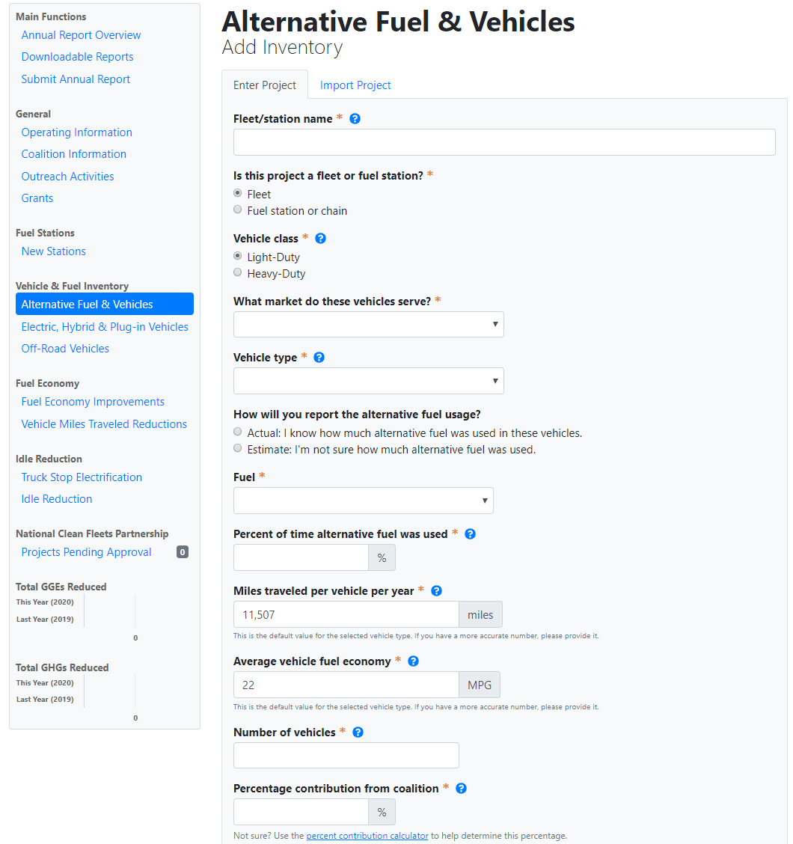
Background

Slide 4
Data Collected
Coalition Specific:
Membership, funding, projects, and activities
Regional Activity:
New and existing alt. fuel stations
New and existing alt. fuel and hybrid vehicle deployments
Sales of alternative fuels
Existing idle-reduction initiatives
Fuel economy, VMT, and idle reduction efforts
NREL and DOE analyze the data and translate into petroleum-use and greenhouse gas reduction for individual regions and for the Clean Cities program as a whole.

Slide 5
Current Survey
This year’s survey is open
Collecting information about fuels used and activities that occurred in 2019
Due date for responses: February 15, 2020
houston-cleancities.org/2019-annual-survey/

Slide 6
Questions?

