Slide 1
Houston-Galveston Clean cities Coalition QUARTERLY MEETING
August 11th 2020

Slide 2
Introductions
Andrew DeCandis, Co-Coordinator
Ben Finley, Co-Coordinator
Gilbert Washington, Coalition Staff
Houston-Galveston Clean Cities Coalition
Chair –
Vice Chair – Norman Whitton
Brian Green
Eddie Murray
Susan Shifflett
2020
Advisory Board
Stakeholders
Attending via Teams

Slide 3
Coalition Chair and Advisory Board
Coalition Chair Election
Officers chair meetings and advise on overall operations of the Coalition
Help determine the direction of Coalition activities
Attend conference calls in between quarterly meetings to discuss and plan upcoming activities
Chair –
Vice Chair – Norm Whitton
Notes:
The coalition is currently and is expected to be financially sustainable over the next 3 years.

Slide 4
Recent Coalition Activities

Slide 5
Greater Houston Area Beneficial Electrification Programs
ICF Account Manager
Bridgette Wellendorf
August 2020

Slide 6
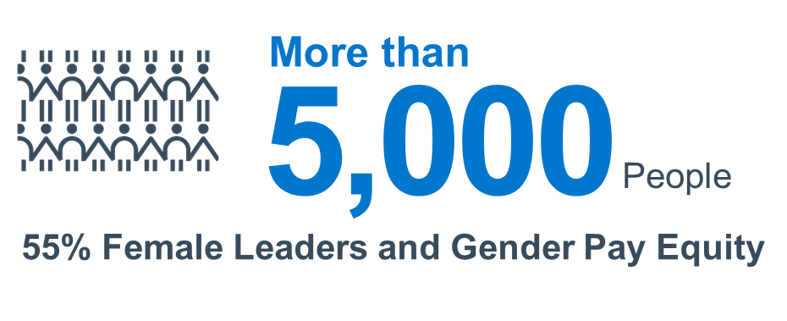
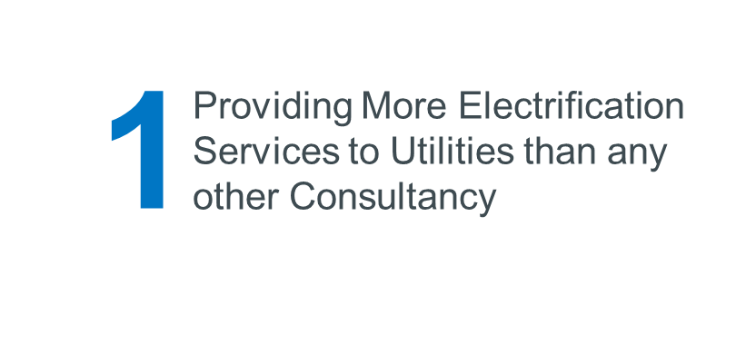
Introduction to ICF
Electrification Services
Electrification Clients
Strategic Planning
Technology Screening
Market Assessment
System/Locational Impact Analysis
Environmental Impact Analysis
Cost-Effectiveness Evaluation
Program Design and Delivery
Program Evaluation
Marketing & Outreach
Grant Application Assistance
Utilities
Non-Utilities
6

Slide 7
Mutual Value Propositions
Electric-powered technologies offer several key benefits to end users over their internal-combustion counterparts. Some of the benefits of electric technologies can include:
Reduced Maintenance
Electric motors have 90 percent fewer moving parts with no engine fluids or hoses significantly reducing time and money spent on maintenance.
Lower Fuel Consumption
By reducing the reliance on fuel, exposure to fluctuating gasoline prices decreases.
Safe and Efficient Workplace
Electric equipment allows an optimal layout of facilities leading to a safer, more efficient work atmosphere.
Less Noise
Electric equipment is much quieter than conventional counterparts which means greater operator awareness for reduced fatigue and increased safety.
Clean and Healthy Environment
Electric equipment produces zero site emissions for a cleaner, healthier work environment.

Slide 8
Texas Emission Reduction Plan (TERP)
Financial incentives to eligible individuals, businesses, or local governments to reduce emissions from polluting vehicles and equipment
Developed and administered by the Texas Commission on Environmental Quality (TCEQ)
11 Grant Programs, 8 have funding available for electrification projects:
We can provide TERP grant application assistance for eligible Entergy and CenterPoint Energy customer electrification projects.
Program | Application |  | Electrification Equipment
 | Status | Period | Off-Road | On-Road
Alternative Fueling Facilities Program (AFFP) | Closed | TBD |  | ■
Seaport and Rail Yard Areas Emissions Reduction (SPRY) Program | Open | 2/12/2021 | ■ | ■
Emissions Reduction Incentive Grants (ERIG) | Closed | TBD | ■ | ■
Rebate Grants for TERP Small Businesses | Open | TBD | ■ | ■
Texas Clean Fleet Program (TCFP) | Closed | TBD |  | ■
Texas Clean School Bus (TCSB) Program | Open | Due 12/17/20 |  | ■
Light-Duty Motor Vehicle Purchase/Lease Incentive Program (LDPLIP) | Open | Due 1/7/21 |  | ■
Governmental Alternative Fuel Fleet (GAFF) Grant Program | Closed | TBD |  | ■

Slide 9
Texas Volkswagen Environmental Mitigation Program (TxVEMP) -Level 2 Charging Equipment for Light-Duty Zero Emission Vehicles
Who is invited to participate?
Eligible applicants include individuals, corporations, organizations, governments or governmental subdivisions or agencies, business trusts, partnerships, associations, or other legal entities, in the State of Texas.
Eligible Activities
Funds may be used for the purchase and installation of new light-duty electric vehicle Level 2 charging equipment. Funding is available statewide for equipment installed:
in a public place, workplace, or multi-unit dwelling (i.e. not located at a private residential dwelling that is not a multi-unit dwelling in Texas); and
at a site without existing light-duty electric charging services or to expand the number of vehicles that may be serviced at an existing site.
Funding Availability
A total of $10.4 million in grant funding will be available for reimbursements of up to $2,500 per installation. Grants will be awarded on a first-come, first-served basis and may not exceed the following percentages of eligible costs:
electric chargers available to the public: 70%
electric chargers available at a workplace or multi-unit dwelling: 60%
Grants will be awarded on a first-come, first-served basis.
We can provide TERP grant application assistance for eligible Entergy and CenterPoint Energy customer electrification projects.

Slide 10
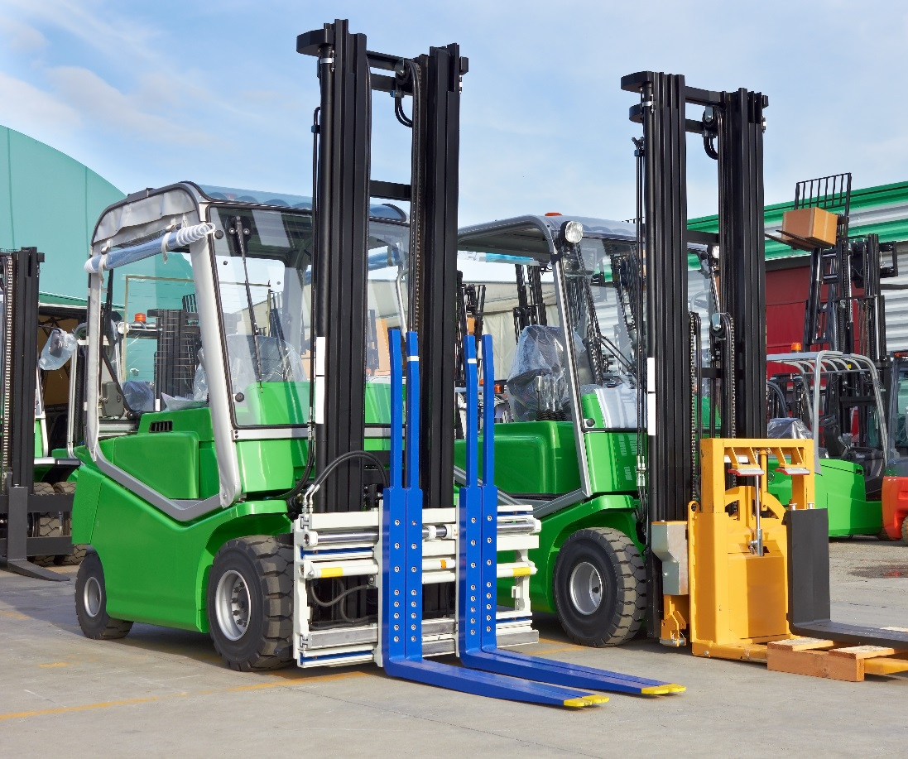
CenterPoint Energy’s Clean Air Technologies Program
Bridgette Wellendorf ICF Sr. Account Manager

Slide 11
CenterPoint Energy’s Clean Air Technologies Program
Contact us for a free electrification consultation. We will help you:
Understand the benefits of electric equipment, specifically forklifts and truck refrigeration units (TRUs).
Calculate the potential financial and environmental savings from converting your fleet.
Connect with local dealers and trade allies
Explore alternative funding opportunities and apply for applicable grants.

Slide 12
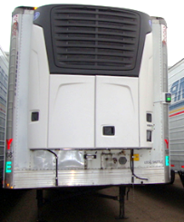
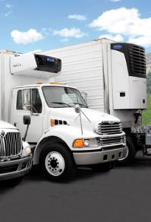
2020 Electric-Standby Truck Refrigeration Infrastructure Funding Assistance
UP TO
$1000
PER BAY
CenterPoint Energy has funding assistance available for customers installing eligible infrastructure to support E/S TRUs.
Primary TRU Manufacturers
SafeConnect manufacturers an electric standby connection system that mitigates the inherent risk of drivers forgetting to disconnect before driving off.

Slide 13
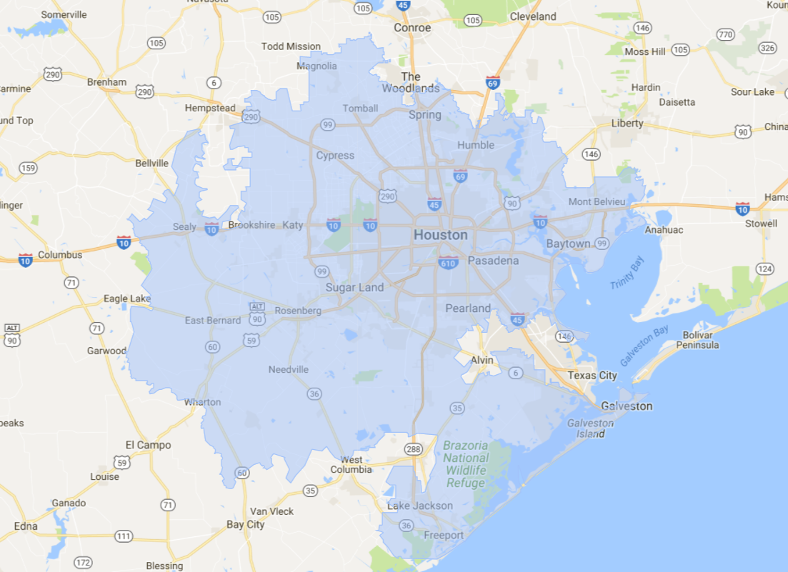
Clean Air Technologies Program: Service Area
Counties Served
Austin
Brazoria
Chambers
Colorado
Fort Bend
Galveston
Harris
Liberty
Matagorda
Montgomery
Waller
Wharton

Slide 14
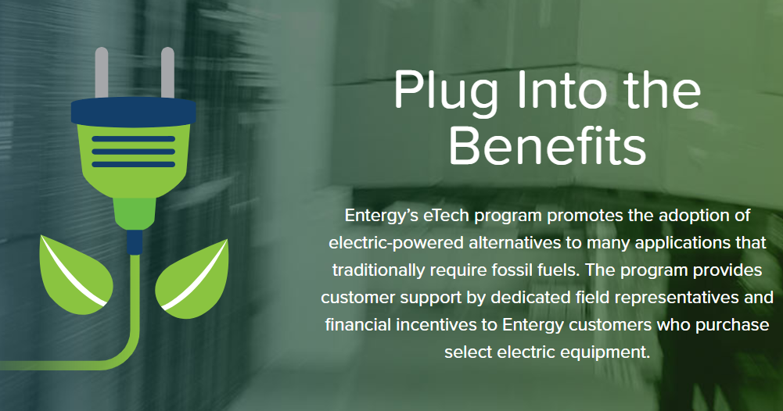
ENTERGY ELECTRIC TECHNOLOGY PROGRAM
14

Slide 15
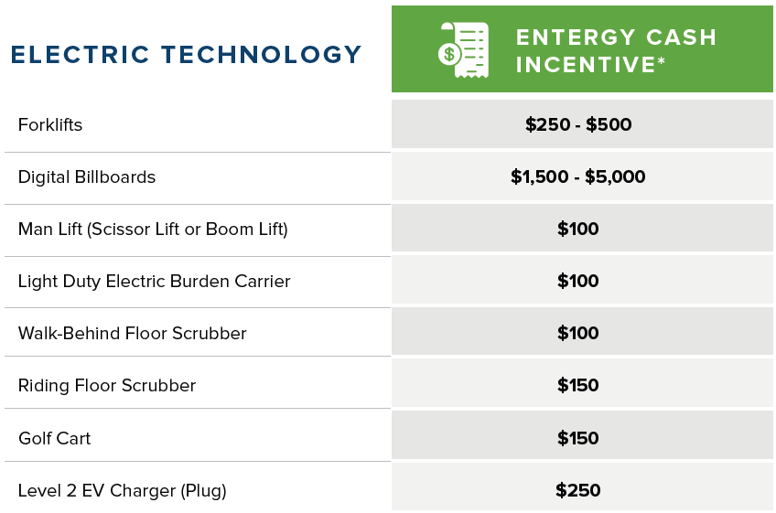
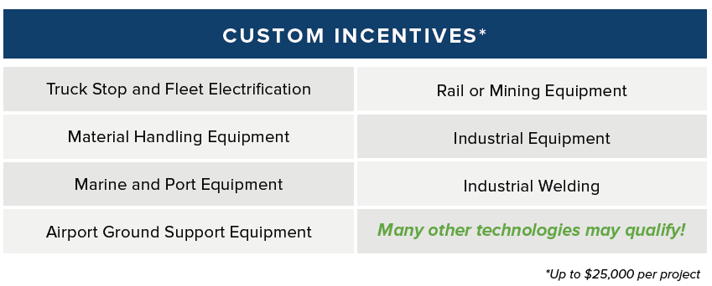
15

Slide 16
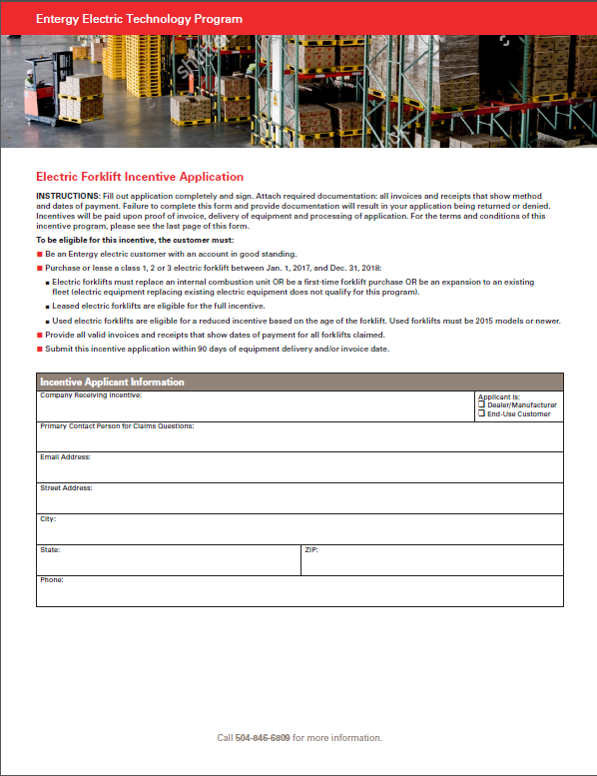
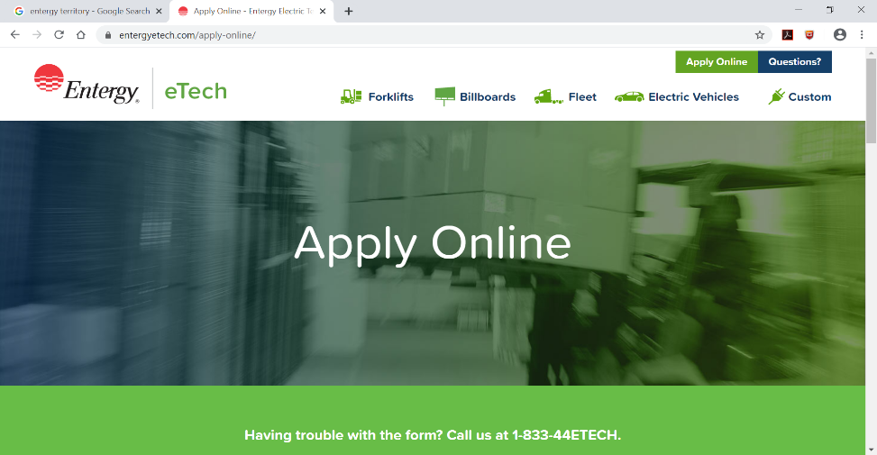
Application Process
Paper Based
OR
Web Based
❶
Equipment meets eligibility requirements.
❷
Dealer submits application and copy of invoice or receipt.
❸
Customer signs Terms and Conditions Form
Check will be issued and arrive within 7-10 business days
http://Entergyetech.com/
16

Slide 17
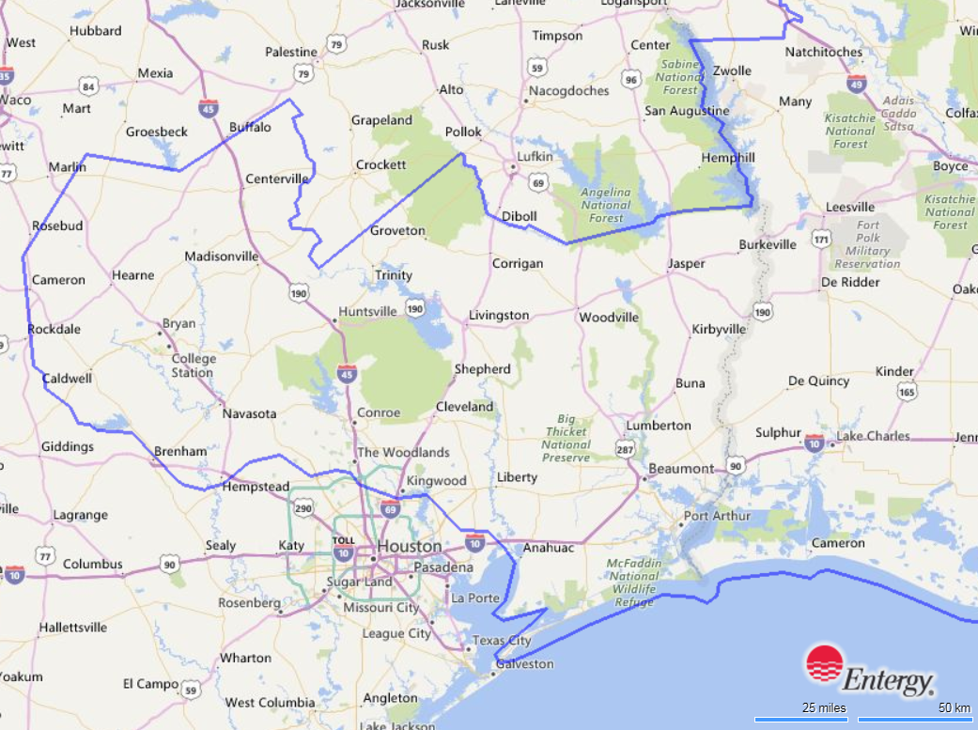
Entergy Texas Service Area
Counties Served
Brazos
Burleson
Chambers
Falls*
Galveston
Grimes
Hardin
Harris*
Houston*
Jasper
Jefferson
Leon
Liberty
Limestone*
Madison
Milam
Montgomery
Newton
Orange
Polk
Robertson
San Jacinto
Trinity
Tyler
Walker
Waller
Washington
*Serves limited portions
17

Slide 18
Thanks! Any Questions?
Bridgette Wellendorf
ICF Sr. Account Manager | +1.346.291.5476 | Bridgette.Wellendorf@icf.com | Houston, TX
CenterPoint Energy Clean Air Technologies Program | www.CNPelectrification.com
Entergy Electric Technology Program | www.EntergyEtech.com

Slide 19
HGCCC 2019 Annual Report
Andrew DeCandis
August 11, 2020
Notes:
Brief introduction of the Annual Report

Slide 20
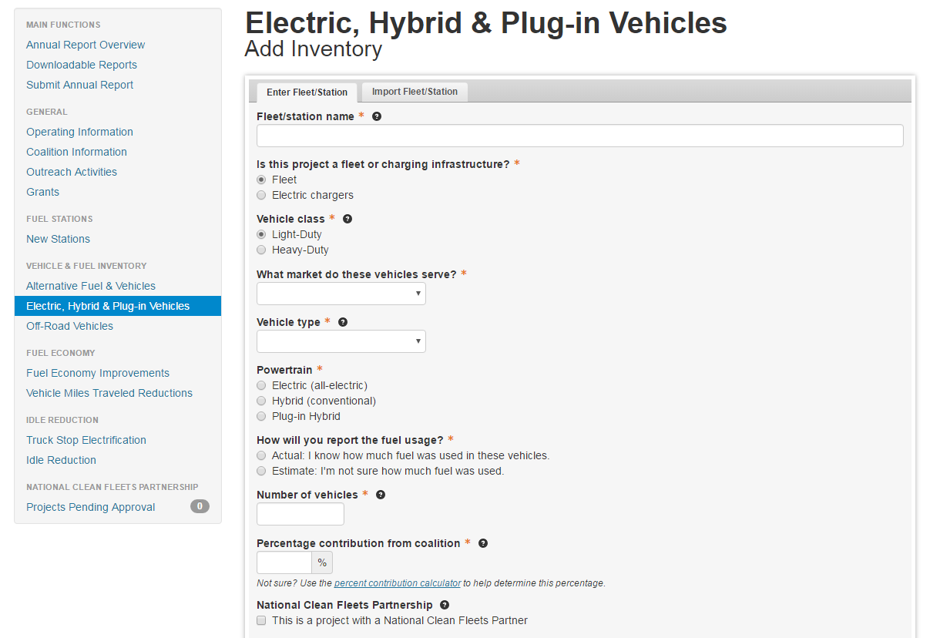

Slide 21
Data Collected in Annual Survey
Data characterizes:
Membership, funding, projects, and activities of the coalitions
Data presents:
Sales of alternative fuels
Deployment of alternative fuel vehicles and hybrid electric vehicles
Idle-reduction initiatives
Fuel economy activities
Programs to reduce vehicle miles traveled
NREL and DOE analyze the data and translate them into petroleum-use and greenhouse gas reduction impacts for individual coalitions and the program as a whole.

Slide 22
HGCCC Annual Report
2019 report has been finalized and accepted by DOE
2017 respondents: 68
2018 respondents: 34
2019 respondents: 41
124 organizations were included in 2018 survey – includes carry-over from previous years
2 National Clean Cities Partners
Notes:
Brief introduction of the Annual Report

Slide 23
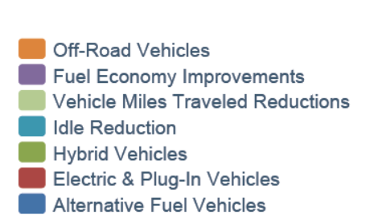
Annual Petroleum Displacement
Changes from last year?
Reporting period overlapped with beginning of COVID lockdown
Increase in total respondents
Continued effects of Harvey

Slide 24
Petroleum Displacement by Category
To view aggregated data for all local coalitions that participate in the Clean Cities program, visit www.eere.energy.gov/cleancities/accomplishments.html

Slide 25
Houston-Galveston Clean cities Coalition: Volunteer Subcommittee

Slide 26
Volunteer Subcommittee
A collection of people willing to volunteer to help accomplish Coalition work outside of Stakeholder Meetings.
What
Provides an opportunity for stakeholders to become more active
Builds cohesion within the coalition
Reduces workload on Coordinators
Provides further education on coalition activities
Why

Slide 27
Volunteer Subcommittee
Active E-Mail is essential
Send E-Mail to
Ben.Finley@h-gac.com
Title E-Mail: CCC Volunteer Subcommittee
Include in E-Mail:
Name
Phone Number
Company
Sign Me Up

Slide 28
Goals
We anticipate building a large volunteer “pool” over the next few years.
Tasks and projects will be identified as needed.
LATER, there may be an opportunity for the subcommittee to perform self identified tasks and projects.
Notes:
The coalition is currently and is expected to be financially sustainable over the next 3 years.

Slide 29
Next Task
Logging Prices of Alternative Fuels
Alternative Fueling Stations App
DOE sponsored app
Users find fueling locations and prices
Can sort by alternative fuel
Alternative Fuel Price Report
DOE sponsored: Alternative Fuel Data Center
Users find data on alternative fuels, to include trending fuel prices
Site is alternative fuel neutral
Notes:
The coalition is currently and is expected to be financially sustainable over the next 3 years.

Slide 30
Alternative Fueling Station Ap

Slide 31
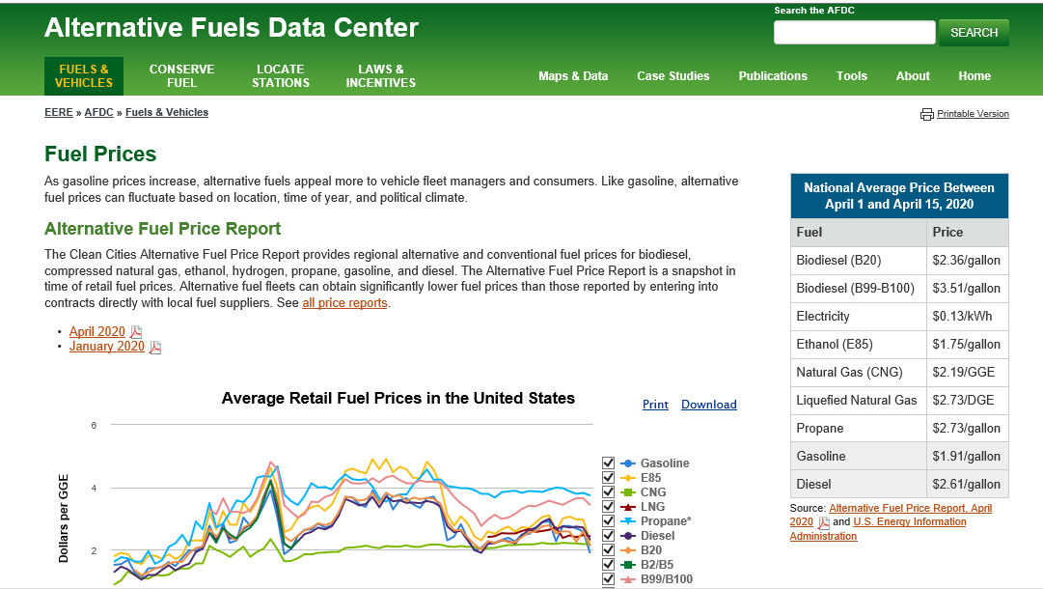
Alternative Fuels Data Center

Slide 32
Next Task
Logging Prices of Alternative Fuels
Particulars
Task needs to be done quarterly
Task typically takes 3 people 1 day to complete
Volunteer will be given a call sheet with contact people
Volunteer to call contact, ask about prices, and records prices / notes
Volunteer e-mail completed call sheets to Co-coordinator
Co-coordinator fills in the gaps
Co-coordinator sends data to DOE
FOR THIS TASK, it might be best if volunteer is not associated with an alternative fuel vendor
Notes:
The coalition is currently and is expected to be financially sustainable over the next 3 years.

Slide 33
Next Project
Virtual Site Visit Collection
Collecting “Infomercials” from Stakeholders
Might satisfy one of our Coalition’s task of “On-Site Visits”
Allows for more promotion of our Stakeholders
Collection of links to infomercials housed on Clean Cities website
Volunteers:
Contact Stakeholders
Inquires about infomercials
Coordinates list of links with a Clean Cities Co-coordinator
Special: Does stakeholder need help making an infomercial?
Notes:
The coalition is currently and is expected to be financially sustainable over the next 3 years.

Slide 34
Next Project
Virtual Site Visit Collection
Goals
At least 1 volunteer
At least 4 infomercials
Start date is August 18th
Deadline is Thanksgiving
Anticipated hours: 8
Notes:
The coalition is currently and is expected to be financially sustainable over the next 3 years.

Slide 35
Summary
Send E-Mail to
Ben.Finley@h-gac.com
Title E-Mail: CCC Volunteer Subcommittee
Sign Up
Logging Prices of Alternative Fuels
Begins next quarter
Call stations from a list, and record prices
Task
Virtual Site Visit Collection
Begins August 18th
Collect links to infomercials from our Stakeholders
Project

Slide 36
2020 Quarterly Meeting Schedule
September 23rd 9:30-11am

Slide 37
Thank You!

