Slide 1
Clean Cities Annual Report
January 27th 2021

Slide 2
Background
Annual survey of public and private stakeholders from of nearly 100 Clean Cities coalitions
Report submitted annually includes major activities and accomplishments for the previous calendar year
Summarizes the use of and the impacts of alternative fuel use in our region
Provides planning data for the Coalition and H-GAC

Slide 3
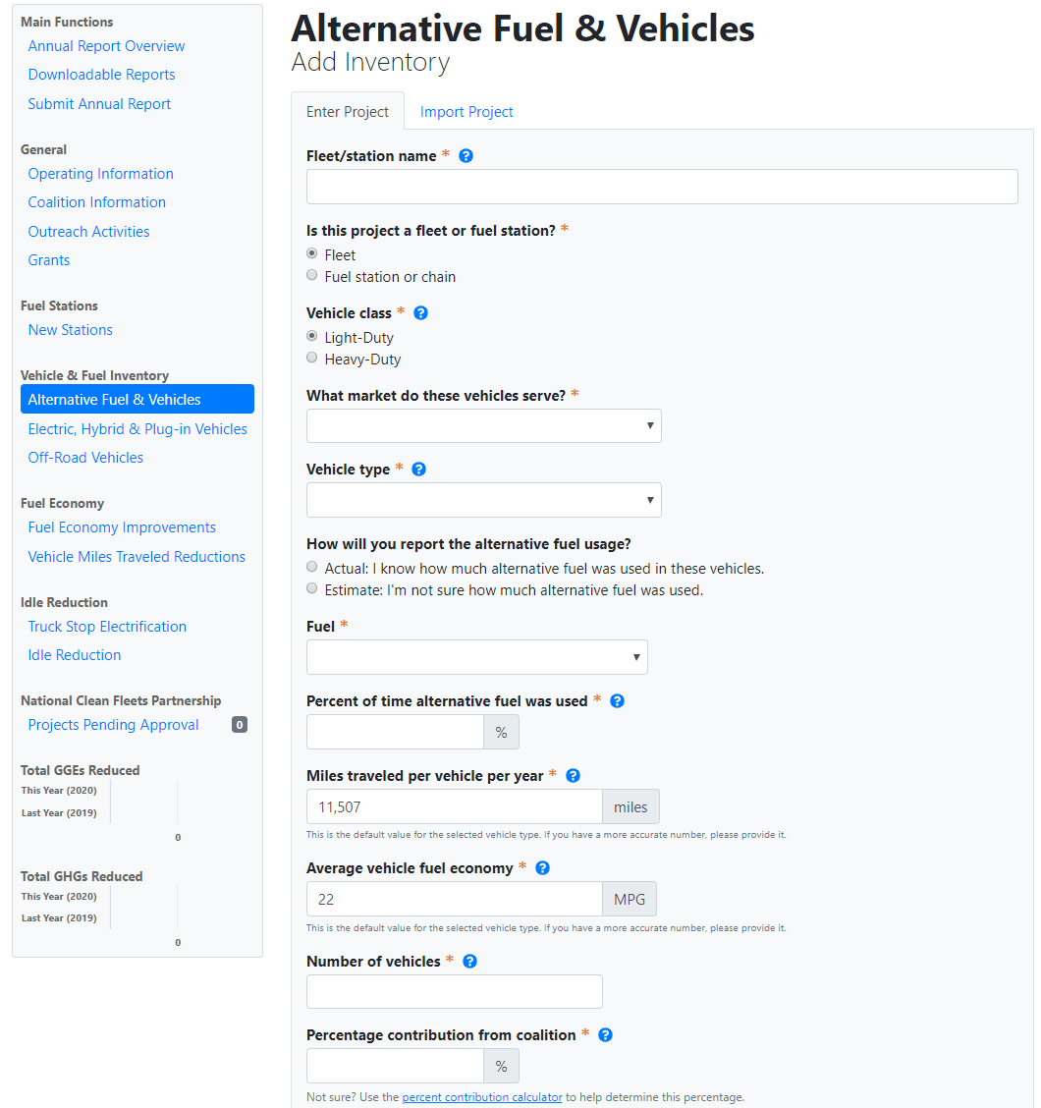
Background

Slide 4
Data Collected
Coalition Specific:
Membership, funding, projects, and activities
Regional Activity:
New and existing alt. fuel stations
New and existing alt. fuel and hybrid vehicle deployments
Sales of alternative fuels
Existing idle-reduction initiatives
Fuel economy, VMT, and idle reduction efforts
NREL and DOE analyze the data and translate into petroleum-use and greenhouse gas reduction for individual regions and for the Clean Cities program as a whole.

Slide 5
Current Survey
This year’s survey is open
Collecting information about fuels used and activities that occurred in 2020
Due date for responses: March 15, 2021
houston-cleancities.org/2020-annual-survey/

Slide 6
Next Steps
Annual Survey Webinar – February 9 @ 10:00 am
Overview of the survey and its uses
Fill out a sample survey
Answer any questions and offer additional assistance
Seven responses so far this year
Will be reaching out to fleets that participated in recent years
Will work to recruit additional fleets to expand our knowledge

Slide 7
Expectations
Questions

Slide 8
2021 Quarterly Meeting Schedule
January 27th 9:30-11am
April 28th 9:30-11am
July 28th 9:30-11am
September 22nd 9:30-11am

Slide 9
Thank You!

