Slide 1
Houston-Galveston Clean cities Coalition QUARTERLY MEETING
August 11th 2021

Slide 2
Meeting Agenda
Introductions
Alternative Fuel Activities at City of Houston – Gary Glasscock, City of Houston
H-GAC Clean Vehicles and Buy America – Gilbert Washington, HGCCC
Current Funding Announcements and Updates – Gilbert Washington, HGCCC
Announcements of Current & Upcoming Activities
Adjourn meeting

Slide 3
Introductions
Sandra Holliday, Air Quality Program Manager
Andrew DeCandis, Planner
Ben Finley, Program Coordinator
Gilbert Washington, Program Coordinator
Houston-Galveston Clean Cities Coalition
Chair – Chris George
Vice Chair – Vincent Sanders
2021
Advisory Board
Stakeholders
Attending in person
Attending via conference call

Slide 4
Meeting Agenda
Introductions
Alternative Fuel Activities at City of Houston – Gary Glasscock, City of Houston
H-GAC Clean Vehicles and Buy America – Gilbert Washington, HGCCC
Current Funding Announcements and Updates – Gilbert Washington, HGCCC
Announcements of Current & Upcoming Activities
Adjourn meeting

Slide 5


Fleet Management Department
STATUS REPORT:
BATTERY Electric Vehicle program
JuLY 21, 2021

Slide 6
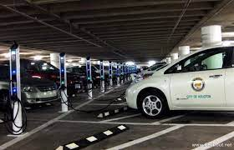
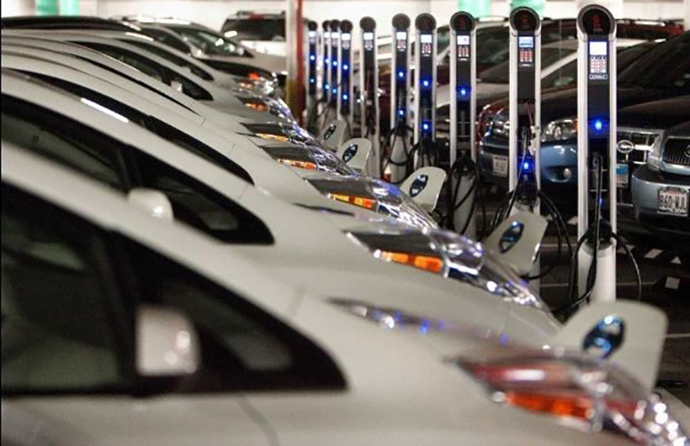
Battery Electric Vehicle Program: Current State
Vehicles
15 Each, Chevy Bolts
25 Each, Nissan Leafs
Electric Vehicle Charging Infrastructure
6 each, Chargers at City Hall Annex
3 each, Chargers at 611 Walker
1 each, Charger at 2805 McKinney

Slide 7

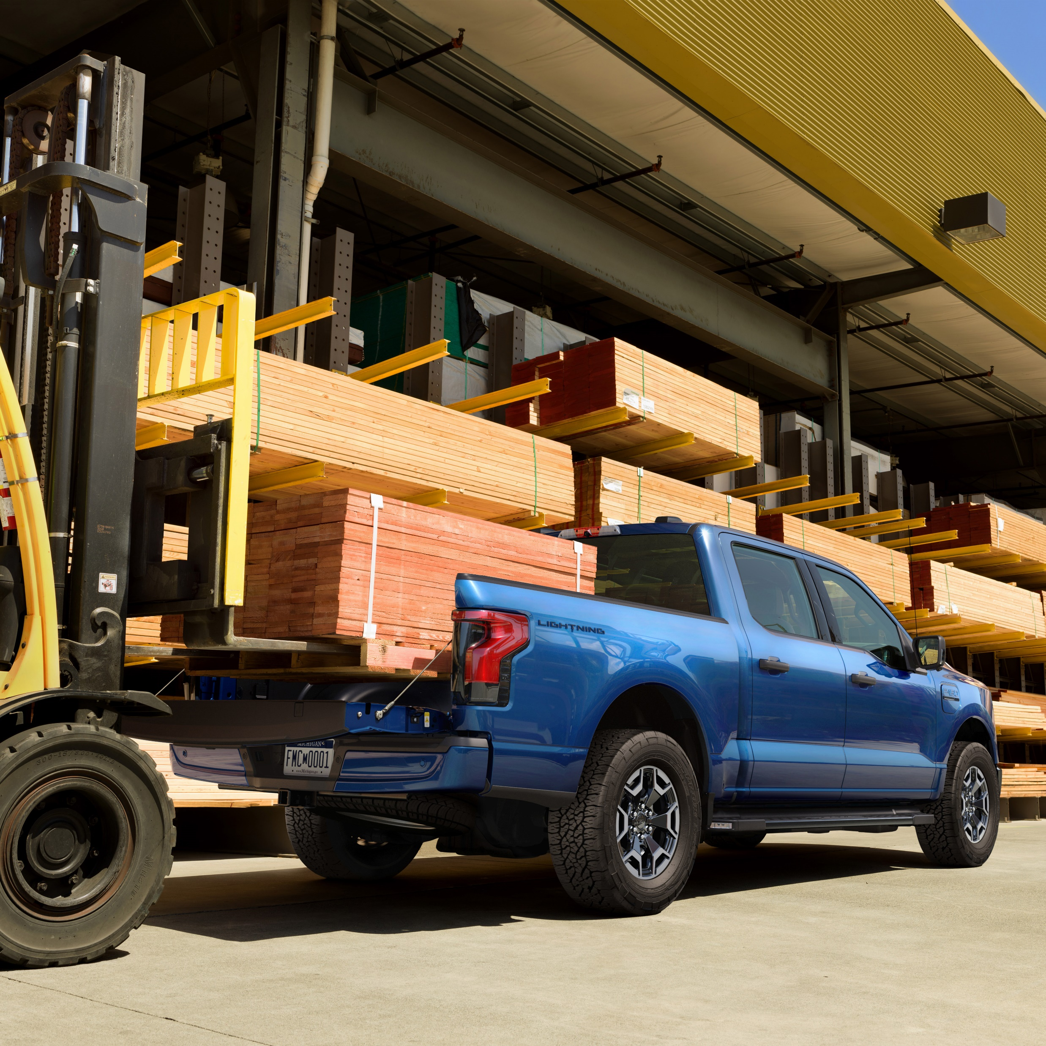
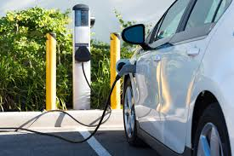
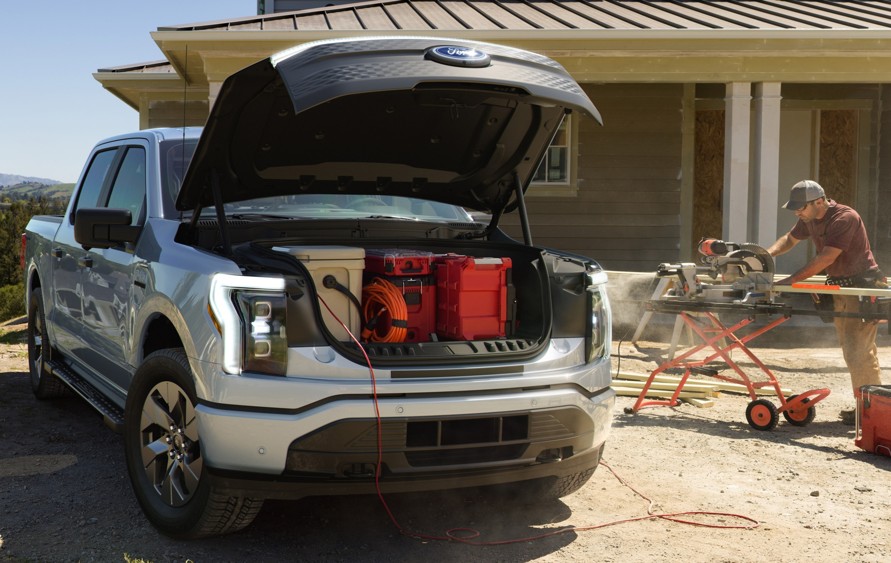
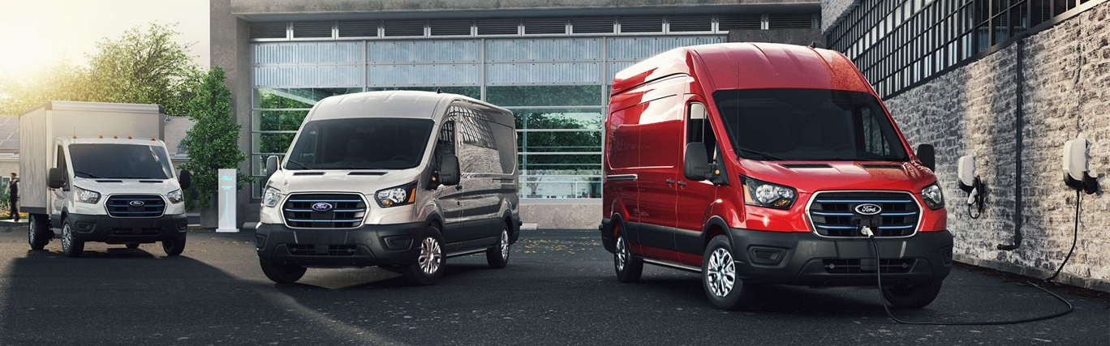
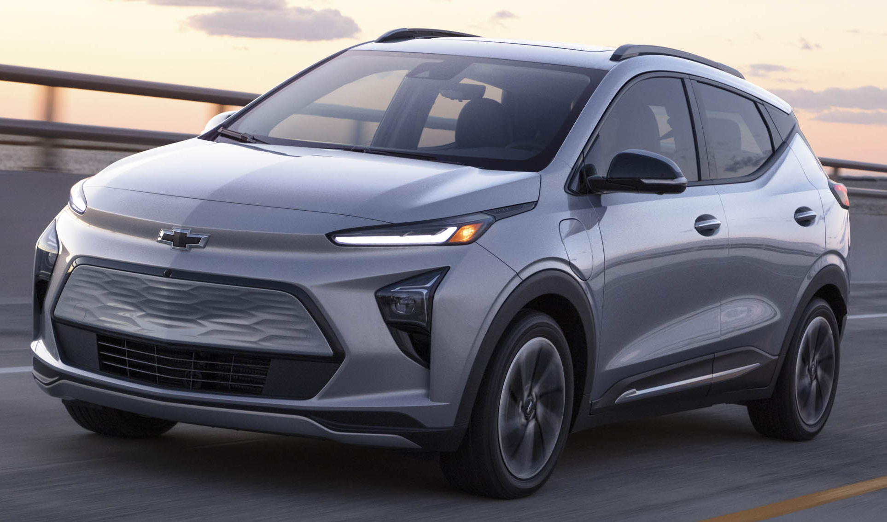
Battery Electric Vehicle Program: Light-Duty Vehicles
PROPOSED PROJECT
Goal: Purchase 100 each, EVs in FY22
EV Model | MSRP | Range (miles)
Ford F-150 Lightening | $39,974 | 230
Ford E-Transit | $43,295 | 126
Chevrolet Bolt | $31,000 | 259
Nissan Leaf | $31,670 | 149
PROJECT STATUS
Complete
Research vehicle specifications
EV Report (Evolve)
100 EVs reserved with Ford
Underway/Pending
Discussions with depts.
Discussions with vehicle manufacturers/dealers
Allocation of funding to Council in August
Solicitation
Auto technician training

Slide 8
Battery Electric Vehicle Program: Light-Duty Vehicles
FY22 EV Purchases - Confirmed
FY22 EV Purchases – Under Discussion
Departments
HFD
HPD
SWD
HPW
GSD
FMD (Fleetshare)
Departments
ARA
DON
HPRD
HHD

Slide 9
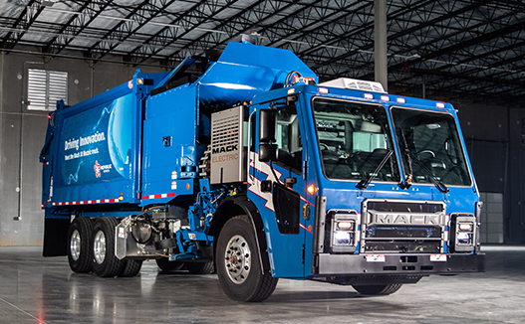
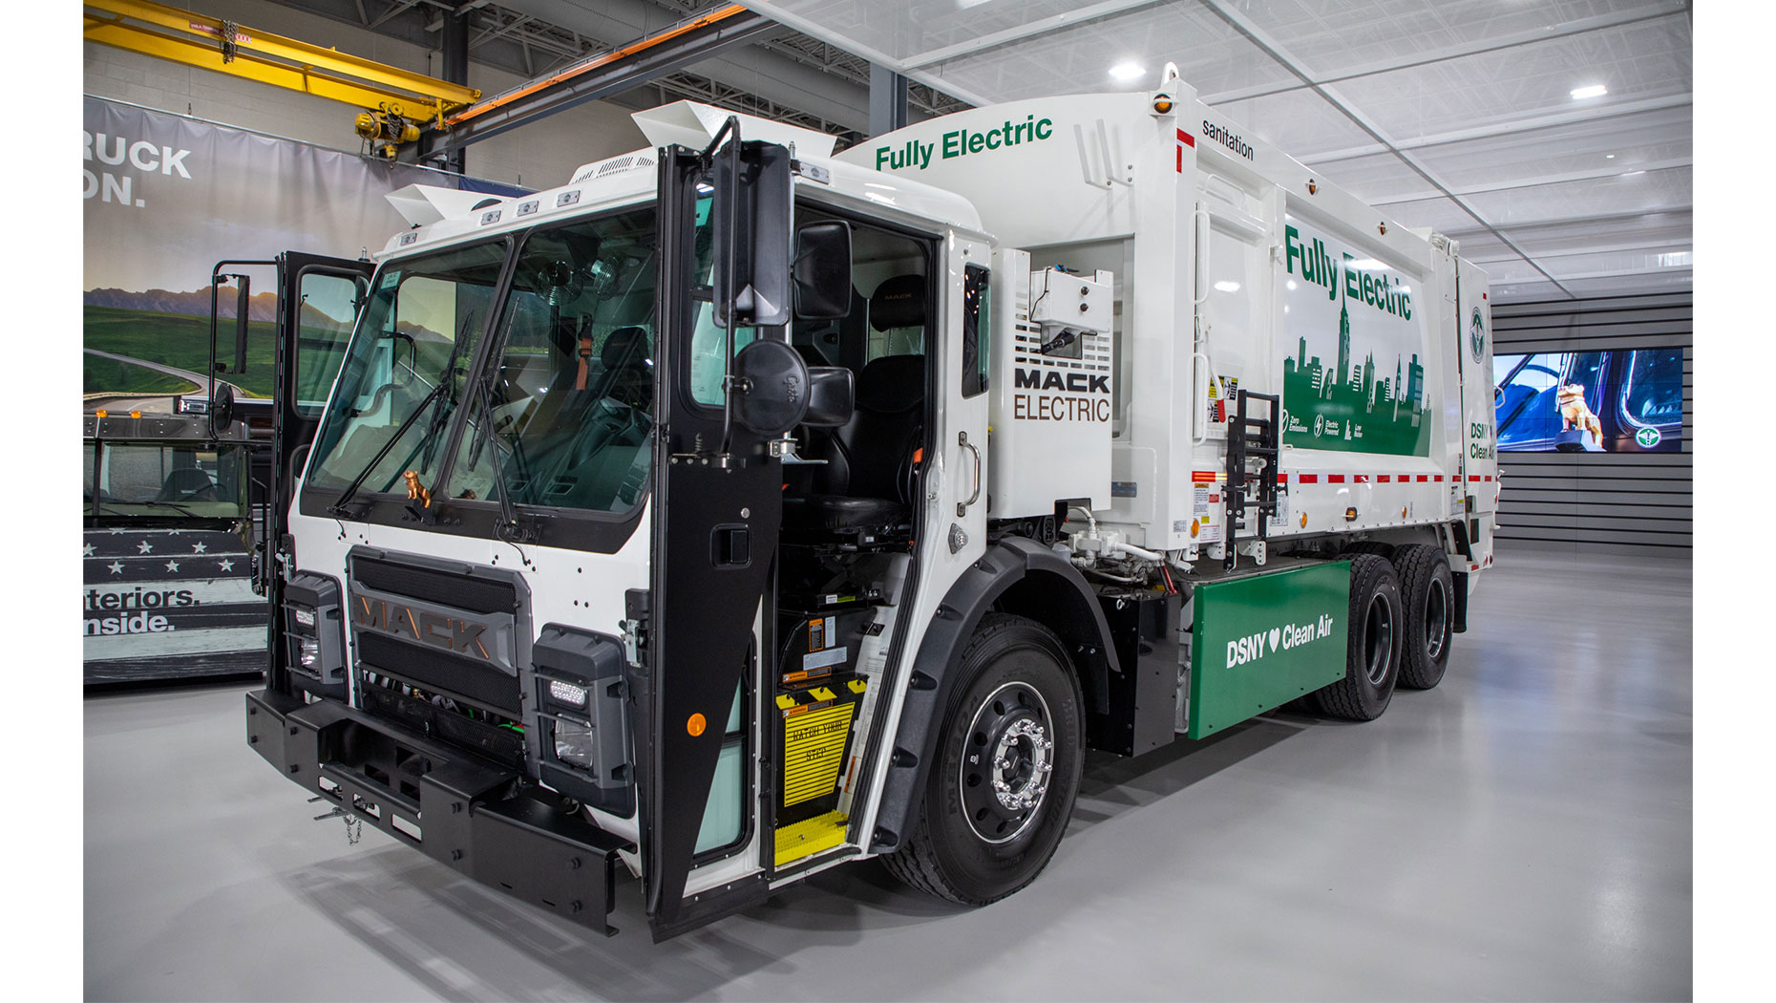
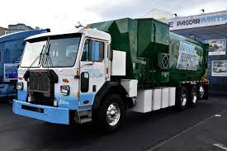
Battery Electric Vehicle Program: Refuse Truck Pilot
PILOT PROJECT
1 Each, Rear-loader, Downtown Operation
Truck to be based at NE Service Center
VEHICLE DETAILS
Two chassis manufacturers: Mack & Peterbilt
Range: 80 to 120 miles
Cost: $600,000/truck
PROJECT STATUS
Complete
Research & specifications for trucks & recharging infrastructure
Underway/Pending
Allocation of funding for Council consideration in August
Installation of recharging infrastructure
Procurement of truck – Delivery expected Spring 2022

Slide 10
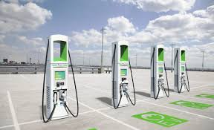
Battery Electric Vehicle Program: Charging Infrastructure
PROJECT STATUS
Complete
Contract awarded for replacement of 42 chargers (Phase 1).
Specifications complete for retrofit of facilities with recharging infrastructure (Phase 2 & beyond).
Charger installation locations identified (Phase 2).
Underway/Pending
Replacement of 42 chargers (Phase 1).
Discussions with departments to prepare Phase 3 package.
Allocation of funding to Council in August (Phase 2 & beyond).
Contracted JOCs to perform facility retrofits (Phase 2 & beyond).
Chargers to be purchased by COH and provided to JOC for installation (Phase 2 & beyond).

Slide 11
Battery Electric Vehicle Program: Charging Infrastructure
Phase 2, EVSE Installations - Confirmed
Phase 3, EVSE Installations - Pending
City Facility | Primary Dept. | Address
Dart | HFD | 1205 Dart
HPD North | HPD | 9455 W. Montgomery
Northeast Service Center | SWD | 5617 Neches
City Hall Annex | GSD/FMD | 900 Bagby
Dalton | GSD/FMD | 2707 Dalton
Berry | GSD | 3026 Berry
City Facility | Primary Dept. | Address
Hermann Park | HPRD | 6001 Fannin
Memorial Park | HPRD | 6501 Memorial Dr
HPARD Headquarters | HPRD | 6200 Wheeler
Note: HPW to install EVSE using Enterprise funding and HPW contractors.

Slide 12
Battery Electric Vehicle Program
QUESTIONS

Slide 13
Meeting Agenda
Introductions
Alternative Fuel Activities at City of Houston – Gary Glasscock, City of Houston
H-GAC Clean Vehicles and Buy America – Gilbert Washington, HGCCC
Current Funding Announcements and Updates – Gilbert Washington, HGCCC
Announcements of Current & Upcoming Activities
Adjourn meeting

Slide 14
Meeting Agenda
Introductions
Alternative Fuel Activities at City of Houston – Gary Glasscock, City of Houston
H-GAC Clean Vehicles and Buy America – Gilbert Washington, HGCCC
Current Funding Announcements and Updates – Gilbert Washington, HGCCC
Announcements of Current & Upcoming Activities
Adjourn meeting

Slide 15
H-GAC Clean Vehicles and Buy America
Where are we now?

Slide 16
H-GAC Funding Assistance: Clean Vehicles Program
Vehicle Replacements
Heavy-Duty (Class 6-8)
School Buses
Charging Infrastructure- (Developing)
Support for Vehicle Replacements
Public Charging Infrastructure
Idle Reduction Infrastructure
Truck Stop Electrification
Marine Shore Power
www.hgac.com/cleanvehicles/

Slide 17
Clean Vehicles Program
$10.4M awarded in 2018 with ~$8M remain available as of today
Replacements
91 Units Replaced
Tons of Reported NOx Reduced:
2018:275 Tons
2019: 144 Tons
2020: 111.5 Tons
Potential Replacements
~450 Units
Potential Tons of NOx Reduced:
1000+ Tons
1000+ Tons
1000+ Tons
Notes:
Awards are typically renewed apprx every 2 years

Slide 18
Buy America Act
Buy America Act
FHWA
Result
Establishes “Buy America” requirements on recipients receiving grant funds from FHWA
“100% of Steel, iron, and manufactured products used in the project are produced in the United States”
Typically issues waivers when Buy America Compliance is not feasible.
Recent Executive Orders
President Trump – April 2017 –Emphasized waiver usage on all federal projects that do not comply
FHWA has not issued a new waiver since
President Biden – January 2021 – Continues previous standards, establishes a Made in America department,
FHWA’s has continued to not issue waivers
Vehicle and equipment replacement grant programs using FHWA funds (such as CMAQ) have been practically suspended since 2017.
Notes:
As many of you are aware, grant funding programs that use FHWA funds have been negatively affected from Buy America. To briefly recap, the Buy America Act states that certain federal funds, such as those originating from the FHWA can not be used to fund projects that can not source and manufacture the 75% of the steel and other metals from the United States. This applies to vehicle replacements (such as trucks) using CMAQ funds (Congestion Mitigation and Air Quality).
In the past, FHWA has issued waivers for vehicle replacement projects; however, this practiced stopped after President Trump’s executive order. President Biden’s executive order expanded the Buy America clause, and FHWA still remains hesitant to issue waivers.
One unfortunate result is that several replacement grant programs have effectively been shut down since 2017. H-GAC’s Clean Vehicles Program has also been caught up in the Buy America turmoil.
Like several of these programs, we are trying to find ways to continue our work.

Slide 19
Our Response
Held meetings with TxDOT and FHWA to explain the situation and request for waivers
Wrote letters to TxDOT and FHWA Administrations to explain the situation and request waivers
Join with other Clean Vehicle Programs to reach out to FHWA Administration to explain the situation and request for waivers
Completed and submitted application/documents officially requesting waivers
Notes:
External Response: H-GAC Staff and administration has had several calls with both TxDOT and FHWA regarding the situation. We have also joined other Clean Vehicle programs to try to have a louder voice while talking with FHWA and TxDOT.
There were two main results from these talks. First, H-GAC was able to squeeze out an extra 3 years of work using left over waivers. Second, H-GAC was asked to reapply for additional waivers.
H-GAC Administration has submitted the request for additional waivers, but have yet to be awarded the waivers.

Slide 20
H-GAC’s Strategies
Use all remaining waivers on School Bus Projects
Continue to update TxDOT and FHWA
Pursue leasing opportunities
Redefine retrofit definition
Focus on EV chargers with public access (BA Compliant)
Continue to apply for waivers
Notes:
Internal Response: While speaking with or Clean Vehicles coalition, we have found that there have been several strategies used in order to continue Clean Vehicles work. Along with trying to exist on unused waivers that were granted before 2017, there have been a few additional strategies… such as :
Allowing for leasing the vehicle without an option to buy. Therefore, the CMAQ funds did not “purchase” non-US metal.
Some programs have redefined the term “Retrofit” from a “Repower” (replace the engine, but keep the truck) to a more “add a piece of auxiliary equipment”.
Other programs have shifted to alt fuel infrastructure projects, however, the Buy America regulation still applies which makes this still a difficult strategy.
We have found a few EV chargers that do meet Buy America requirements, but when we look at more traditional infrastructure projects, such as CNG stations, proving the US source and manufacturing is still an issue.
Other places have decided to pause their Clean Vehicles programs, and direct their applicants towards other grant programs that do not have the Buy America requirement.
And there is one program that is rolling the dice by continuing to operate in hopes that they are too small of a fish for the federal government to care about. Please note that H-GAC does not endorse this strategy.
What strategies does H-GAC endorse?
We have already extinguished all possible waivers.
We continue to hold discussions with our Clean Vehicles coalition, as well as TxDOT and FHWA administrators
We are pursuing the option to provide grant funding for leasing. We anticipate that our applicants will be larger trucking companies that are looking for a pilot project.
We are also looking into redefining the term “Retrofit”, to allow auxiliary equipment to attached to current engines.
AND we are currently studying how to make an EV charger campaign competitive with other programs.

Slide 21
Meeting Agenda
Introductions
Alternative Fuel Activities at City of Houston – Gary Glasscock, City of Houston
H-GAC Clean Vehicles and Buy America – Gilbert Washington, HGCCC
Current Funding Announcements and Updates – Gilbert Washington, HGCCC
Announcements of Current & Upcoming Activities
Adjourn meeting

Slide 22
2021 Quarterly Meeting Schedule
January 27th 9:30-11am
April 28th 9:30-11am
August 11th 9:30-11am
November 10th 9:30-11am

Slide 23
Thank You!

