Slide 1


Fleet Management Department
STATUS REPORT:
BATTERY Electric Vehicle program
JuLY 21, 2021

Slide 2
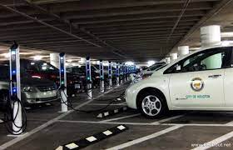
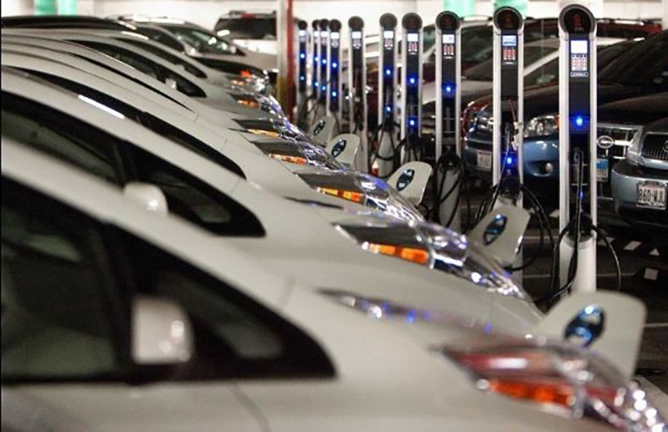
Battery Electric Vehicle Program: Current State
Vehicles
15 Each, Chevy Bolts
25 Each, Nissan Leafs
Electric Vehicle Charging Infrastructure
6 each, Chargers at City Hall Annex
3 each, Chargers at 611 Walker
1 each, Charger at 2805 McKinney

Slide 3

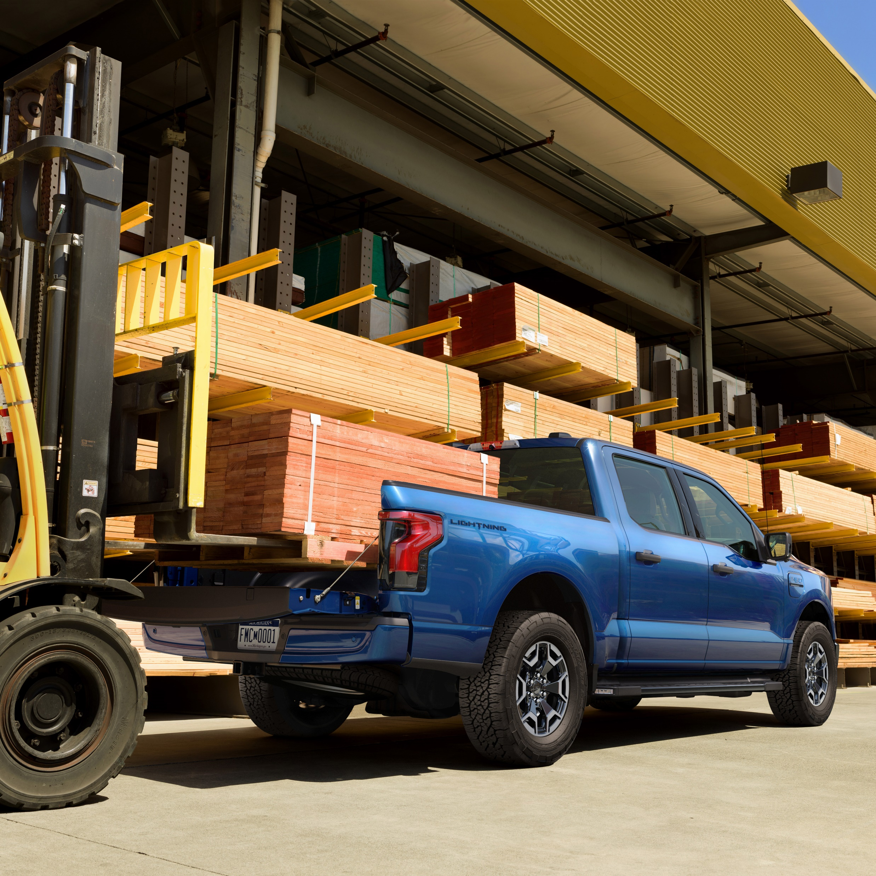
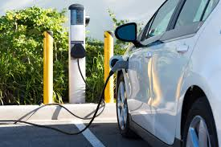
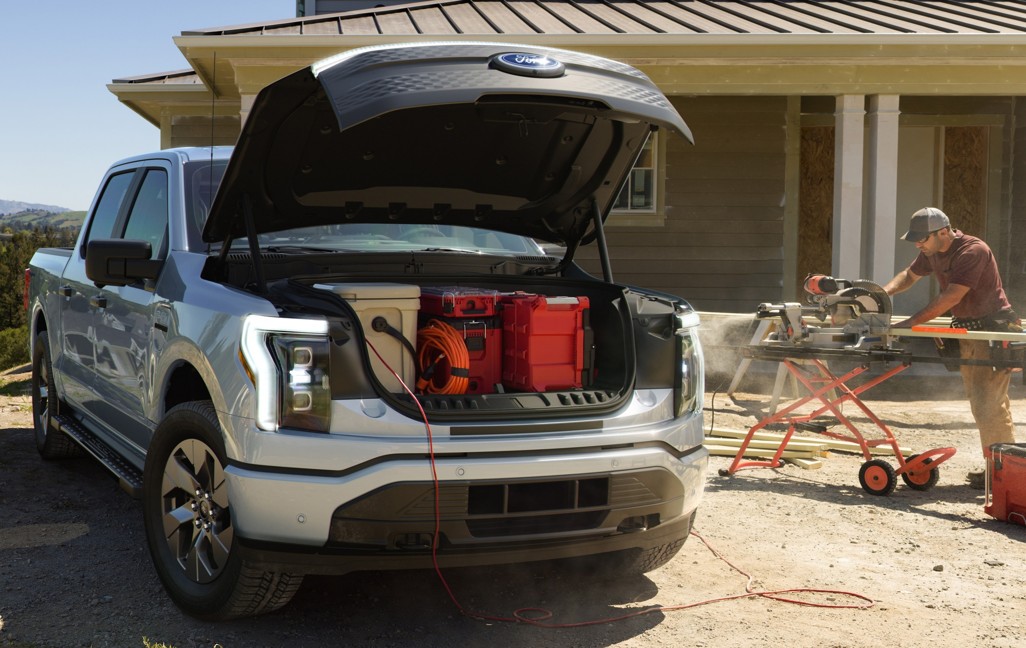
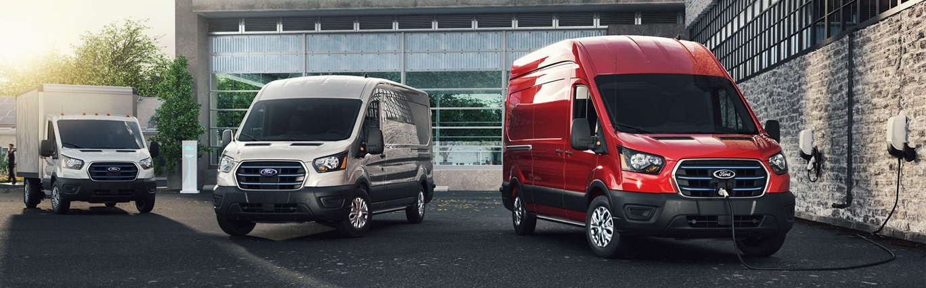
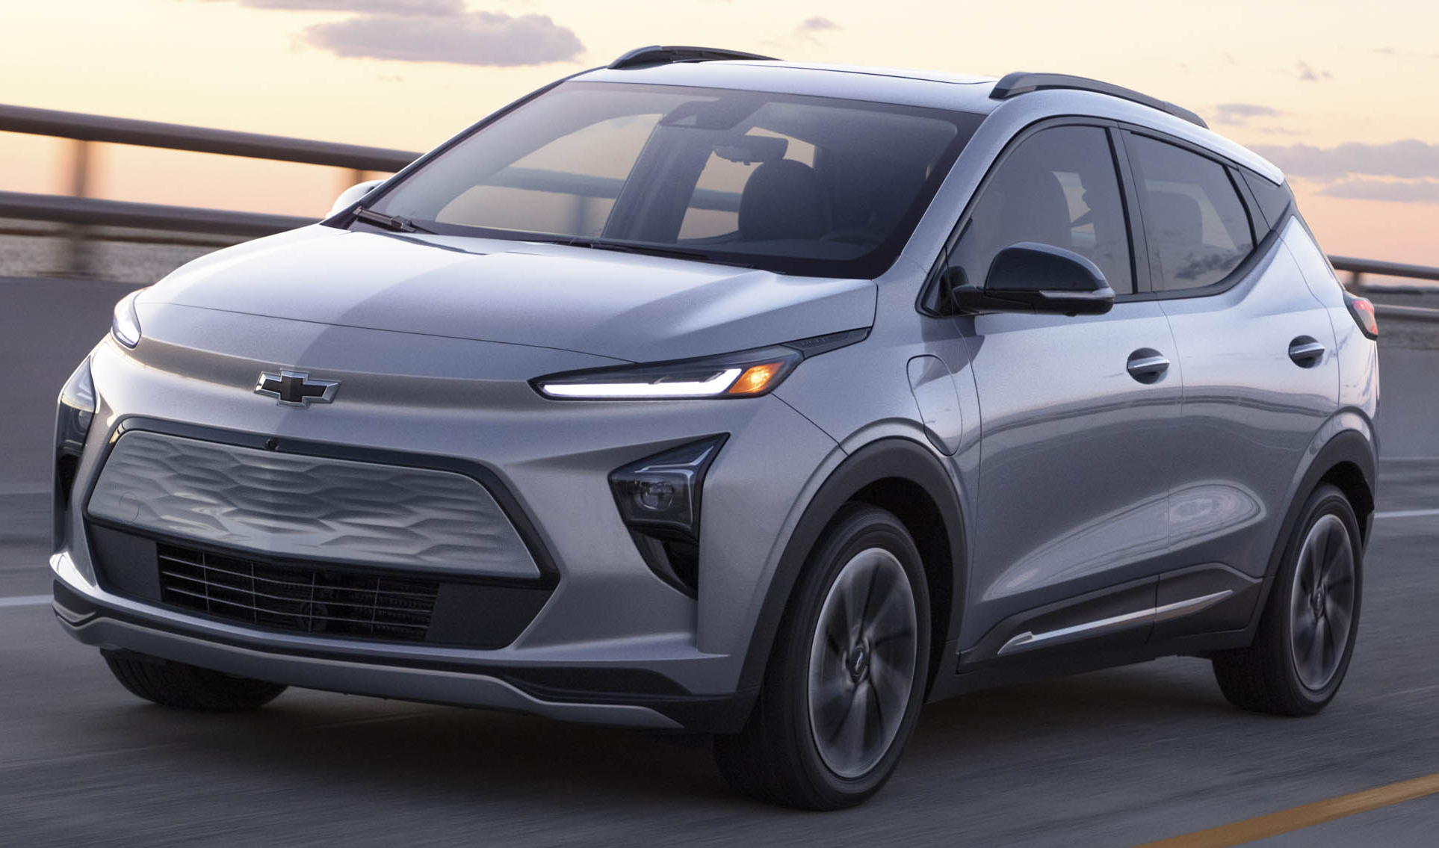
Battery Electric Vehicle Program: Light-Duty Vehicles
PROPOSED PROJECT
Goal: Purchase 100 each, EVs in FY22
EV Model | MSRP | Range (miles)
Ford F-150 Lightening | $39,974 | 230
Ford E-Transit | $43,295 | 126
Chevrolet Bolt | $31,000 | 259
Nissan Leaf | $31,670 | 149
PROJECT STATUS
Complete
Research vehicle specifications
EV Report (Evolve)
100 EVs reserved with Ford
Underway/Pending
Discussions with depts.
Discussions with vehicle manufacturers/dealers
Allocation of funding to Council in August
Solicitation
Auto technician training

Slide 4
Battery Electric Vehicle Program: Light-Duty Vehicles
FY22 EV Purchases - Confirmed
FY22 EV Purchases – Under Discussion
Departments
HFD
HPD
SWD
HPW
GSD
FMD (Fleetshare)
Departments
ARA
DON
HPRD
HHD

Slide 5
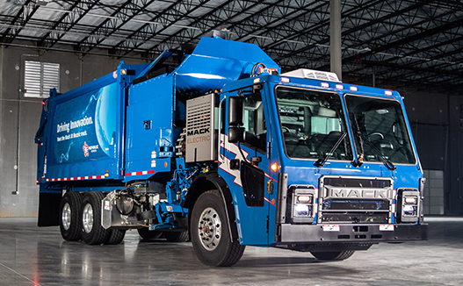
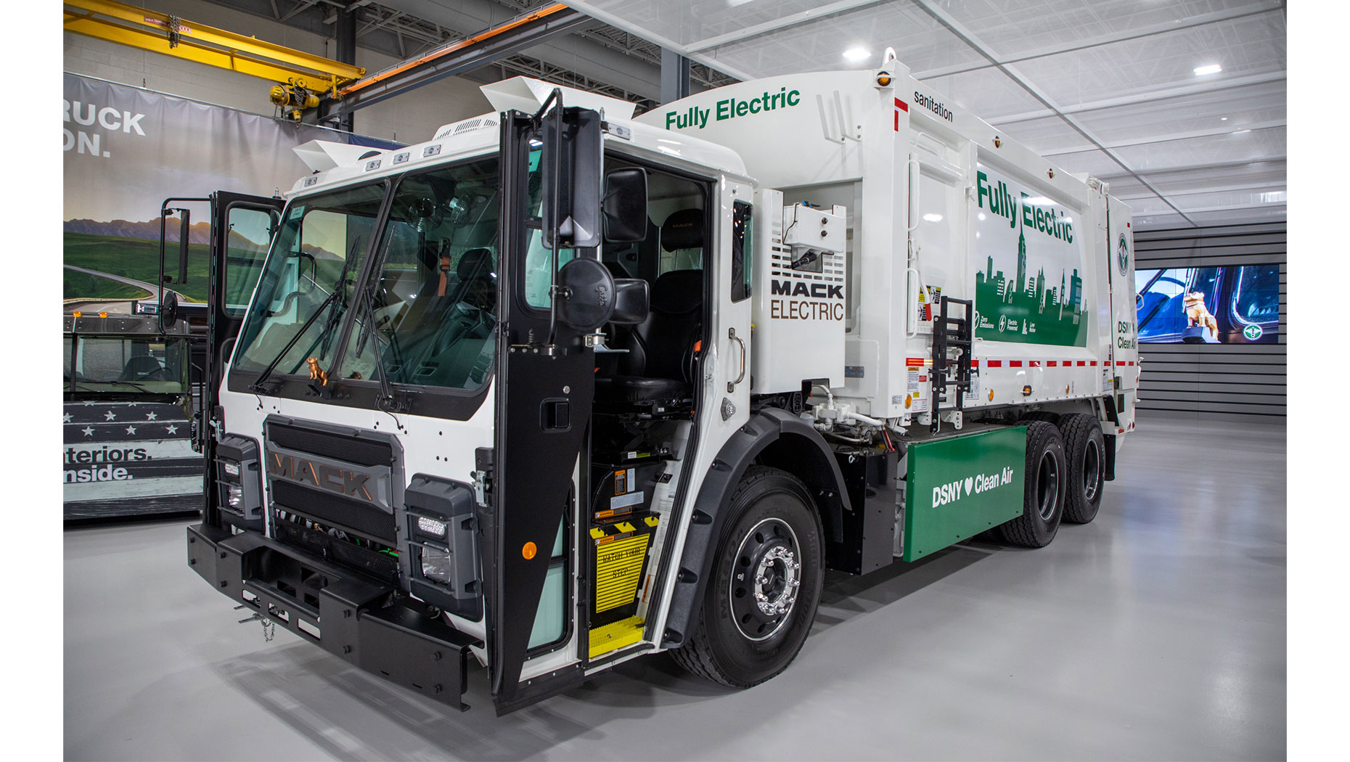
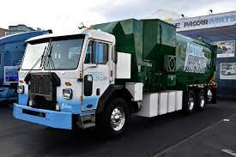
Battery Electric Vehicle Program: Refuse Truck Pilot
PILOT PROJECT
1 Each, Rear-loader, Downtown Operation
Truck to be based at NE Service Center
VEHICLE DETAILS
Two chassis manufacturers: Mack & Peterbilt
Range: 80 to 120 miles
Cost: $600,000/truck
PROJECT STATUS
Complete
Research & specifications for trucks & recharging infrastructure
Underway/Pending
Allocation of funding for Council consideration in August
Installation of recharging infrastructure
Procurement of truck – Delivery expected Spring 2022

Slide 6
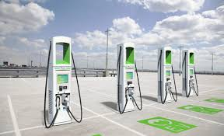
Battery Electric Vehicle Program: Charging Infrastructure
PROJECT STATUS
Complete
Contract awarded for replacement of 42 chargers (Phase 1).
Specifications complete for retrofit of facilities with recharging infrastructure (Phase 2 & beyond).
Charger installation locations identified (Phase 2).
Underway/Pending
Replacement of 42 chargers (Phase 1).
Discussions with departments to prepare Phase 3 package.
Allocation of funding to Council in August (Phase 2 & beyond).
Contracted JOCs to perform facility retrofits (Phase 2 & beyond).
Chargers to be purchased by COH and provided to JOC for installation (Phase 2 & beyond).

Slide 7
Battery Electric Vehicle Program: Charging Infrastructure
Phase 2, EVSE Installations - Confirmed
Phase 3, EVSE Installations - Pending
City Facility | Primary Dept. | Address
Dart | HFD | 1205 Dart
HPD North | HPD | 9455 W. Montgomery
Northeast Service Center | SWD | 5617 Neches
City Hall Annex | GSD/FMD | 900 Bagby
Dalton | GSD/FMD | 2707 Dalton
Berry | GSD | 3026 Berry
City Facility | Primary Dept. | Address
Hermann Park | HPRD | 6001 Fannin
Memorial Park | HPRD | 6501 Memorial Dr
HPARD Headquarters | HPRD | 6200 Wheeler
Note: HPW to install EVSE using Enterprise funding and HPW contractors.

Slide 8
Battery Electric Vehicle Program
QUESTIONS

