Slide 1
Hydrogen in Texas and H2@Scale
Presented by:
Brian Weeks, PE
bweeks@gti.energy
281.235.7993

Slide 2
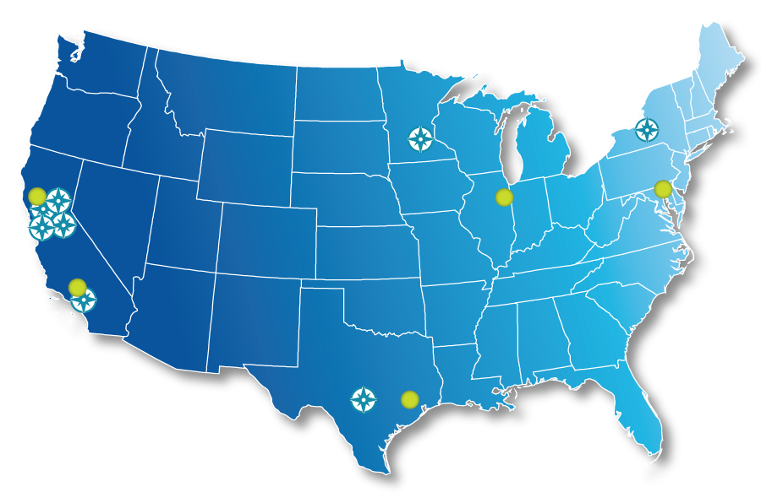
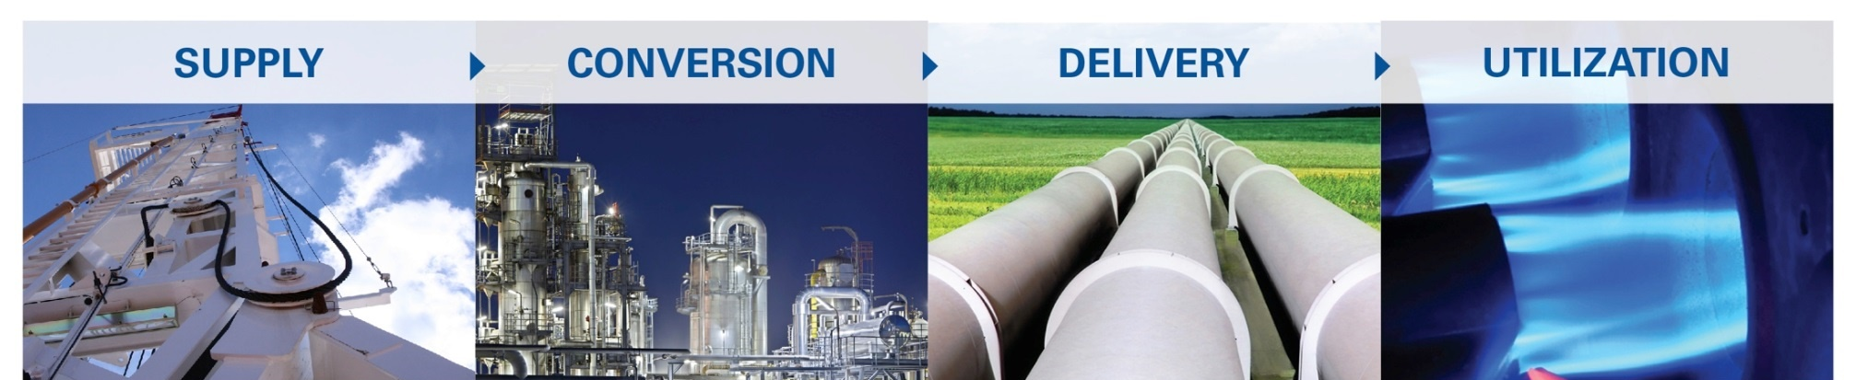
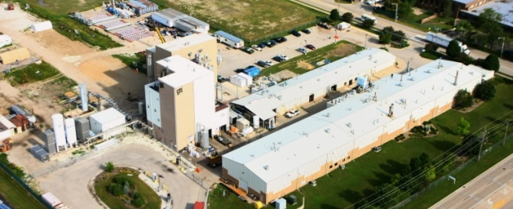
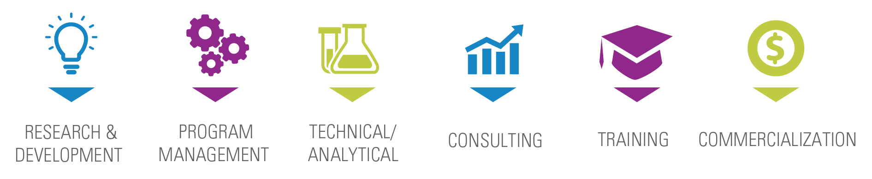


80-year History of Turning Raw Technology into Practical Energy Solutions
FOR A BETTER ECONOMY AND A BETTER ENVIRONMENT
SUPPLY
CONVERSION
DELIVERY
UTILIZATION
World-class piloting facilities headquartered in Chicago area
www.gti.energy
Notes:
Independent, not-for-profit established by the natural gas industry
GTI tackles tough energy challenges turning raw technology into practical solutions
Downhole to the burner tip including energy conversion technologies

Slide 3

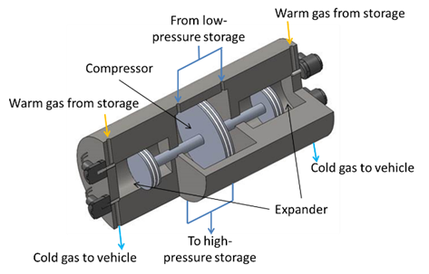
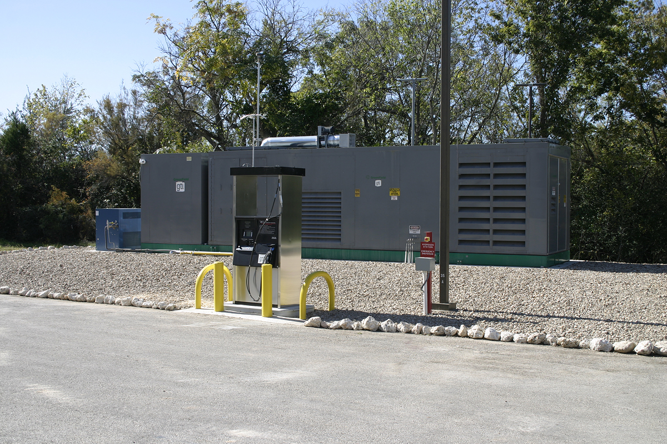



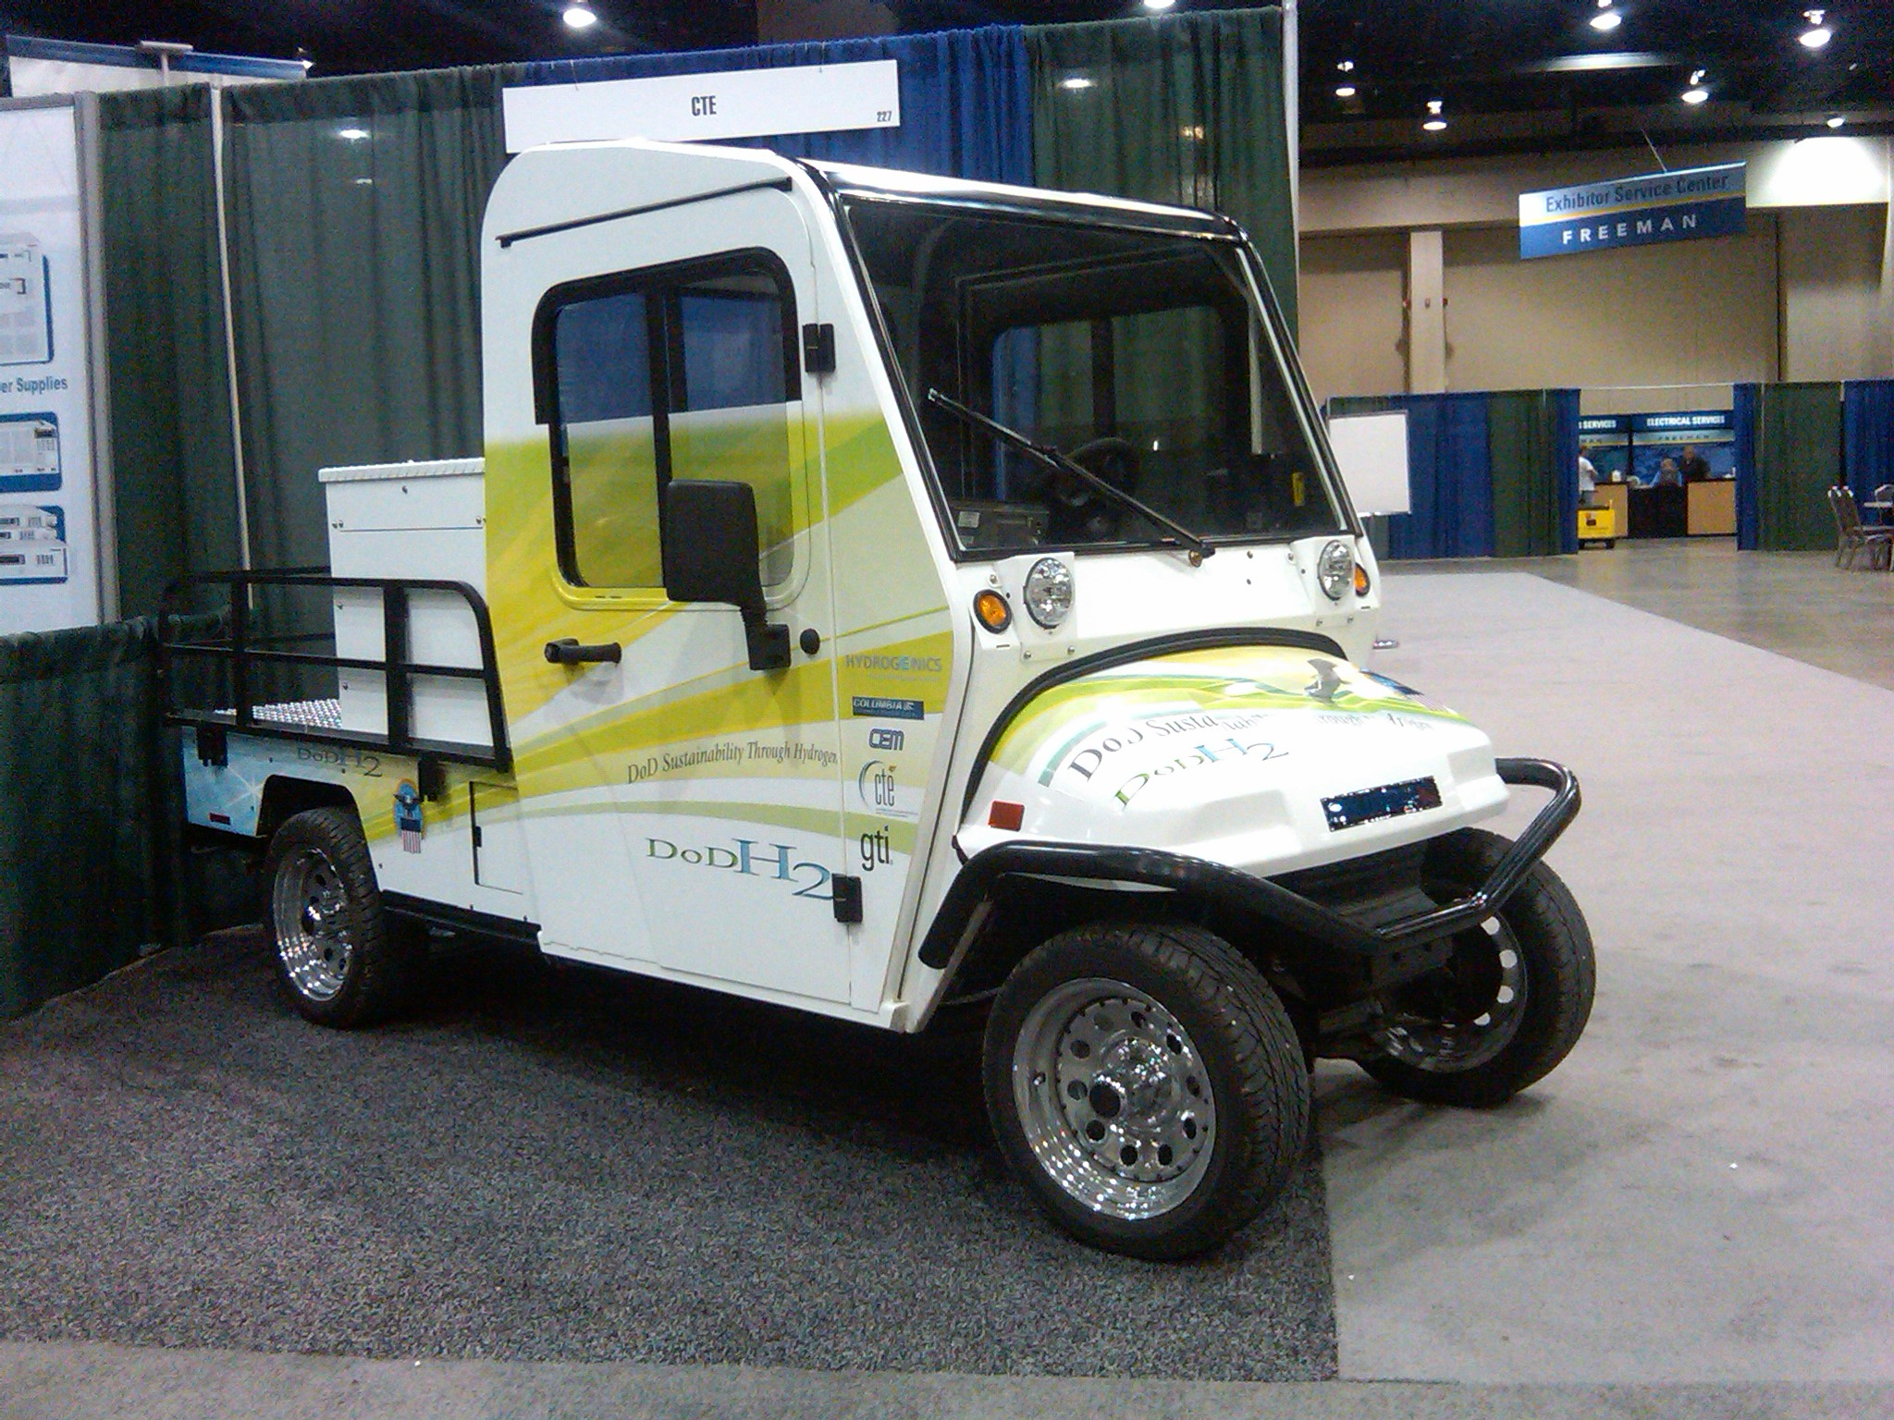



GTI and Hydrogen in Texas
Hydrogen Technology Programs in Texas for 15 Years
H2@Scale Project
15 Texas Industry & Univ Partners
Hydrogen technology demo and techno-economic analysis
8 separate, coordinated hydrogen projects in one.
DOE/Industry-sponsored - $14mm
Hydrogen Fueling Infrastructure
GTI , UT-CEM, Argonne, Quantum
Linear expander for pre-cooling dispensed H2 fuel
DOE-sponsored $3.2mm
Hydrogen Fueling Station
GTI, DOE, TCEQ, UT-CEM, FTA
1st hydrogen fueling station in TX
Multi-vehicles over 8 years of
On-site H2 generation
$3mm+ funding
Integrated Hydrogen & Energy Storage System
GTI, UT, Entergy, Linde, Quanta
Hydrogen for power & storage
Beaumont, TX plant site
NETL/ LCRI funding - $1.3mm
IHESS
Low Carbon Resources Initiative
GTI / EPRI Partnership
Texas Members: CP, COP, Atmos, Sempra, One Gas, etc.
$130mm funding, incl Texas projects and TX hydrogen
Pipeline Integrity Research
Distribution/transmission integrity for H2 blends
Advanced risk models/risk mitigation planning
Testing & materials analysis
CP, Atmos, One Gas, Entergy
$20mm+ annual funding
H2 Utility Vehicle
DOD $3mm funding
GTI / UT-CEM / Par-Car / CTE
Designed by GTI and UT-CEM
Built and tested at JJ Pickle Ctr Test Track
HyBlend
NREL/GTI/Sandia/Argonne, etc.
H2 and natgas pipeline blending
Support TX renewables by providing grid-scale storage
DOE-sponsored - $14mm
Texas partners & Austin site demo
Alternative Transportation Training
GTI, Clean Energy, TX NGVA
Medium/heavy-duty on-road/off-road vehicles & hybridization
Maintenance garage training for CNG, LNG, and H2 HD vehicles
www.altfuelgarage.org
Biomass Gasification
New commercial start-up
Woody biomass to H2 and other fuels
Based in Houston – global projects

Slide 4
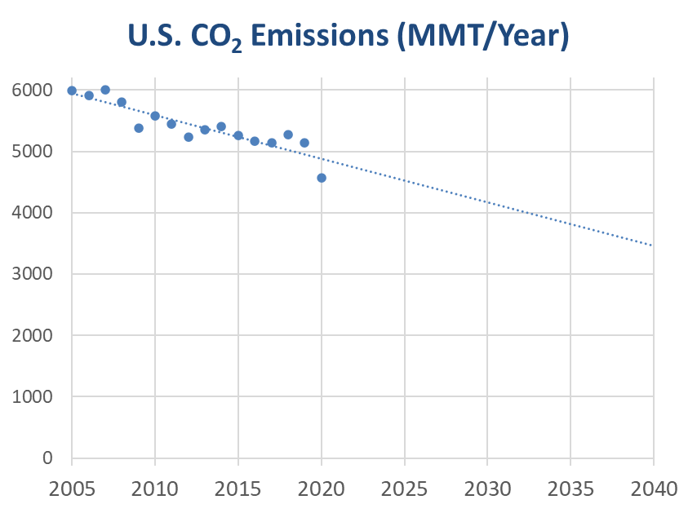
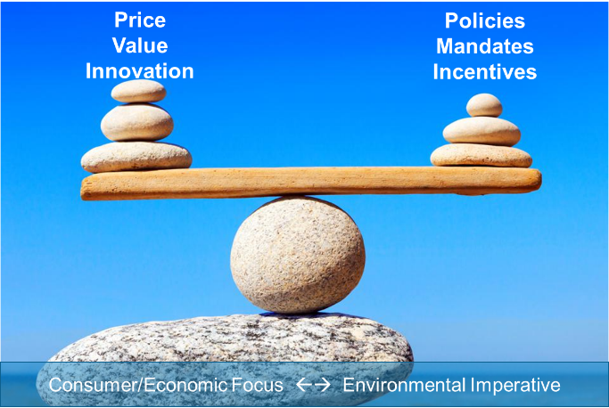
Most CO₂ emission reductions since 2005 due to shale gas cost-effectively displacing coal (and with minimal consumer energy cost impacts).
How do we achieve even greater rates of reduction after “low hanging fruit” is picked? What are the consumer energy cost and energy system implications?
~75-100 MMT/Year
Period of unprecedented U.S. energy transition and CO₂ reductions
End of the line for coal (~870 MMT of “low hanging fruit”)
~200-250 MMT/Year
Pathway calls for “super unprecedented” U.S. energy transition and CO₂ reductions?
DOE-EIA
Notes:
Let’s set the stage for why hydrogen is now the center of attention.
US CO2 emissions have led the world in reductions over the past 15 years. The main reason is the replacement of the coal plant fleet with natural gas fired power generation, along with the addition of renewables such as wind and solar.
We can reduce a similar amount by 2030 by continuing to do the same, however we cannot reach “net zero carbon” by 2050 by doing what we’re doing now. New technologies, along with a better integrated energy network is required for the nation to hit net zero decarbonization goals by 2050.

Slide 5

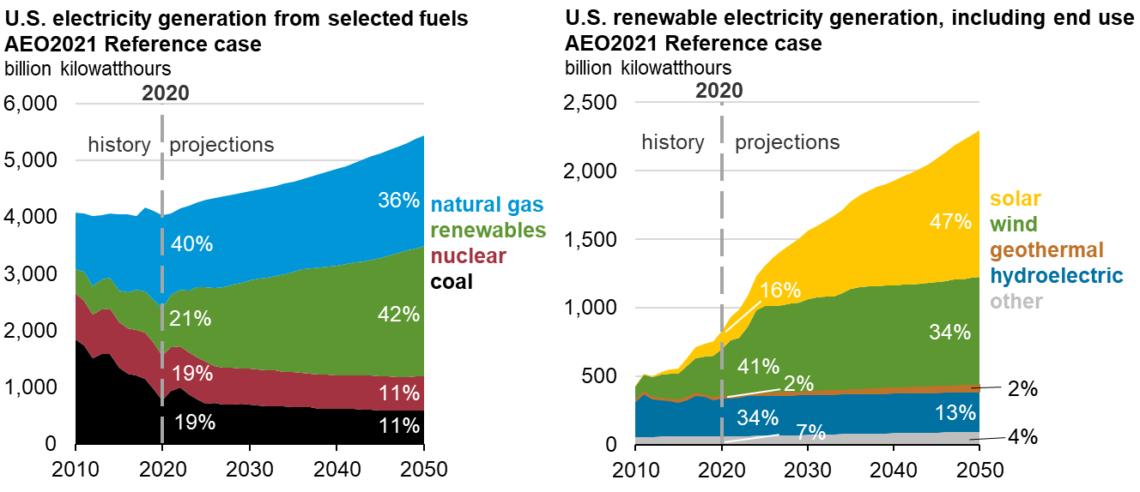
Power Generation Market
Passing The Baton
Coal to Gas + Renewables
Wind to Solar
DOE-EIA (AEO 2020)
Notes:
Wind and solar increasing share of the power generation mix
Not dispatchable – which means, we need energy storage for this growth to continue

Slide 6
Increased Wind Curtailment is a growing Concern
2017 – 2020 Actual Wind Curtailment MWh
Wind curtailments in ERCOT have almost doubled in the past 4 years
Source: Electric Reliability Council of Texas
Notes:
Back to the need for energy storage…
Texas has the largest wind generation fleet of any state in the country. It’s also unique in that it operates its own grid that is separate from the other two large grid interconnects in the country. Consequently, the issue of non-dispatchability of renewable energy has become a growing problem, compounded by the fact that wind resources are on the opposite side of the state from the large population centers.

Slide 7
The Concerns of the Power Industry Today
The Climate Objective of the US Power Industry is to Reach Zero Carbon Output
Eventually…….
The Reality is that the Electric Industry Need to Satisfy this ENTIRE Triangle

Slide 8
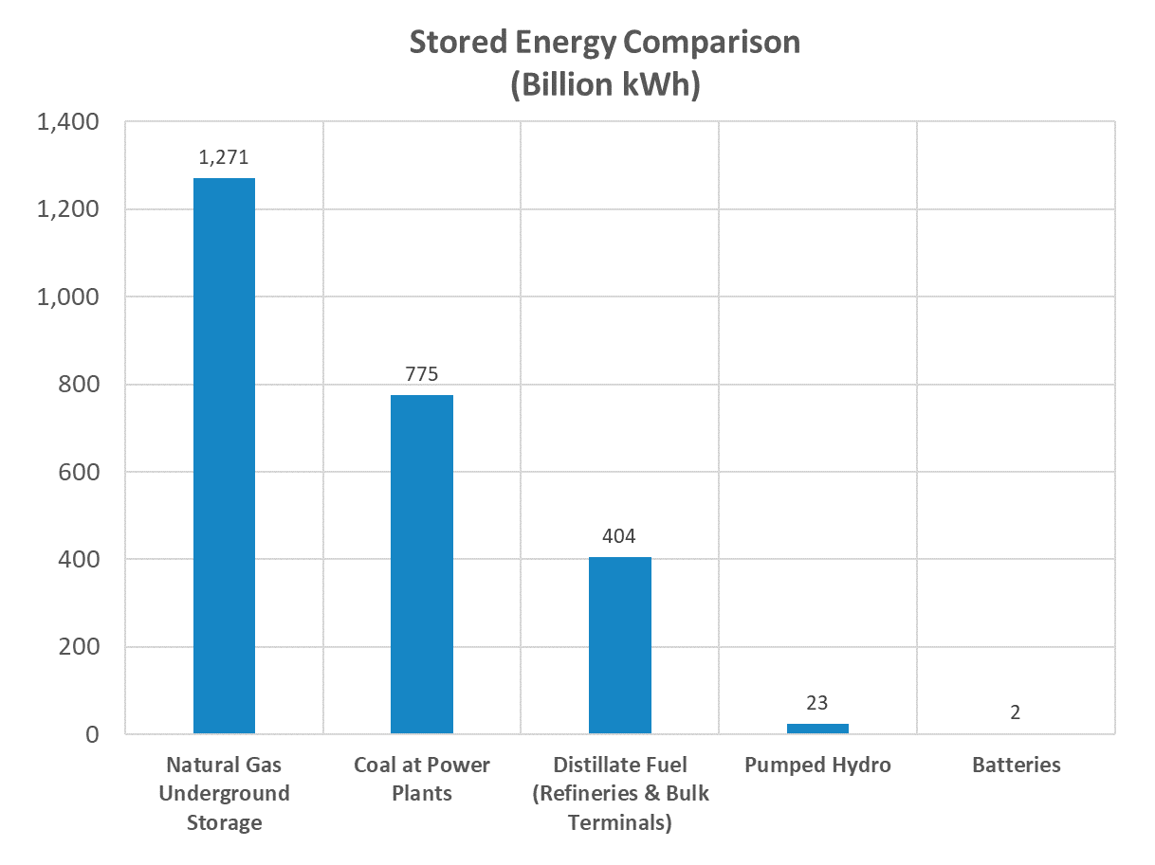
Energy Storage Options – U.S. Capacities
Many energy storage options currently used in today’s energy market
Different forms suited for different uses
  Electricity
  Chemical energy carriers
Other Distributed Energy Storage
  LNG Plants
  CAES
  Flywheel
Source: DOE-EIA
Notes:
Many energy storage options are currently used in today’s energy market including underground natural gas storage, pumped hydro storage, electrical energy storage in batteries, liquefied natural gas (LNG), propane-air peak shaving, and compressed air energy storage to name a few. Additionally, these could be expanded to include a broader range of distributed fuel storage facilities including other liquid fuels (e.g., distillate fuel oil) or solid fuels (e.g., coal). To illustrate, Figure 1 shows examples of selected stored energy capacities in the U.S. (noting that each of these forms of energy are different, particularly electricity compared with chemical energy carriers). Comprehensively, these all comprise forms of distributed energy systems that store energy for ultimate use in serving energy markets applications.

Slide 9






“Green Hydrogen”, a.k.a. Power-to-Gas
Hydrogen
Blending
System
Electrolyzer
Natural Gas Pipeline
Notes:
Adding hydrogen to natural gas can reduce greenhouse gas emissions from gas use. More significant life cycle benefits can be recognized if the hydrogen is produced from low‐carbon energy sources such as biomass, solar, wind, nuclear, or fossil resources with carbon capture and storage (CCS).
Higher concentrations of hydrogen should increase the emissions benefit of blended hydrogen and reduce carbon footprint, however there are limits to the amount of hydrogen that the existing infrastructure can handle and part of our challenge is to determine those limits while balancing environmental goals with pipeline integrity and customer service.
Some pipeline operators also view hydrogen storage and transport as revenue opportunities for low/zero carbon fuel transport and storage.

Slide 10
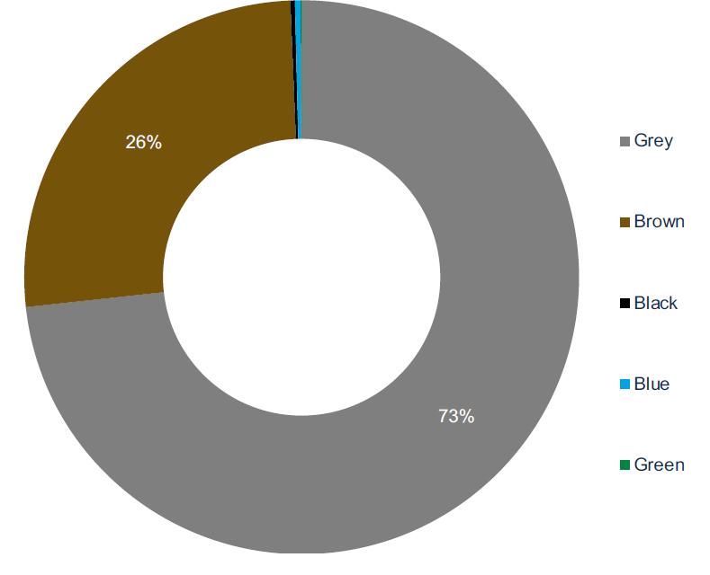
Over 98% of today’s H₂ demand is met by hydrocarbon-based fuels
Natural Gas w/o CCS
Coal w/o CCS
>830 MT CO₂
Oil Products w/o CCS
Natural Gas w/ CCS
Electrolysis
Source: WoodMac

Slide 11





Whether “Green” or “Blue”, Large Scale Hydrogen Supplies Require Increased Market Demand
Building
Heating & Onsite Distributed Power Generation
Industry
Chemicals, Iron& Steel, Refining, Onsite Heat
Power
Energy storage, power integration
Transport
Trucks, Passenger vehicles, Ships, Planes
Highest Value Market per/kg

Slide 12
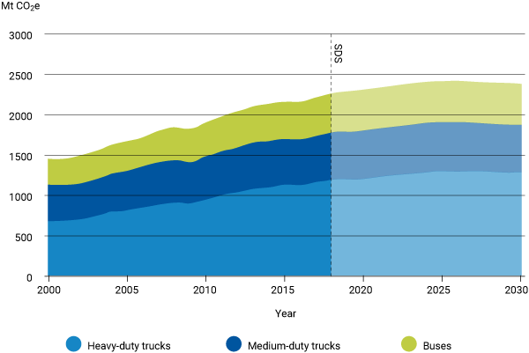
Why Focus on Heavy Duty Vehicles
CO2 Emissions from Heavy-Duty Vehicles in the Sustainable Development Scenario, 2000-2030
Source: IEA
Commercial, heavy-duty transport remains challenging to decarbonize cost effectively.
HD Vehicles Transport 80% of Goods in the US
HD Vehicles represent 4% of vehicle traffic but consume 20% of fuel
Routes and fuel logistics are predictable.
Notes:
FUELS: GROWING EMISSIONS PROFILE OF THE HD TRANSPORT SECTOR
We know that light-duty transportation emissions will continue to grow in developing countries.
We also expect continued demand for heavy-duty transport worldwide—and with it, the challenge of how to decarbonize cost effectively.
As this chart shows, we anticipate on-road, heavy-duty transport to continue to be a significant source of greenhouse gas emissions. While there are an array of heavy-duty transport like rail, marine, or aviation, this chart focuses on on-road emissions.
To achieve our dual imperatives of providing energy to power growing economies and decarbonizing economy-wide, we will have to bring online new energy solutions at scale that meet or exceed criteria we currently rely on for fuels.

Slide 13
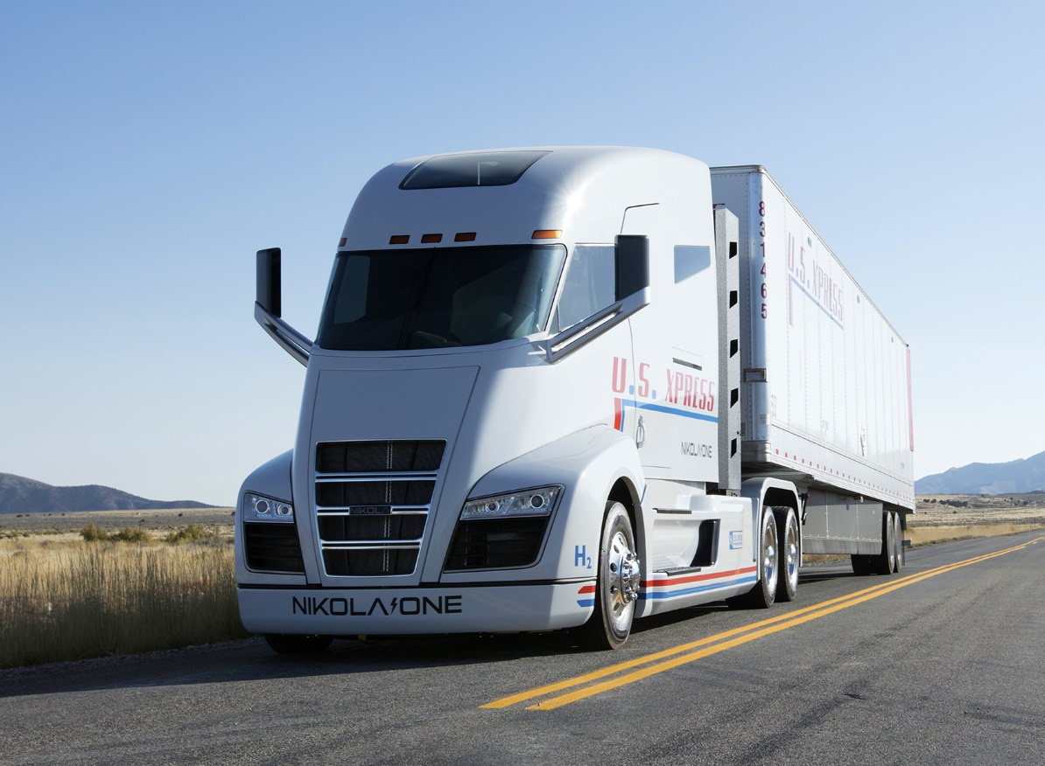
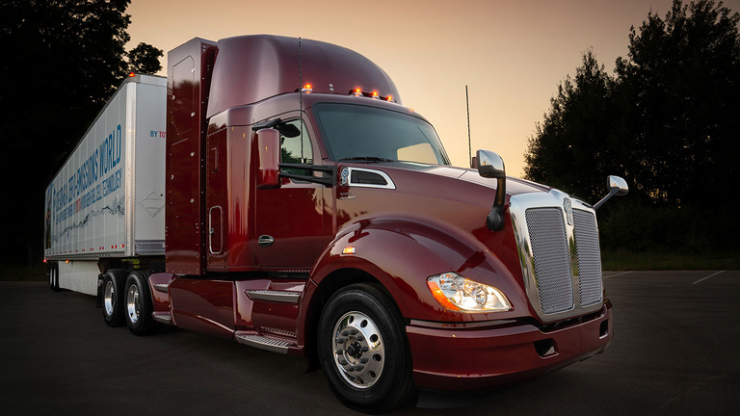
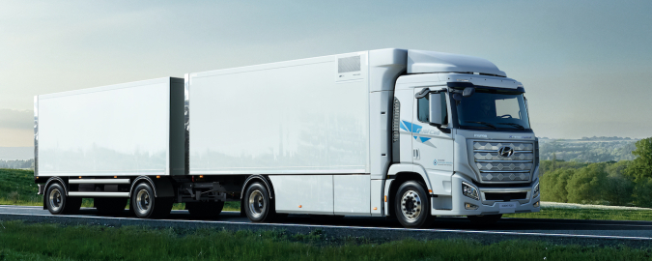
Hydrogen in Heavy-Duty
Toyota with Freightliner
Cummins invested in 2 fuel cell companies
Hyundai
Nikola
Notes:
Growing sector – industry focus for R&D. Hyundai delivering 10 to Europe – first mass produced HD FCEV

Slide 14
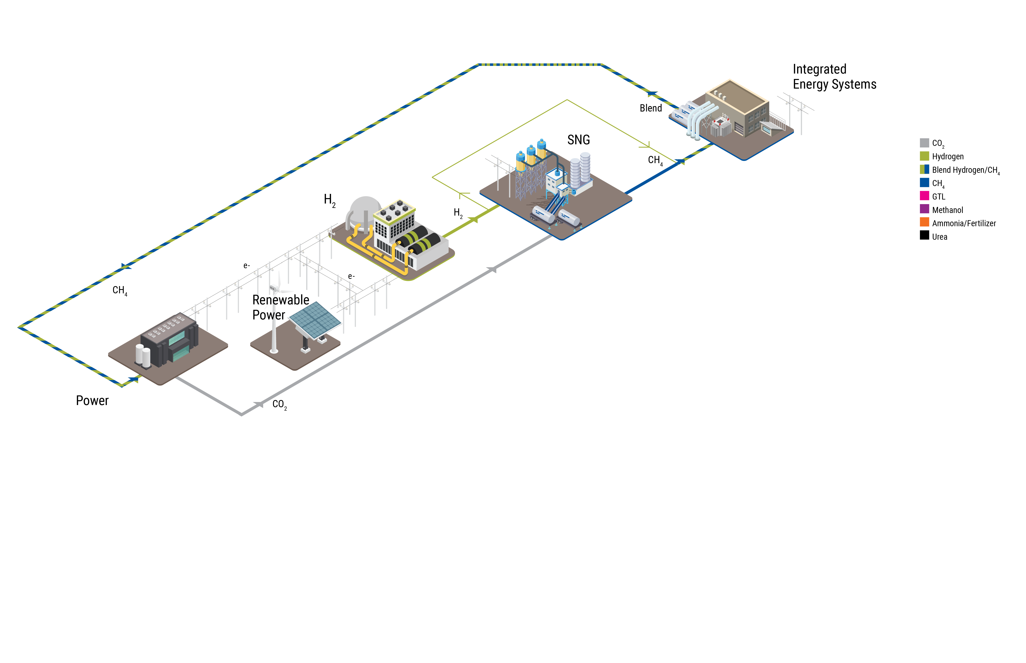
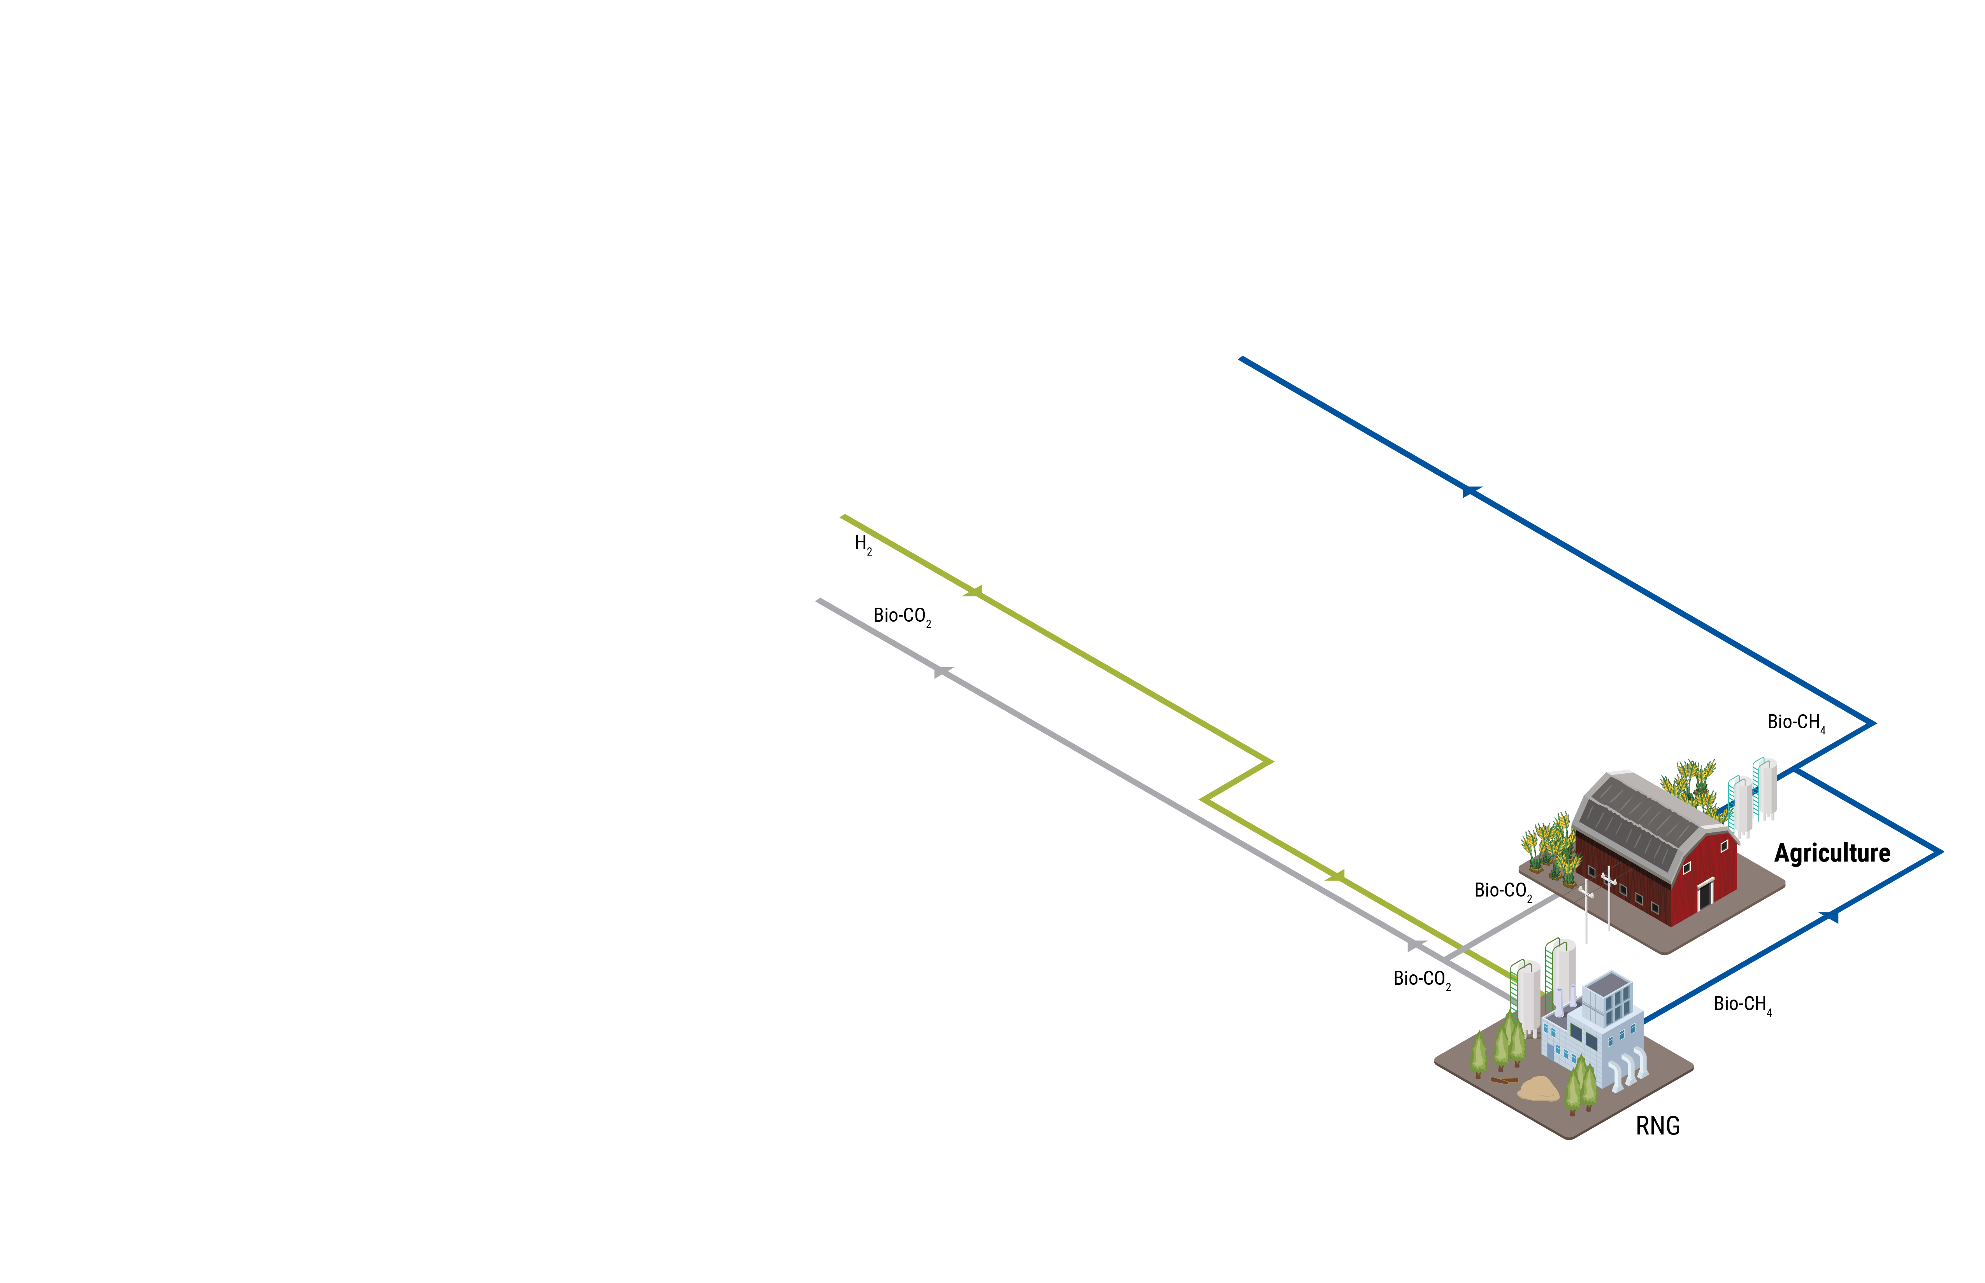
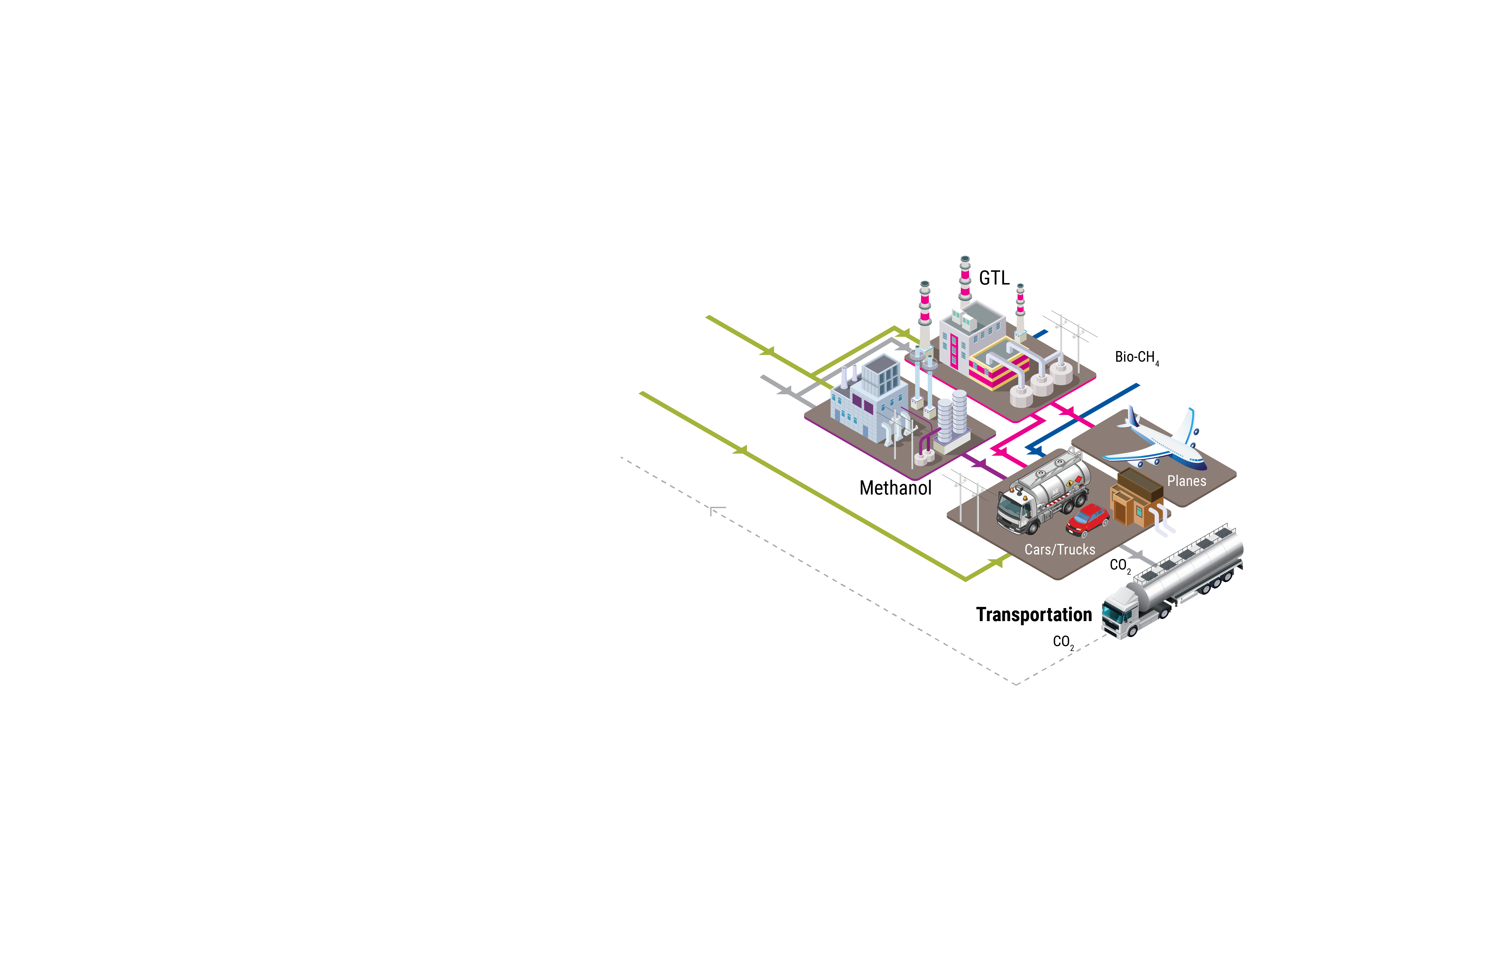

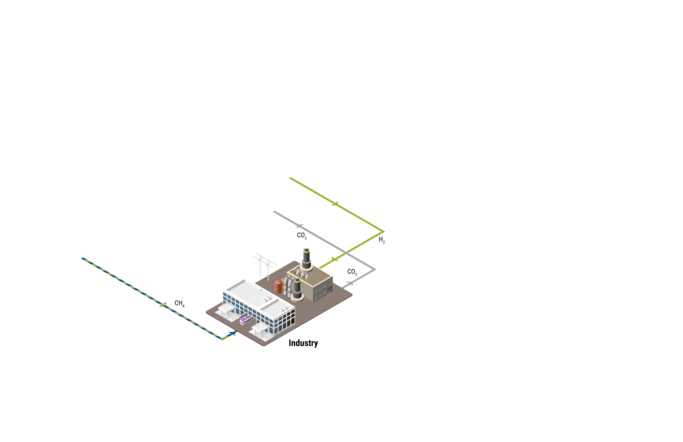
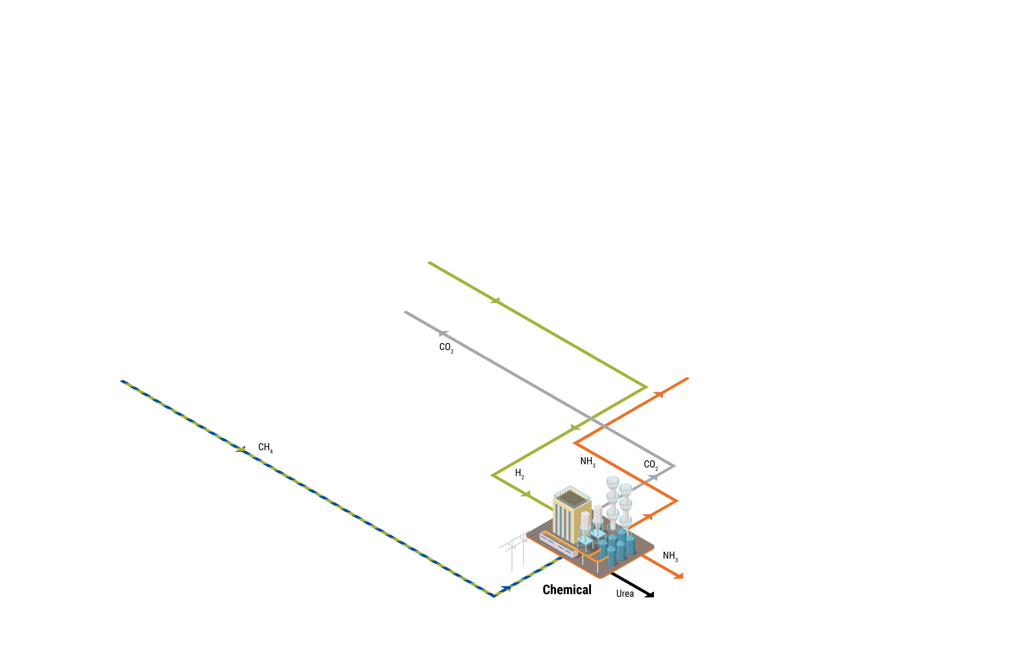
Transportation Sector – Part of an Integrated Energy System
  Centralized & Distributed Hydrogen Generation
  Hydrogen fueling system
  NG delivery & CNG fueling
  Biofuels – drop-in liquid fuel
  EV Fueling
  CCUS
  GTL/Ammonia
Notes:
Hydrogen is a link between renewables and existing infrastructure.
A new, integrated energy system should heavily leverage existing infrastructure, including natural gas infrastructure.
The existing natural gas infrastructure will be an important tool in the energy transition toward decarbonization.

Slide 15
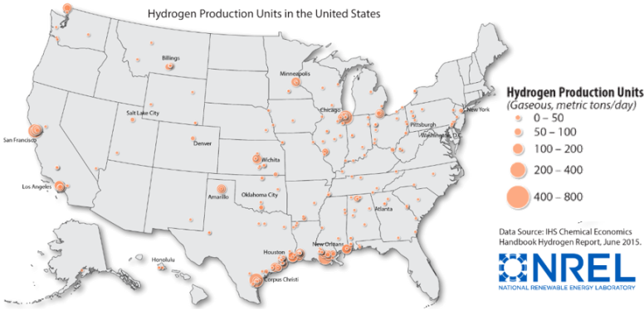
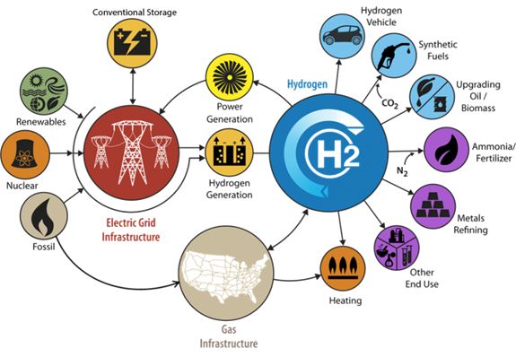
H2@Scale relevant for Texas
Texas ideal to lead H₂ production for a sustainable energy system
Excellent resources of natural gas, solar and wind for RH₂
Largest H₂ producer in the nation
Major industry leaders on Hydrogen Council have significant presence in Texas

Slide 16
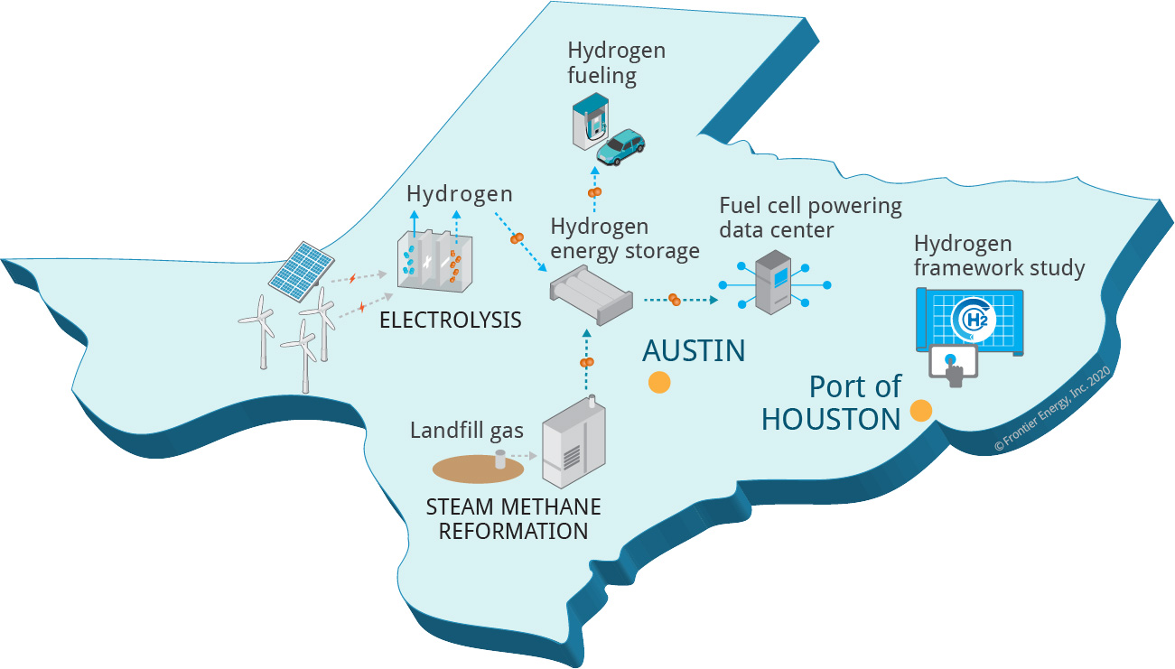
Approach
Show H2@Scale benefits
Demonstrate multiple RH₂ generation options, co-located with vehicle fueling and a large base load consumer to enable cost-effective H₂ energy solutions
Develop framework for actionable H2@Scale pilot plans in Texas, Port of Houston and Gulf Coast region, including energy storage

Slide 17
Demonstration activities at UT (track 1)
~100% renewable H₂ generation
  Two small-scale, on-site SMR’s (GTI and OneH2)
  Two on-site small scale PEM electrolyzers using power from Wind (virtual deliveries) and solar (adjoining solar facility at project site)
Large scale, industry H₂ user
  PowerCell fuel cell powering Texas Advanced Computing Center
Vehicle refueling
  Published SAE J2601-4 fueling of 7-10 Toyota Mirai’s with 700 Bar and 350 Bar fueling on-site
  Fuel cell Drones included

Slide 18
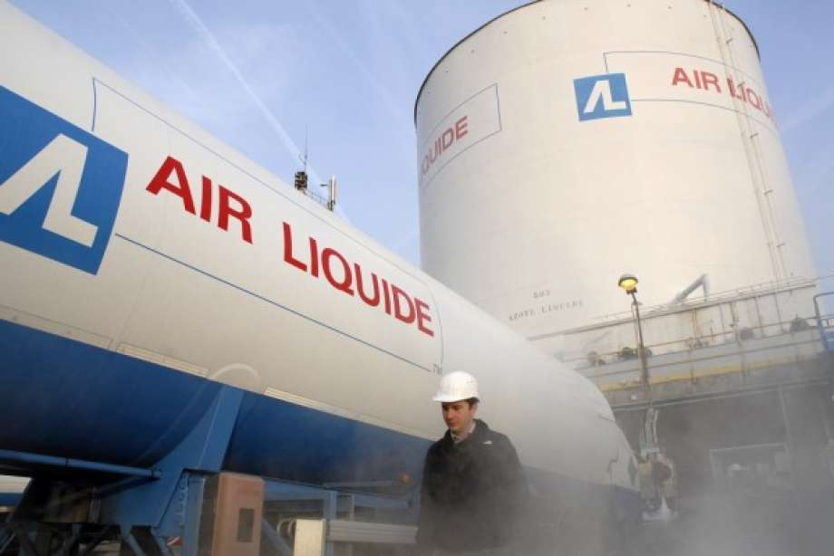
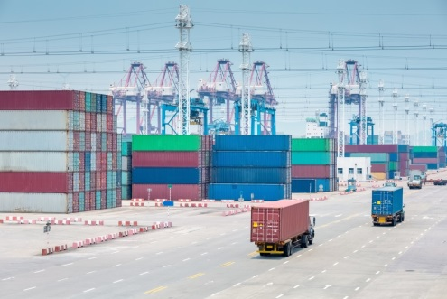
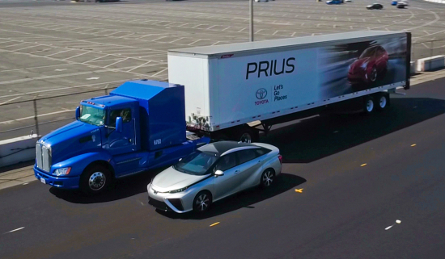
Port of Houston H₂ Framework (track 2)
Identify policy and regulatory barriers
Define use and implementation plans leveraging existing industry resources
Develop actionable plan for H2@Scale and FCEV rollout in region
  Identify specific “actionable” projects for near-term deployment in or near to Port Houston, e.g.; power generation, fleet operations, hydrogen export, hydrogen generation.

Slide 19
Project Stakeholders
Project Leadership
Sponsors
Co-Leads | Role
Frontier Energy | Prime Applicant / Overall Project coordination
GTI | Site Design/build-out, Planning, Engineering, Safety, Techno-Economic Analysis, Study Co-Lead
University of Texas, Center for ElectroMechanics | Site Host, Demonstration Operations, Modeling / Techno-Economic Analysis, Study Co-Lead
Air Liquide
Chart Industries
Mitsubishi Heavy Industries
OneH2
ONE Gas
ONEOK
Shell
SoCalGas
Toyota
Waste Management Inc.
Content Contributors (not comprehensive)
Port Houston
Rice University / Baker Institute
Center for Houston’s Future
Linde
Air Products
Denbury Resources
ConocoPhillips
LCRI
CenterPoint Energy
McDermott International
U.S. Department of Energy
Texas Commission on Environmental Quality

Slide 20
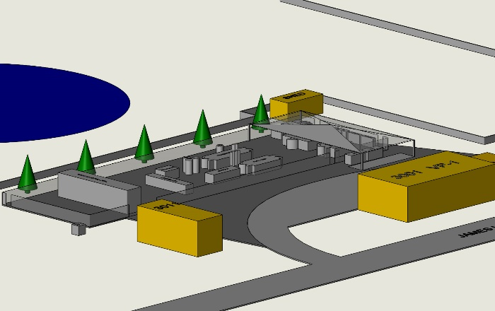
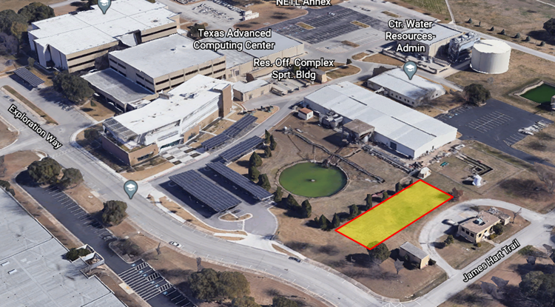
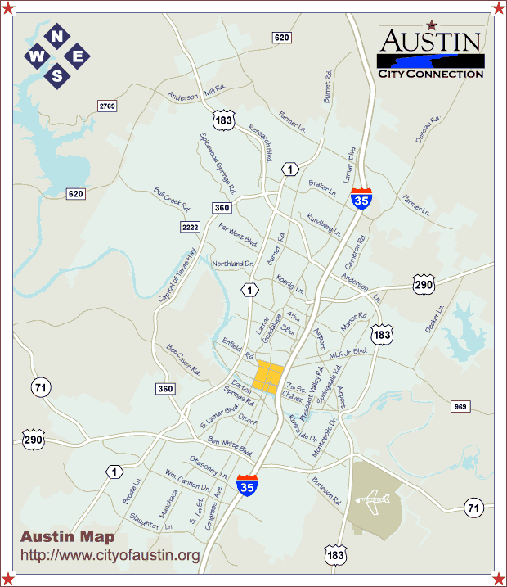
Project demonstration site

Slide 21
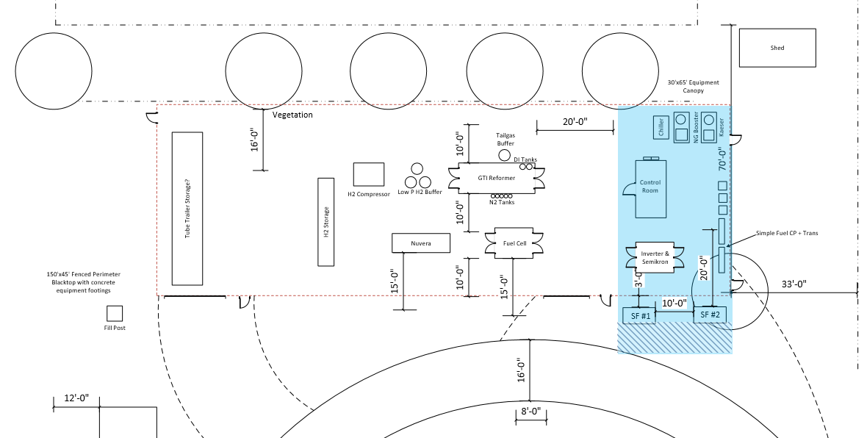
Preliminary site layout
Finalizing utility requirements and locations prior to handing off to UT facilities engineers
Hydrogen Equipment
Hazard zone
Electrical Equipment
Non-hazard zone

Slide 22














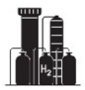



H2@Scale in TX Supplemental Projects
Demonstration and Framework for H2@Scale in Texas and Beyond
Sponsors: Air Liquide, CenterPoint, Chart, Chevron, ConocoPhillips, Frontier Energy, GTI, LCRI, McDermott, MHIA, ONE Gas, OneH2, ONEOK, Shell, SoCalGas, Toyota, UT Austin, US DOE, Waste Management
Scope: H2@Scale TX – demonstration and strategic roadmap
West Texas Wind Farm Study
Contributors: GTI and UT
Scope: Assess H2 potential at wind farm facility. Use wind farm data for demonstration.
Permian Basin H2 Study
Contributor: UT
Scope: Assess H2 potential and pathways from Permian Basin to Gulf Coast (blue, green, ammonia).
FCEVs in Texas Study
Contributors: GTI, UT, Frontier, Lone Star Clean Fuels Alliance
Scope: Assess use of fuel cell electric vehicles in Austin, TX and necessary hydrogen infrastructure.
Hydrogen Modeling / ESG Study
Contributors: GTI, CHF, Rice
Scope: Mapping social, health, and carbon intensity impacts.
Pipeline Study – NG +H2, CO2
Contributor: GTI
Scope: Assess Texas pipelines suitability for blending H2 with natural gas, as well as CO2.
H2 Liquefaction Study
Contributor: GTI
Scope: Assess H2 liquefaction opportunities in Texas
H2 Drone Fueling Assessment
Contributors: GTI, DMI
Scope: Assess refueling of hydrogen powered drones. Support demonstrations.

Slide 23
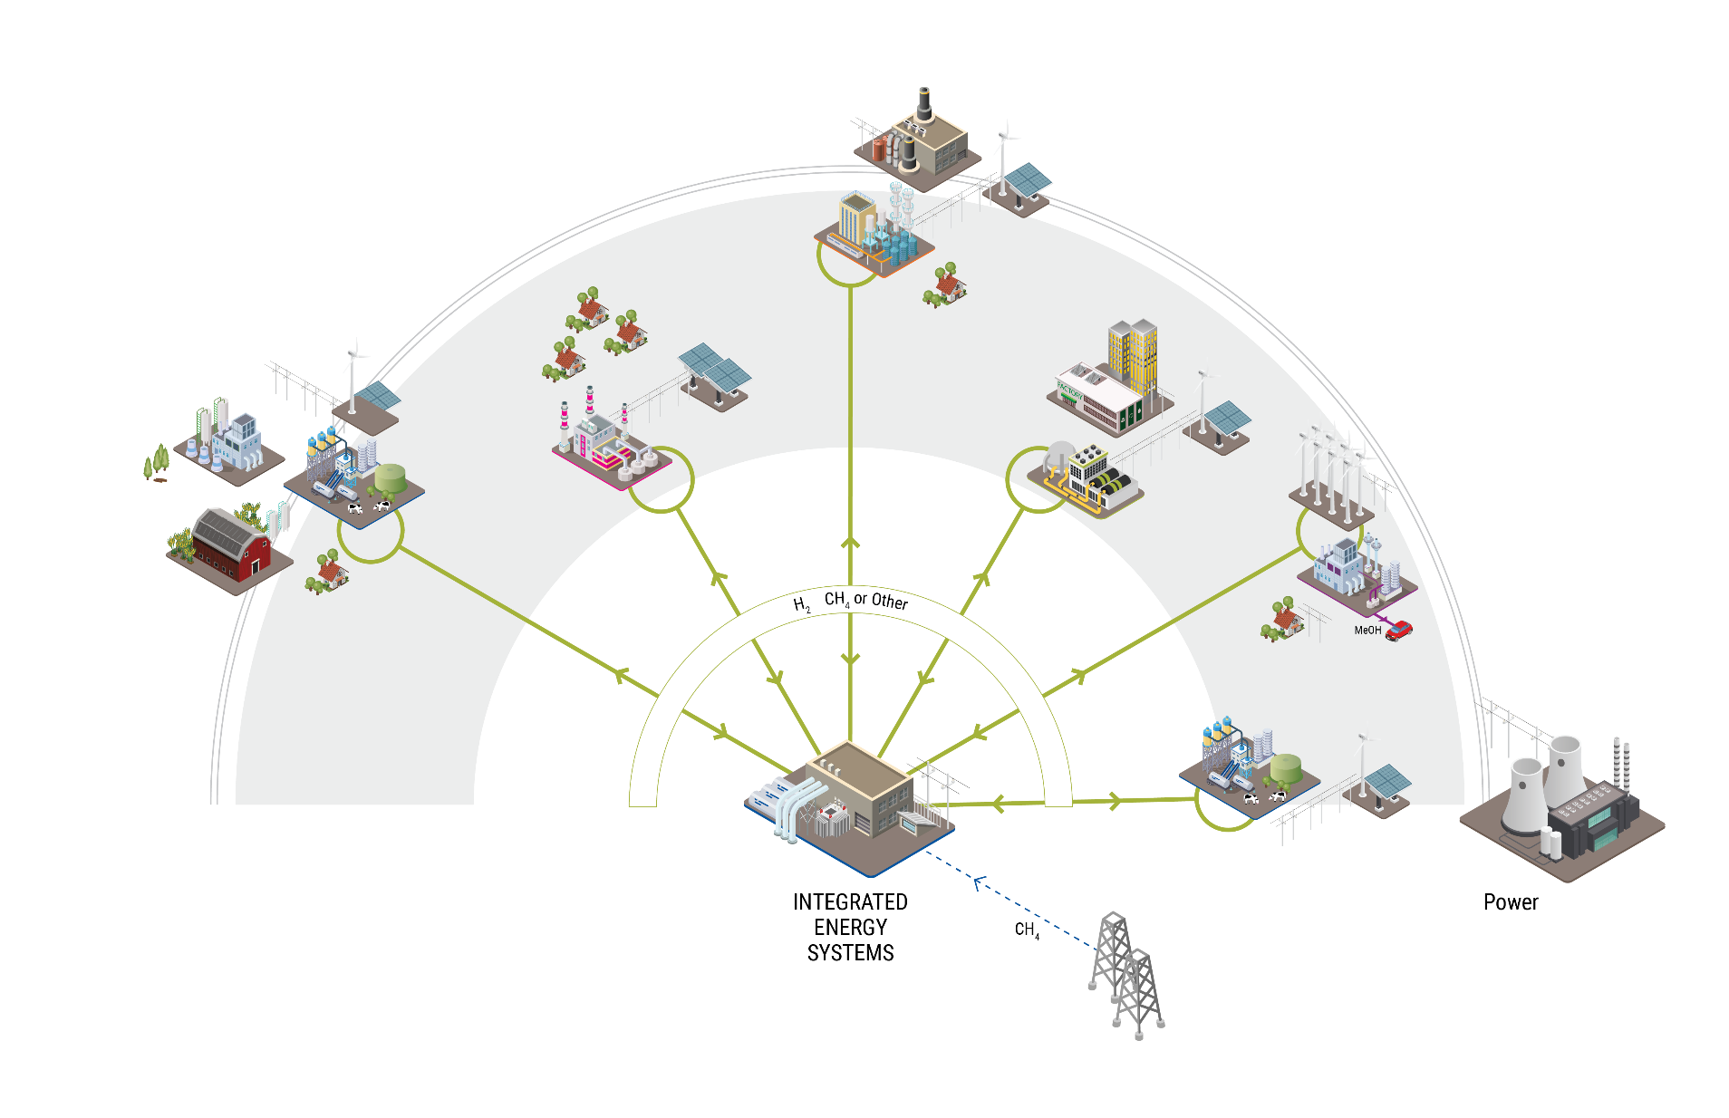
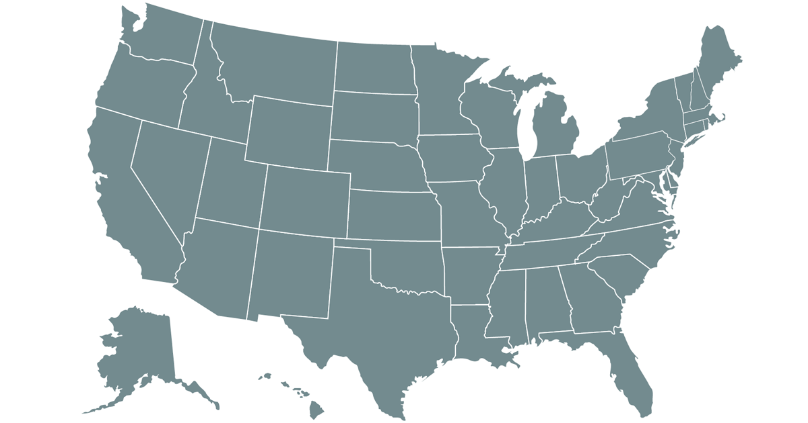
HYDROGEN HUBS
Market Creation
Notes:
hydrogen will be one solution for our path towards net zero but how we enable it will require a different mindset, a different approach that keeps cost, flexibility, reliability, resiliency and in today’s climate the customer top of mind.
The concept of establishing hydrogen hubs is critical to advancing a hydrogen economy at a pace needed to meet aggressive decarbonization goals as well as to be economically competitive in the global arena. Creating networks where supply and demand are matched regionally or locally while also using infrastructure assets to foster a hydrogen market is being explored and developed. The scenarios and use cases may differ depending on regional differences and specific energy needs. And Energy decisions are being made on a local level so we must provide optionality and scalability in our solutions.
Through a project within DOE’s H2@scale program we will have the opportunity to start shaping a framework around the development of future hydrogen hubs, especially focused around industrial regions.

