Slide 1
Clean Cities Annual Report
March 1, 2022

Slide 2
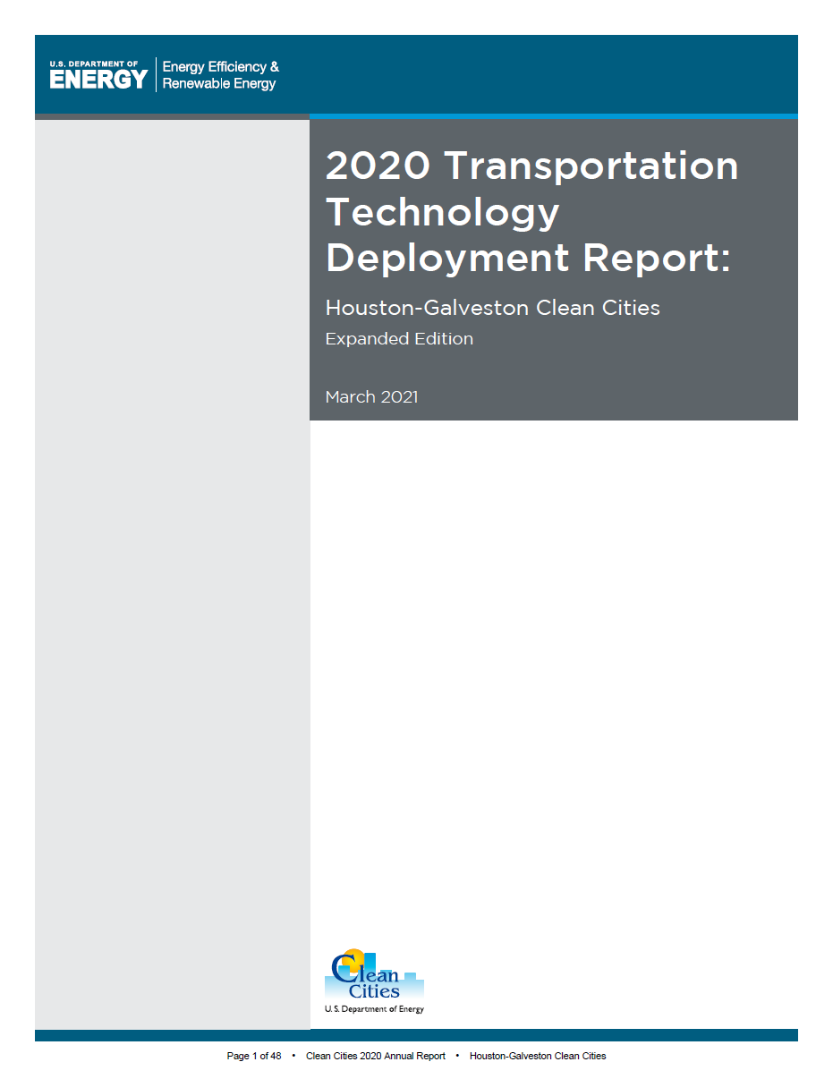
Background
Annual survey of public and private stakeholders from of nearly 100 Clean Cities coalitions
Report submitted annually includes major activities and accomplishments for the previous calendar year
Summarizes the use of and the impacts of alternative fuel use in our region
Provides planning data for the Coalition and H-GAC

Slide 3
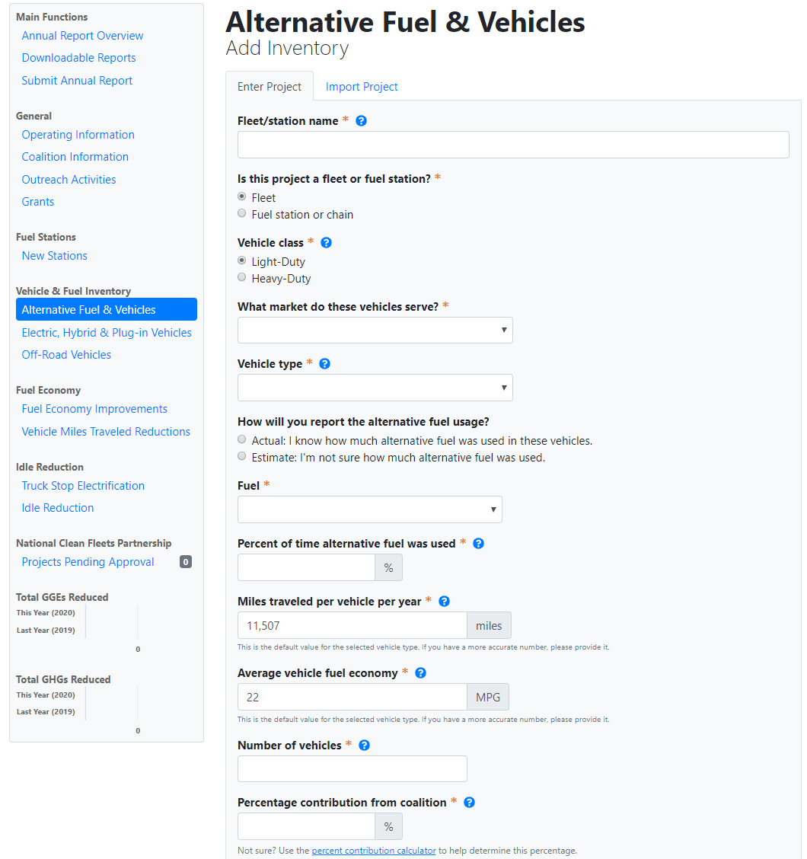
Background

Slide 4
Data Collected
Coalition Specific:
Membership, funding, projects, and activities
Regional Activity:
New and existing alt. fuel stations
New and existing alt. fuel and hybrid vehicle deployments
Sales of alternative fuels
Existing idle-reduction initiatives
Fuel economy, VMT, and idle reduction efforts
NREL and DOE analyze the data and translate into petroleum-use and greenhouse gas reduction for individual regions and for the Clean Cities program as a whole.

Slide 5
2020 at a Glance
Outreach: nearly 3,300 Outreach Activities
Nationally, coordinators spent 135,700 hours on Clean Cities efforts
Coalition funding raised (includes grants): $151M
Energy use impact of Clean Cities programs was over 955 Million GGE / year
AFVs: over 1,000,000 vehicles total
AFV energy use impact: 740 million GGE / year
AFV emissions reductions: 3.09 million tons / year
Notes:
EUI is a metric that measures combined progress in both energy savings from
efficiency projects and increased fuel diversity, through use of domestic alternative fuels.

Slide 6
2020 Houston Results

Slide 7
2020 Houston Results

Slide 8
Current Survey
This year’s survey is open
Collecting information about fuels used and activities that occurred in 2021
Due date for responses: March 15, 2022
houston-cleancities.org/2021-annual-survey/

Slide 9
Next Steps
Nine responses so far this year
Will be reaching out to fleets that participated in recent years
Will work to recruit additional fleets to expand our knowledge
We held an annual survey webinar on February 10
Overview of the survey and its uses
Fill out a sample survey
http://www.houston-cleancities.org/webinars/

Slide 10
Expectations
Questions

Slide 11
2022 Quarterly Meeting Schedule
March 1st 9:30-11am
May 10th 9:30-11am
August 9th 9:30-11am
November 8th 9:30-11am

Slide 12
Thank You!

