Slide 1
Local Government Energy Reporting
Shaun Auckland
Local Governments Program Manager, SPEER

Slide 2
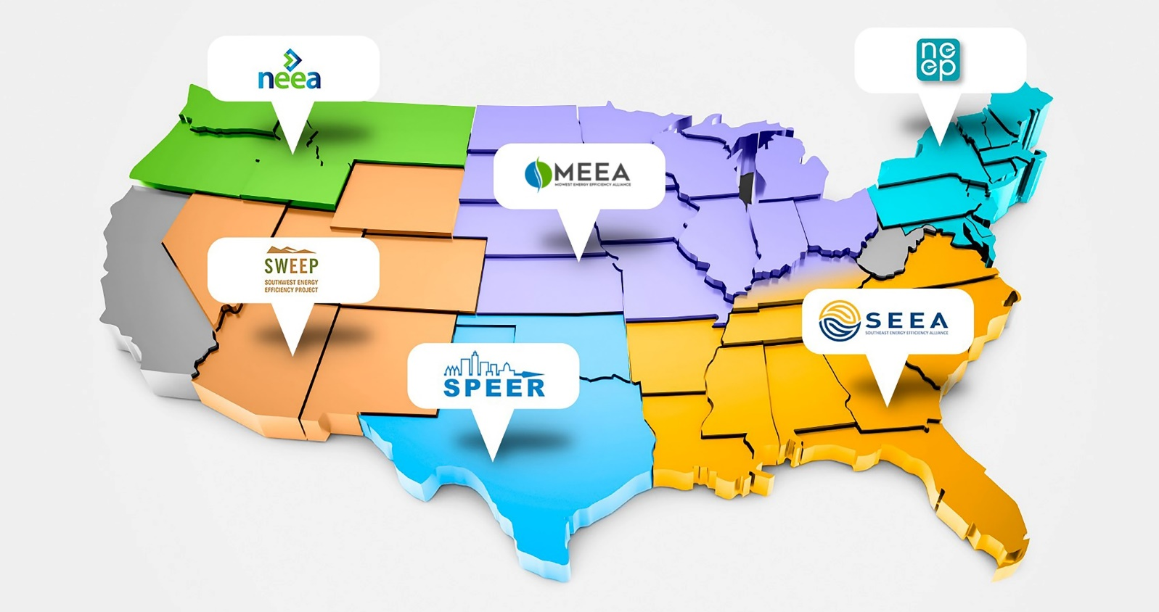
SPEER’s mission is to accelerate the adoption of advanced building systems and energy efficient products and services in the South-central US.
About SPEER:
Our Work
Policy
Building Codes
High Performance Buildings
Local Government
Our Members
Advocacy Orgs
Cities
ESCOs
Manufacturers
Trade Associations
Utilities

Slide 3
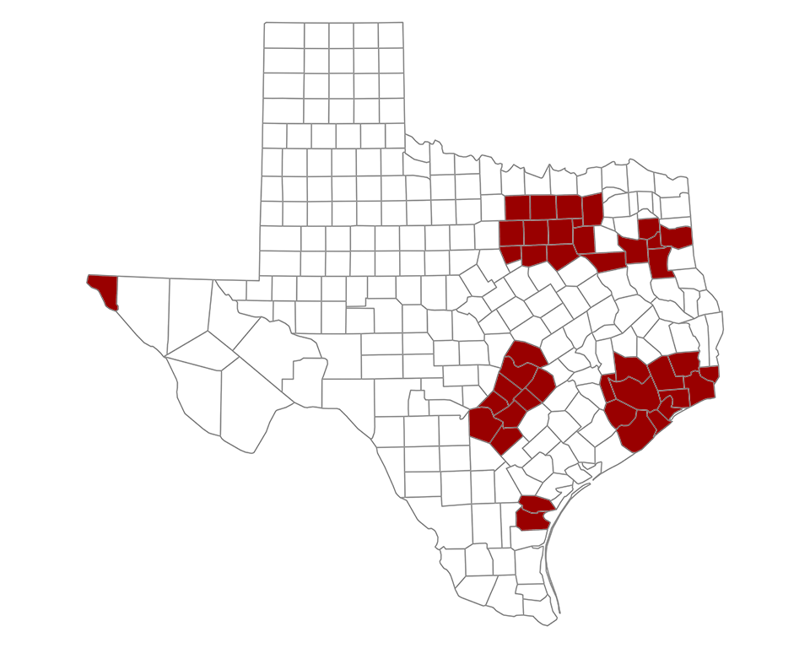
Local Government Energy Reporting
What?
Texas Health and Safety Code §388.005
Who is required to report?
Political subdivisions including cities, counties, water districts, and other local government entities in 41 non-attainment or nearing non-attainment counties in Texas
Requirements
Establish a goal to reduce the entity's electricity consumption by at least 5 percent annually for 10 years, beginning Sept. 1, 2011*
Submit a report annually to the State Energy Conservation Office (SECO) regarding the entity's progress and efforts to meet the 5 percent annual reduction goal
* Extended an additional seven years beginning 9/1/2019
Notes:
The reporting requirements apply to each political subdivision, the institution of higher education, and state agency facility located in the 41 non-attainment areas or affected counties in Texas: Bastrop, Bexar, Brazoria, Caldwell, Chambers, Collin, Comal, Dallas, Denton, El Paso, Ellis, Fort Bend, Galveston, Gregg, Guadalupe, Hardin, Harris, Harrison, Hays, Henderson, Hood, Hunt, Jefferson, Johnson, Kaufman, Liberty, Montgomery, Nueces, Orange, Parker, Rockwall, Rusk, San Patricio, Smith, Tarrant, Travis, Upshur, Waller, Williamson, Wilson and Wise.

Slide 4
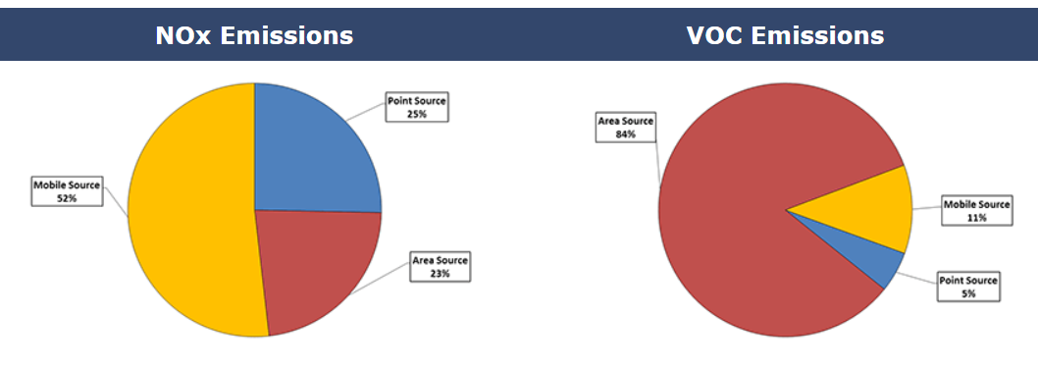
Local Government Energy Reporting
Why?
Originally introduced in the 77th Legislative Session (2001) to reduce air emissions associated with consumption of electricity in counties in non-attainment or nearing non-attainment with the Clean Air Act.
Why Else?
Establishing a energy efficiency goal, collecting and evaluating energy consumption data and benchmarking performance to peers helps public entities identify money saving opportunities.

Slide 5
What is reported?
REQUIRED: Electricity Consumption and Units
Annual electricity consumption in kWh
Buildings
Traffic Lighting
Street Lighting
Water (pump) facilities
Wastewater facilities
TOTAL annual consumption
Units
Building Gross Square Footage
Number of Traffic Lights
Number of Street Lights
Number of Water Customers Served
Number of Waste Water Customers Served
Progress toward goal
Identify specific energy conservation measures or policies implemented and resources utilized
Summarize current and planned progress toward goal

Slide 6
What is reported?
OPTIONAL: Gas and Water Consumption
Natural Gas
Unit of Measure (CCF, BTU, Therms)
Buildings
Water (pump) facilities
Wastewater facilities
TOTAL annual consumption
Water
Buildings
Water Facilities
Wastewater Facilities
TOTAL annual consumption
WHY?
Analysis of consumption of all fuels is necessary to benchmark performance to peers

Slide 7
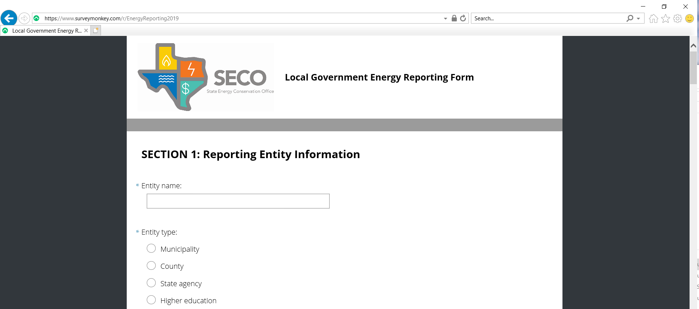
NEW Online Reporting Form!
SECO Local Government Energy Reporting

Slide 8
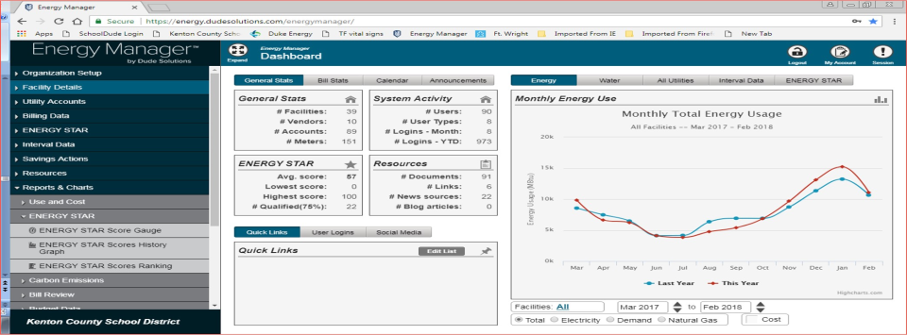
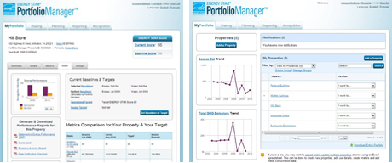
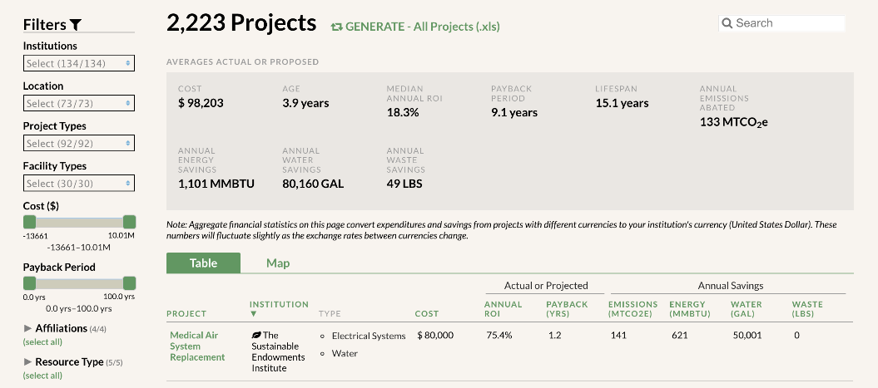
Energy Data Management Software
Free
ENERGY STAR Portfolio Manager - DOE/EPA
Third Party
Energy Manager – Dude Solutions
EnergyCAP
Sustainability Focused
Environmental Sustainability Management – CSRware
GRITS – Sustainable Endowments Institute

Slide 9
Local Government Energy Resources
Shaun Auckland, MS LEED GA
Local Governments Program Manager, SPEER

Slide 10
Take Advantage of Resources Available to Local Governments
City Efficiency Leadership Council
Peer-to-Peer networking
Information about new resources
Remote Energy Audits
Analysis of energy profile
Identification of energy efficiency opportunities
Technical Assistance
Preliminary Energy Assessment (PEAs)
Analysis of current systems, O&M programs
Energy Management Policy development
Funding options
Prioritized project planning
LoanSTAR
2% (1% for ARRA funds)
10 year payback (15% for >50 HVAC)
Open enrollment deadline – 8/31/19
Notes:
Resources
SECO – LocalGov.Reporting@cpa.texas.gov
North Central Texas Council of Governments
Energy Management, Efficiency, and Renewable Energy Program
City Efficiency Leadership Council / SPEER
One-on-One Training and Education
Regional Roundtables
Webinar Trainings
Portfolio Baselining and Benchmarking Assistance

Slide 11
What is the City Efficiency Leadership Council (CELC)?
A collaborative network of Texas cities, school districts, and other public entities engaged in partnership and resource exchange in an effort to expand adoption of energy management best practices in the public sector
How can CELC support energy management in my city?
Regional Roundtable Luncheons, Monthly Webinars, City Best Practice Case Studies, City Efficiency Toolkit, Local Government Energy Reporting Assistance, Portfolio Baselining and Benchmarking, Technical Support
How can my city get involved?
Contact SPEER to set up a brief intake interview OR attend a regional roundtable luncheon
Who can join CELC?
Open to staff of any public jurisdiction including city and county governments, public school districts, and other publicly funded entities

Slide 12
Building Operator Certification
Curriculum developed by NEEC with input from 100 industry experts
36 states
Classroom-based with hands-on training
Estimated $10,500 in energy savings & 113,660 gallons of water
Notes:
Developed by NEEC 1996 -longest running certification program in energy efficient operation & maintenance. Mostly geared toward building owners, building operators, facility managers, and those in leadership positions such as directors and technicians. Keeps communication open and they understand the issues the technicians are bringing to them.
Since 96 over 17k building operators across N. America have been trained and earned their credential, representing 20% of the eligible workforce.
Objective: train & recognize building engineers and maintenance staff to improve their job skills by creating a more comfortable EE facility
Savings: independent, third party evaluators (17) over 15 years

Slide 13
Energy Code Programs
Collaboration
Training, Outreach and Education
Energy Code Ambassadors
Notes:
ENERGY CODES IN TEXAS AND OKLAHOMA
Builders in Texas build significantly more homes than any other state in the nation. With the state population projected to continue growing dramatically over the next few decades, this trend is almost certain to continue. Building energy codes reduce the cost of operating our homes and buildings and they help maintain low electric rates by reducing the need for new power plants. All new buildings and major construction projects, in both incorporated cities and the unincorporated areas of counties, are required to meet or exceed these minimum codes regardless of local adoption and enforcement. While the State of Texas has adopted the 2015 International Energy Conservation Code (IECC) as a minimum, many cities throughout the state are building better homes for their citizens by having adopted and enforcing the 2021 IECC, which saves about 8% in energy costs over the 2015 IECC. Builders in Texas are going to build almost 200,000 new homes in Texas in 2021 so every improvement and reduction in energy cost per home is magnified greatly and is crucial to our long-term success and the reliability of our electrical grid.
eepartnership.org | 512.279.0750 | t: @EEPartnership | f: EEPartnership
Resilience:
SPEER’s traditional Energy Code Training has been expanded to include other topics crucial to resiliency such as the installation of stucco, weather resistive barriers, flashing details, grading and drainage, air barriers, HVAC sizing and many more related items. The current confusing state of code adoption and enforcement creates major inequities between the health, safety, durability, efficiency and resilience of homes and buildings built in cities, and those built in the unincorporated areas of counties. Our efforts to increase resiliency and the quality of construction throughout Texas and Oklahoma are a passion and we are committed to improving all aspects of resiliency as well as reducing energy use.
Collaboration:
SPEER convenes the Energy Code Working Groups of both Texas and Oklahoma on a regular basis to support state efforts to improve energy code compliance. Additionally, we routinely collaborate with many groups, including but not limited to, The National Association of State Energy Officials (NASEO), The Responsible Energy Codes Alliance (RECA), The North Central Texas Council of Governments (NCTCOG), Texas’ State Energy Conservation Office, the other Regional Energy Efficiency Organizations (REEOs) and others throughout Texas and Oklahoma as well as the rest of the United States.
Outreach and Education:
The largest of SPEER’s efforts on energy codes is our outreach and education initiatives. SPEER hosts
webinars and in-person and field trainings, all of which come at no cost to the participants. We average almost 5000 people a year at our various outreach and educational opportunities. Our webinars are recorded and available on our YouTube channel where we currently have almost 100 videos and 400 subscribers! SPEER regularly provides training and education for the Building Officials Association of Texas (BOAT), The Building Performance Association, The Building Professional Institute, TPREIA/InterNACHI, local ICC Chapters, NCTCOG, Home Builders Associations and many cities and other groups throughout Texas and Oklahoma. Representatives of member firms, trade associations and company representatives with direct knowledge of the topic deliver the webinars. SPEER staff work closely with our Energy Code Ambassadors, local International Code Council Chapters, HBAs and other groups to host in-person trainings throughout the region. SPEER trainings are available on request to industry groups or other interested parties by emailing codes@eepartnership.org or calling 512-279-0750.
Energy Code Ambassadors:
eepartnership.org | 512.279.0750 | t: @EEPartnership | f: EEPartnership
SPEER supports the largest Energy Code Ambassador network in the U.S. with almost 35 code officials, energy raters, builders and other industry professionals working to provide peer-to-peer energy code support to their networks throughout Texas and Oklahoma. SPEER convenes the Ambassador group once a year in Austin for a 2-day training and hosts monthly conference calls to discuss local and regional issues and provide any support needed. The Ambassadors are our “boots on the ground” throughout Texas and Oklahoma.

Slide 14
Key Dates for Reporting
Sept 1 - August 31
End of State Fiscal Year / reporting period
February 1
Completed reporting forms due to SECO

Slide 15
THANK YOU!
Shaun Auckland
Local Government Program Manager
SPEER
512-279-0765 | cities@eepartnership.org
www.eepartnership.org

